Slide 1
First and Second Corinthians
Lesson 10
Authentic Christian Ministry

Slide 2
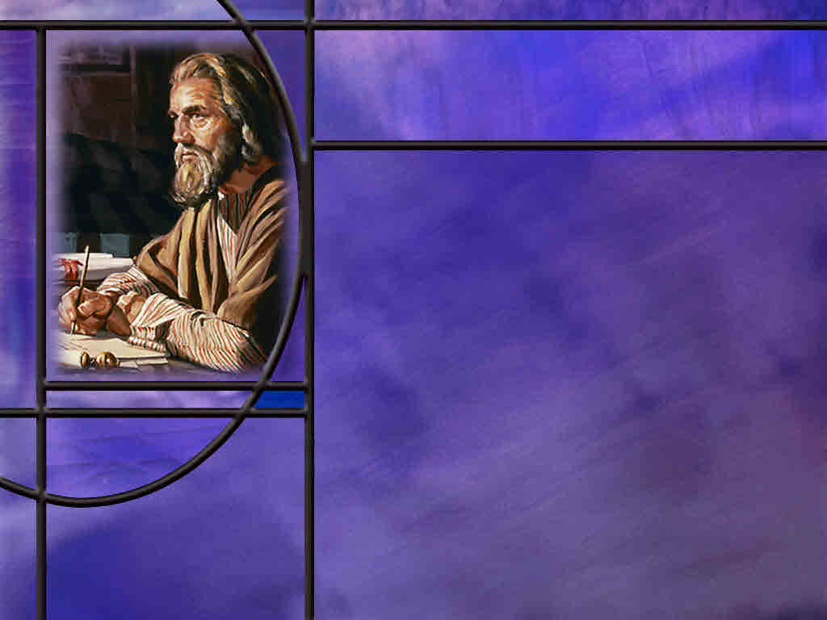
Memory Text
2 Corinthians 4:8-10 ESV
We are afflicted in every way, but not crushed; perplexed, but not driven to despair; ⁹ persecuted, but not forsaken; struck down, but not destroyed; ¹⁰ always carrying in the body the death of Jesus, so that the life of Jesus also may be manifested in our bodies.
What situation is Paul describing here?
What does “carrying in the body the death of Jesus mean?”
How can we develop the kind of resilience in our ministries that is unafraid of troubles or hardship?
Notes:
B2:
1. He is describing the difficulties he and his coworkers have faced in the gospel ministry.
2. Christianity was not a popular religion in the times and places Paul proclaimed the gospel.
3. He is describing the very real opposition that he faced in missionary work among the Gentiles and non-believing Jews.
4. It seems that his life was always in peril.
5. But regardless of how difficult the opposition, God always brought him through.
6. Later he would write to the Philippians:
Philippians 4:13 NKJV - I can do all things through Christ who strengthens me.
7. And if you look at the context of that verse, what he is really saying is the he can endure all that the Lord allows him to go through because of the strength he receives by faith in Jesus Christ.
8. So let’s look at his four “but not” statements and what they mean:
9. “Hard pressed or afflicted… but not crushed”: surrounded by trouble, yet not overwhelmed beyond endurance.
10. “Perplexed… but not in despair”: confused or without a clear way forward, yet not driven to hopelessness.
11. “Persecuted… but not forsaken”: opposed or hunted, yet not abandoned by God.
12. “Struck down… but not destroyed”: knocked down, yet not annihilated.
13. Phillips paraphrases the last phrase as “We may be knocked down but we are never knocked out!”
14. With God’s help we can get back to our feet and fight on to victory.
B3:
1. Here Paul appears to be drawing a parallel between the persecution of Jesus and the persecution of His followers.
2. Paul very likely carried scars in His body just like Jesus had scars in His.
3. When we get to 2 Cor 11, he will describe all the dangers he has gone through for Christ.
4. He received 39 lashes form the Jews on five different occasions.
5. He was beaten with rods three time.
6. He was stoned and left for dead outside the city of Lystra.
7. I believe that Paul carried some scars just like Jesus did.
8. But just like his scars could speak of the death of Jesus, so Paul’s life and continued ministry could speak of the resurrection life of Jesus.
9. Paul may get knocked down, but not knocked out.
10. As Jesus rose form the dead, so He empowers Paul to get back up and continue the fight for souls.
B4:
1. Form his epistles, we can know that Paul had a laser focus on the commission that he had been given by Jesus.
2. He was not turned aside by the temptations of the world to a life of ease and pleasure.
3. To the Philippians he wrote:
Philippians 3:13-14 NKJV - Brethren, I do not count myself to have apprehended; but one thing I do, forgetting those things which are behind and reaching forward to those things which are ahead, ¹⁴ I press toward the goal for the prize of the upward call of God in Christ Jesus.
4. Paul focused his life on the eternal things rather than the temporal, on His heavenly citizenship rather than on the things of this world.
5. He had his priorities straight.
6. When I look at myself, I see my love of ease, of entertainment, of leisure, of pleasure.
7. I look at all the things that occupy my time and attention.
8. They are things that I think I need to do, but they are often not really important in the long run.
9. President Eisenhower said: “The important is seldom urgent and the urgent is seldom important.”
10. The apostle Paul learned to endure whatever it took to see the cause of Christ go forward.
11. Let us pray that we will have the wisdom, like the apostle Paul, to focus on the important rather than the urgent.
12. May we each press toward the goal for the prize that God offers us in Christ Jesus.

Slide 3
Overview
Chapters 3 – 7 of 2 Corinthians cover a multitude of subjects related to the apostolic ministry of the apostle Paul and the Corinthian response to it. These include the superiority of the new covenant ministry, sufferings and rewards of ministry, the ministry of reconciliation, warnings against alliances with unbelievers, and his joy at their repentance.
  New Covenant Ministry
  Absent from the Body
  Ministry of Reconciliation
  Unequally Yoked
  Summary
Notes:
1. Five Chapters is a lot to cover in one lesson.
2. So I have picked out some subjects that I think are important without trying to cover everything.

Slide 4
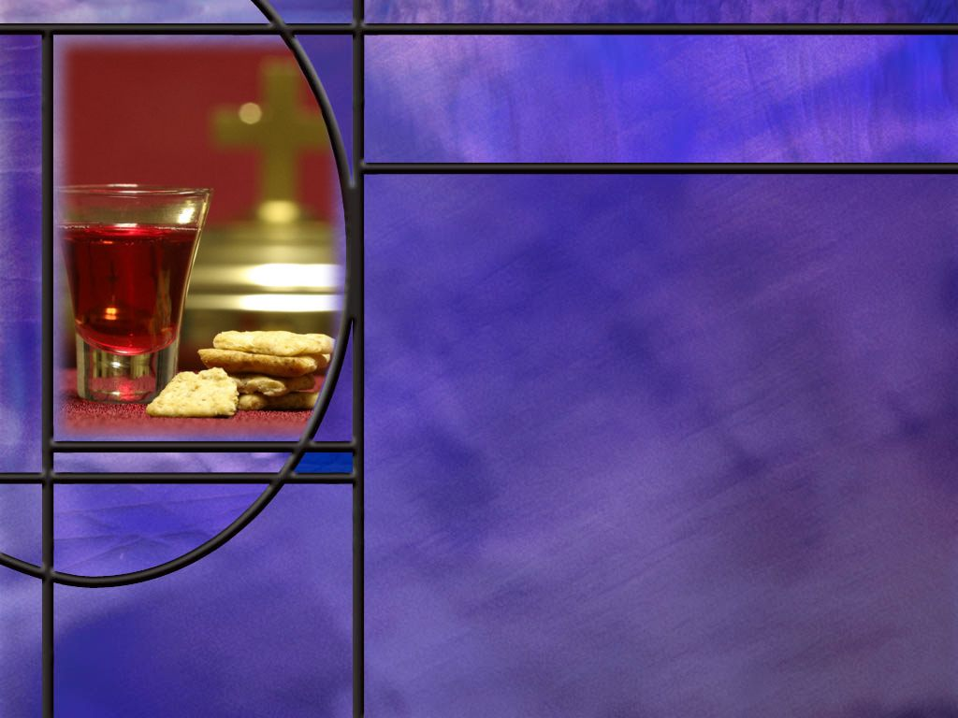
New Covenant vs. Old
Why does Paul say he doesn’t need letters of recommendation? (2 Cor 3:1-3)
How does Paul contrast the old and New covenants here? (2 Cor 3:6-8)
How does Paul explain how we are being changed by the Spirit? (2 Cor 3:18)
Notes:
B1:
[See notes on linked slide.]
B2:
[See notes on linked slide.]
B3:
[See notes on linked slide.]

Slide 5
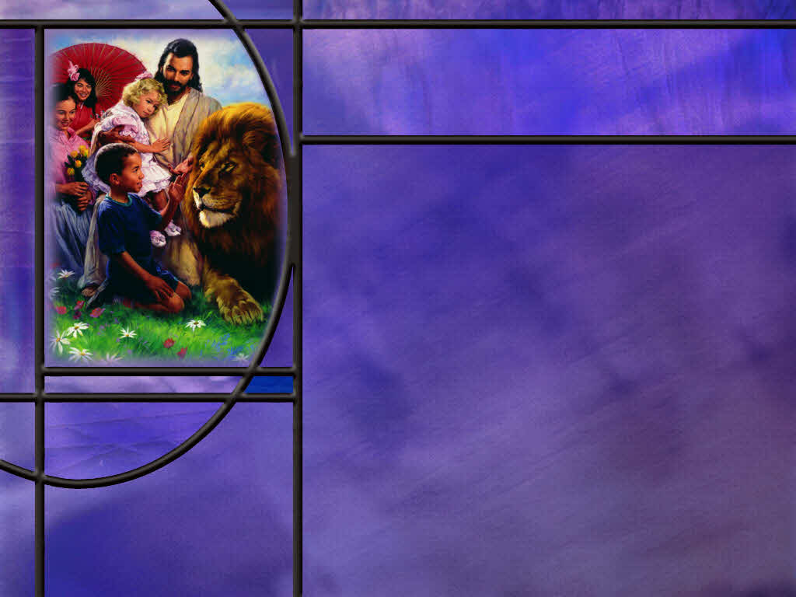
Absent from the Body
How is Paul often misquoted when he writes about being absent from the body? (2 Cor 5:6-8)
As an apostle, what rewards can Paul look forward to? (2 Cor 5:9-10)
Notes:
B1:
[See notes on linked slide.]
B2:
[See notes on linked slide.]

Slide 6
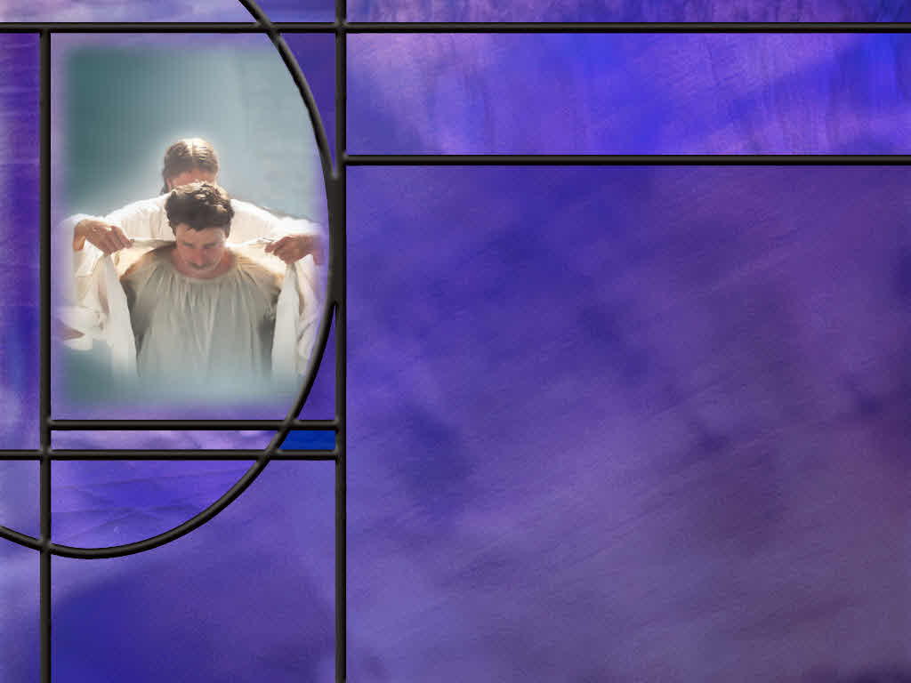
Ministry of Reconciliation
What does Paul say the love of Christ has done for us? (2 Cor 5:14-15)
What does it mean to be “in Christ?” (2 Cor 5:17-18)
How does Paul describe the ministry of reconciliation? (2 Cor 5:19-20)
What final thought does Paul leave us with to explain how sinners can be reconciled to a holy God? (2 Cor 5:21)
Notes:
B1:
[See notes on linked slide.]
B2:
[See notes on linked slide.]
B3:
[See notes on linked slide.]
B4:
[See notes on linked slide.]

Slide 7
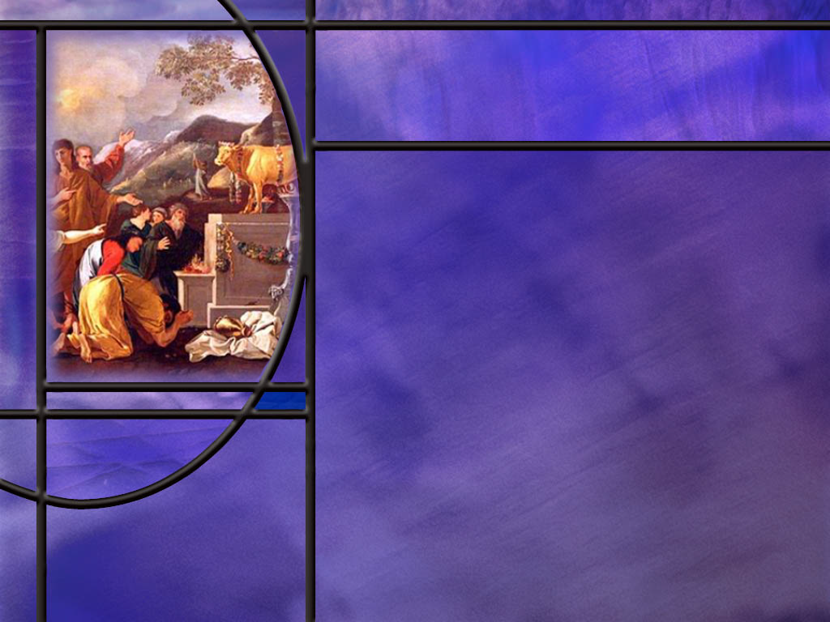
Unequally Yoked
What is Paul’s main concern in warning the church at Corinth to avoid relationship where they are yoked together with unbelievers? (2 Cor 6:14-18)
How does Paul’s warning of not being unequally yoked together apply in principle to choosing a spouse?
Notes:
B1:
[See notes on linked slide.]
B2:
1. Our usual application of these verses is for choosing a husband or wife.
2. In our most intimate relationships, we are to be equally yoked together.
3. Christians should find another Christian to marry.
4. And ideally, SDA’s should find another SDA to marry.
5. If Christ is your most important relationship, don’t marry an unbelieve that has no relationship with Christ.
6. Chances are that, if you do, you will bring upon yourself heartache and trouble.
7. Both husband and wife should be cleaving to Jesus, and the closer they get to Him, the closer they will get to each other.
8. Christ at the center of a marriage will greatly increase the chances of happiness and success.

Slide 8
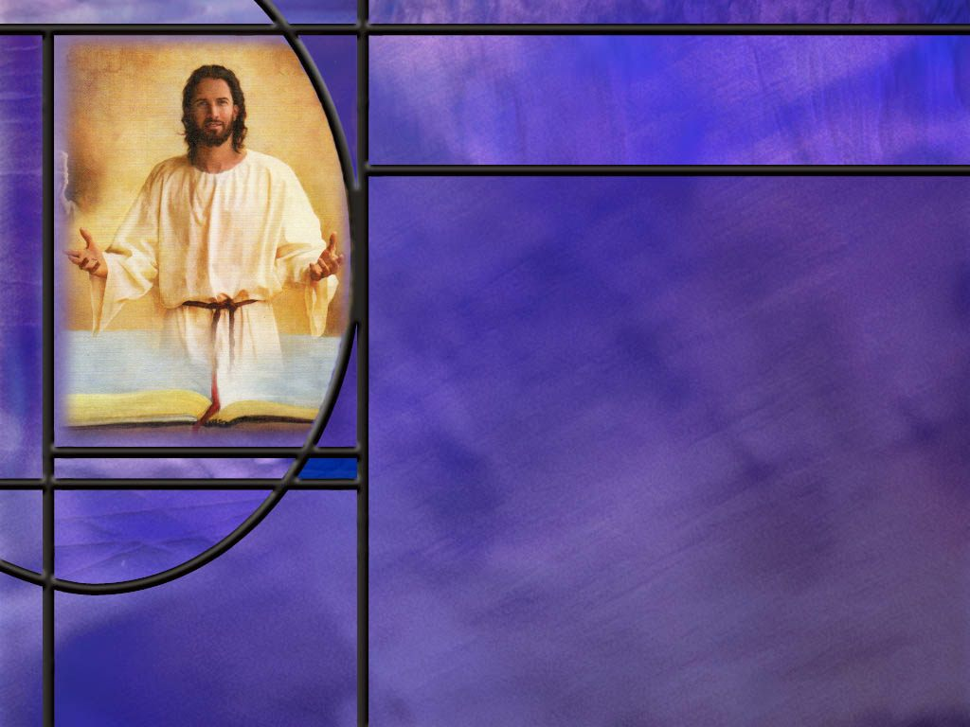
Summary
Paul defends his apostleship, not with letters of recommendation, but by pointing to the transformed lives of the Corinthians themselves—they are his “letter” written by the Spirit on human hearts.
In contrasting the Old Covenant with the new, Paul has a particular function of the Covenant law in mind: the law defines sin, all have sinned, and all are condemned to death; hence, the letter kills.
But the Spirit convicts us of sin, leads us to repentance, forgiveness, justification, and eternal life; hence the Spirit gives life.
It is by the Spirit that we are transformed into the likeness of Christ as we behold His character and seek to become like Him.

Slide 9
Summary
In his ministry, Paul’s life always seemed to be in danger. Like Jesus, he carried the scars of his persecution in his body.
In all these troubles, he kept his focus on his mission and the upward call of God, confident that “our light and momentary troubles are achieving for us an eternal glory that far outweighs them all.”
Paul’s words about being absent from the body are often misquoted by those who believe in the immortality of the soul.
Paul is simply stating his preference to be at home with the Lord in the eternal kingdom with his immortal resurrection body rather than to be in his present mortal body or being in the intermediate state of unconsciousness in death (being naked or unclothed).

Slide 10
Summary
Paul’s famous passage about not being unequally yoked together with unbelievers, in its original context, was very likely a warning against idolatrous worship and the blending of Christian faith with pagan cult practices common in Corinth.
He pointed to the Corinthian Christians as the temple of God and warned, “what agreement has the temple of God with idols?”
In First Corinthians, Paul had already warned about sharing in idolatrous temple meals.
Will you look for opportunities this week to behold intently the character of Jesus praying for the Spirit to change you into his likeness?

Slide 12
2 Corinthians 3:1-3 ESV
- 1 Are we beginning to commend ourselves again? Or do we need, as some do, letters of recommendation to you, or from you? ² You yourselves are our letter of recommendation, written on our hearts, to be known and read by all. ³ And you show that you are a letter from Christ delivered by us, written not with ink but with the Spirit of the living God, not on tablets of stone but on tablets of human hearts. [R]
Notes:
Q1: What is Paul’s “letter of recommendation” affirming his apostolic ministry for Christ?
1. He writes to the Corinthians: “You yourselves are our letter of recommendation.”
2. Paul doesn’t need a letter from some church authority affirming that he is an apostle of the Lord Jesus.
3. He simply points to the changed lives of the Corinthians as evidence of his ministry for Christ.
4. They are living proof of his ministry, written by the Spirit on human hearts, not with ink, not on tables of stone.
5. When we trust in Jesus as our Savior and are justified, the Holy Spirit gives us the new birth.
6. We are born from above with a new worldview and a new direction in life.
7. The Spirit produces the fruit of the Spirit in our lives making us more like Jesus.
8. This is the evidence that Paul points to – the change the Spirit has produced in their hearts – that validates his ministry for the Lord Jesus.
9. Changed lives, not certificates, are the best credentials of an effective minister of the gospel.

Slide 13
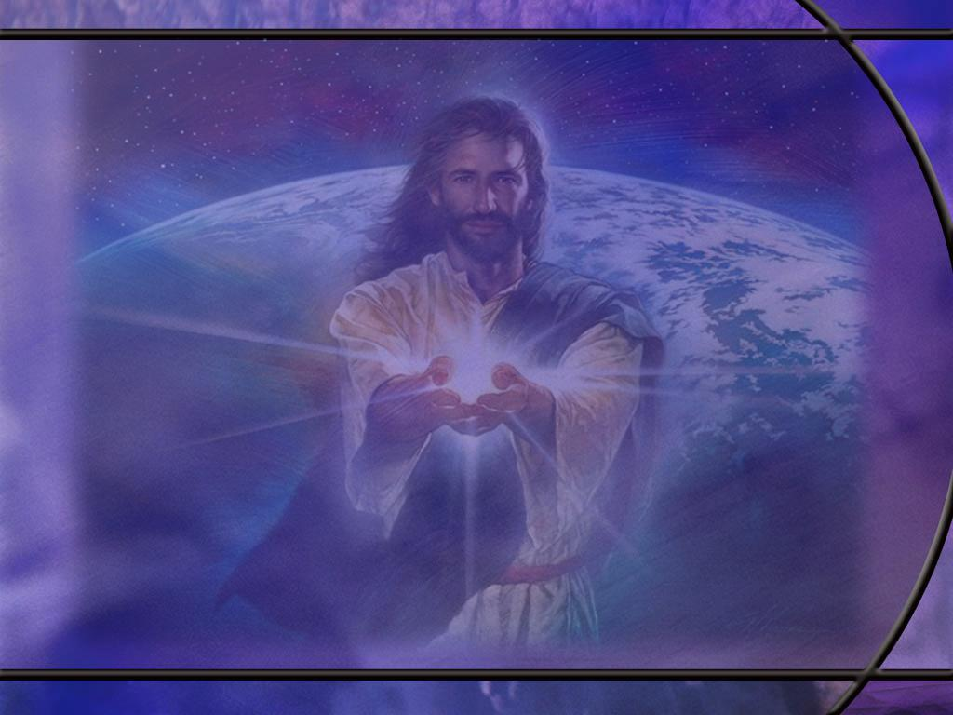
2 Corinthians 3:6-8 ESV
God has made us sufficient to be ministers of a new covenant, not of the letter but of the Spirit. For the letter kills, but the Spirit gives life. ⁷ Now if the ministry of death, carved in letters on stone, came with such glory that the Israelites could not gaze at Moses' face because of its glory, which was being brought to an end, ⁸ will not the ministry of the Spirit have even more glory? [R]
Notes:
Q1: In what sense does the letter kill but the Spirit give life?
1. So here Paul argues that the Old Covenant had its glory.
2. In fact, Moses’ face shown with the glory of being in the presence of God.
3. So he had to put a veil over his face as he talked to the Israelites.
4. He refers to the Old Covenant as the ministry of death.
5. Letters carved on stone, the Ten Commandments, are the ministry of death that kills. How so?
6. Here Paul is thinking of a certain function of the Law of the Old Covenant.
7. Paul would later write it to the Romans:
Romans 3:20, 23 KJV - Therefore by the deeds of the law there shall no flesh be justified in his sight: for by the law is the knowledge of sin. ... 23 For all have sinned, and come short of the glory of God;
8. The Law defines sin; we all have sinned; and the wages of sin is death.
9. But the Spirit gives life.
10. The Holy Spirit convicts us of sin, leads us to repentance, forgiveness, justification, and eternal life.
Q2: But wasn’t forgiveness available under the Old Covenant as well?
1. Yes it was. We can look at David and his repentance in Ps 51, and the forgiveness he experienced.
2. So what’s the difference?
3. Under the OC, the means of the forgiveness of sin was not fully revealed.
4. It took Jesus, the Son of God, to be sacrificed for our sins and rise again to see God’s provision for forgiveness.
5. Too many in Paul’s day had made obedience to the law the way to find acceptance with God.
6. But Paul preached the gospel of salvation by grace through faith.
7. The only way to find acceptance with God is to have our sins forgiven and have Christ’s righteousness placed to our account.
8. The New Covenant provides the full and final means by which God forgives our sins in Christ.
9. And that far surpasses the glory of the OC, which was only a shadow teaching substitutionary atonement.
10. The OC had been made into a system of righteousness by works: obey and live.
11. The NC made it clear that he who is justified by faith shall live.
12. So Paul argues that the glory of the NC which is the final and permanent solution to the sin problem far surpasses the glory of the OC which was only a shadow.
13. If the ministry that brought condemnation had glory, how much more does the ministry that brings righteousness?

Slide 14
2 Corinthians 3:18 (NKJV)
But we all, with unveiled face, beholding as in a mirror the glory of the Lord, are being transformed into the same image from glory to glory, just as by the Spirit of the Lord. [R]
Notes:
Q1: How would you state the principle of this verse?
1. What you behold with admiration, you become.
Q2: What is the Christian to behold?
1. The glory of the Lord.
2. The goodness of the Lord, the love of the Lord, the kindness, compassion, mercy, grace, and forgiveness of the Lord.
3. God’s glory is His character.
4. We are to behold the character of Christ.
Q3: How should we behold according to this verse?
1. “as in a mirror.”
2. The implication is that we should look intently like we are studying our own reflection in a mirror.
3. We want to look as good as possible so we study our reflection to correct all the defects we can.
4. We need to study the character of Jesus to meditate on all the perfection of His character.
5. As we study His character, we will become more like Him.
Q4: How can we behold the character of Jesus?
1. Take time in the word to study the life of Jesus.
2. Meditate on what He does and says, especially on the last scenes of His life.
3. Hide His words in our hearts and call them to mind as we live.
4. Read the epistles to appreciate the significance of the gospel of righteousness by faith and the importance of obedient living.
5. Take time to fall in love with Jesus.
6. Maintain constant communion with Him by prayer and praise.
7. Make Him your hero and best friend.
Q5: Who is the agent of change that transforms us from glory to glory?
1. It is the work of the Holy Spirit to make us like Jesus.
2. He gives us the fruit of the Spirit and the gifts of the Spirit.
3. He gives us the new birth that sets us on a new path in life when we trust Jesus for the forgiveness of our sins.
4. He pours out the agape love of God in our hearts.
5. As we are faithful in beholding Jesus, we become more like Him from one level of glory to the next.
6. So let’s pray for the Holy Spirit to do His work in our lives.

Slide 15
2 Corinthians 5:6-8 KJV
Therefore we are always confident, knowing that, whilst we are at home in the body, we are absent from the Lord: ⁷ (For we walk by faith, not by sight:) ⁸ We are confident, I say, and willing rather to be absent from the body, and to be present with the Lord. [R]
Notes:
Q1: This is a favorite funeral text used by those who believe in the immortality of the soul. How do they interpret these verses?
1. They often misquote these verses by claiming that Paul writes: “To be absent from the body is to be present with the Lord.”
2. Is that what Paul says here? No!!
3. He says, “I would prefer to be absent from the body and present with the Lord.”
4. Here it is in the NIV or NASB
2 Corinthians 5:8 NIV - We are confident, I say, and would prefer to be away from the body and at home with the Lord.
2 Corinthians 5:8 NASB - but we are of good courage and prefer rather to be absent from the body and to be at home with the Lord.
5. I can get on a plane in Boston and say, “I would prefer to be absent from Boston and present in Los Angeles.”
6. But it takes an 8-hour flight to get there.
7. The same is true of this passage. There is an intermediate state between this life and the life to come.
8. There are three states Paul identifies in 2 Cor 5:1-5:
living in this earthly tent (our natural body)
being unclothed or naked (unconscious in death)
being clothed with our heavenly dwelling (our resurrection body which brings immortality)
9. Paul is expressing a desire for the kingdom of God to come.
10. He prefers his immortal resurrection body in the kingdom to his earthly body here or to the unconscious state of death.
11. So note what Paul says here in verse 4:
2 Corinthians 5:4 NIV - For while we are in this tent [our current physical bodies] , we groan and are burdened, because we do not wish to be unclothed [unconscious in death without a living body] but to be clothed instead with our heavenly dwelling [our resurrection body], so that what is mortal may be swallowed up by life.
12. So again, Paul does not say to be absent from the body is to be present with the Lord.
13. He simply prefers his resurrection body to his present body and to the intermediate state of being unconscious.

Slide 16
2 Corinthians 5:9-10 NIV
So we make it our goal to please him, whether we are at home in the body or away from it. ¹⁰ For we must all appear before the judgment seat of Christ, so that each of us may receive what is due us for the things done while in the body, whether good or bad. [R]
Notes:
Q1: Where and when do we appear before the judgment seat of Christ?
1. This is the pre-advent judgment which occurs in heaven before Christ returns, because His rewards are with Him when He comes.
2. In this judgment, God reviews the lives of all who have professed faith in Him.
3. This is to reveal who has remained in Christ by faith and to vindicate God’s justice before the unfallen angels.
4. This judgment pictures a heavenly tribunal, where evidence is examined and a verdict is pronounced.
5. Believers are not physically present.
6. Living believers are still on earth; dead believers are asleep in their graves awaiting the resurrection.
7. But Christ is our Advocate and represents us as the record of our lives is examined.
8. The judgment determines who will be raised in the first resurrection and what rewards they may receive in the kingdom of God for their faithful service to Christ.
9. Based on our understanding of the time prophecies of Daniel, this judgment began in 1844 and will continue until probation closes and Jesus returns.
10. While we are saved by faith, we are judged by works.
11. God knows our hearts, so he doesn’t need a judgment to determine if our faith is genuine.
12. So the pre-advent judgment is not for God’s benefit; it is really for the benefit of the angels in heaven who do not see the heart of each individual.
13. Our works are examined in the judgment to prove to the angels whether or not our faith is genuine.

Slide 17
2 Corinthians 5:14-15 ESV
For the love of Christ controls us, because we have concluded this: that one has died for all, therefore all have died; ¹⁵ and he died for all, that those who live might no longer live for themselves but for him who for their sake died and was raised. [R]
Notes:
Q1: What has Christ’s love for us brought about in our lives?
1. Paul makes an important theological statement here.
2. He says that the lives of Christian believers are controlled by the love of Christ for us.
3. That love was manifest in the fact that He died for us. And not only for us but for all.
4. So salvation is available to all even though all do not avail themselves of it.
Q2: We understand that Christ’s death on the cross was a literal death. But what does it mean that “all have died?”
1. Paul seems to answer that in verse 15.
2. Those who live in Christ are no longer living for themselves but for Him who died for them and rose again.
3. So Christ pays the penalty of death for all who believe in Him and through baptism are raised to newness of life, living a new life for Christ.
4. And Paul is saying here that the same cancelation of the death penalty is available to all, because Christ died for all.
5. It just takes faith in Christ as a living Person for the forgiveness of sins to be justified and have Christ cancel the death penalty for them too.

Slide 18
2 Corinthians 5:17-18 ESV
Therefore, if anyone is in Christ, he is a new creation. The old has passed away; behold, the new has come. ¹⁸ All this is from God, who through Christ reconciled us to himself and gave us the ministry of reconciliation; [R]
Notes:
Q1: What change is Paul describing here?
1. It is the new birth, being born from above, or being born of the Spirit.
2. Jesus told Nicodemus, “You must be born again” to see the kingdom of God.
3. This new birth begins with justification that places us “in Christ.”
4. When we are justified, our sins are forgiven and Christ’s righteousness is imputed to us.
5. We trust in Jesus by faith and He forgives us by grace.
6. Then we are filled with the HS and He make us new creations.
7. We have a new heart, a new love, a new direction in life, a new destiny.
8. Now all things are of God, and God is love.
9. The HS pours out the agape love of God in our hearts (Rom 5:5) and gives us the fruit of the Spirit beginning with agape love.
10. We become ministers of reconciliation, bringing peace between others and God and between ourselves and others.

Slide 19
2 Corinthians 5:19-20 ESV
that is, in Christ God was reconciling the world to himself, not counting their trespasses against them, and entrusting to us the message of reconciliation. ²⁰ Therefore, we are ambassadors for Christ, God making his appeal through us. We implore you on behalf of Christ, be reconciled to God. [R]
Notes:
Q1: How did God reconcile the world to himself?
1. God put into effect His plan from the foundation of the world for not counting their trespasses against them.
2. In other words, God had a plan from the beginning for forgiving our sins.
3. That plan was to lay their sins upon His Son, our Lord Jesus Christ.
4. So if we receive Jesus as our Savior and Lord and trust Him for the forgiveness of our sins, our sins are laid on Him and His righteousness is laid on us.
5. We will see this in verse 21.
Q2: To whom has God entrusted the ministry of reconciliation?
1. He has entrusted it to us.
2. Not just to the apostle Paul, but to all born-again believers who are in Christ.
3. If that is you, you have a ministry; it is the ministry of reconciliation.
4. We are ambassadors for Christ, calling the lost to be reconciled to God.
5. And the only way they can be reconciled to God is to understand the gospel of righteousness by faith.
6. So Paul gives us one more verse in which he explains how we can be reconciled to God.

Slide 20
2 Corinthians 5:21 NKJV
For He made Him who knew no sin to be sin for us, that we might become the righteousness of God in Him. [R]
Notes:
Q1: Who are the He and Him of this verse?
1. The “He” is God the Father.
2. The “Him” is God the Son, Jesus Christ.
3. Here at the beginning of the verse, both Father and Son are involved.
4. Then look at the end of the verse:
5. We become the righteousness from God the Father in Him, God the Son.
6. Both Father and Son are intimately involved with this transfer of sin and righteousness.
7. Martin Luther has called this verse “The Great Exchange,” or the “Wonderful Exchange.”
Q2: What is the “Great Exchange” described in this verse?
1. The Great Exchange described in this verse is the essence of the Gospel.
2. In Christ, we exchange our sin for His righteousness.
3. It is like exchanging a bag of garbage for a Rolls Royce.
4. In fulfillment of the everlasting covenant made between Father and Son from the foundation of the world, Jesus Christ died on the cross for the sins of all mankind.
5. He Himself was sinless, but He suffered the death penalty for our sins.
6. So, when we are “in Christ” the Father can accept the death of His Son in place of our death.
7. In that sense, Christ bears our sins and becomes sin for us.
8. When we receive Christ as our Savior, confess our sins, and trust in His blood for our forgiveness, God forgives us and declares us justified or not guilty.
9. This is justification by faith or righteousness by faith.
10. And since our sins are all forgiven and we are cleansed, we have a standing in the courts of heaven as perfectly righteous, like Jesus our sinless Savior.
11. His perfect righteousness is placed to our account.
12. This is the Gospel, the good news of salvation by by grace through faith in Christ.

Slide 21
2 Corinthians 6:14-18 NIV
Do not be yoked together with unbelievers. For what do righteousness and wickedness have in common? Or what fellowship can light have with darkness? ¹⁵ What harmony is there between Christ and Belial? Or what does a believer have in common with an unbeliever? ¹⁶ What agreement is there between the temple of God and idols? For we are the temple of the living God. …." ¹⁷ Therefore, "Come out from them and be separate, says the Lord. Touch no unclean thing, and I will receive you." ¹⁸ And, "I will be a Father to you, and you will be my sons and daughters, says the Lord Almighty.“ [R]
Notes:
Q1: I know we usually use this passage in warning about choosing a non-Christian spouse. But what do you think Paul’s main concern is as he writes to the Corinthian church?
1. Paul’s primary worry is idolatrous worship and the blending of Christian faith with pagan cult practices common in Corinth.
2. The city was full of temples and religious festivals.
3. Some Christians were tempted to participate in meals, rituals, or civic activities tied to idol worship while still claiming to follow Christ.
4. We saw this in First Corinthians with food offered to idols and eating meals in the temples of idols.
5. Paul insists this cannot be mixed: “What agreement has the temple of God with idols?” (6:16).
6. In this setting, “unbelievers” in 6:14 likely includes those promoting or embodying idolatrous, lawless, or satanic values—especially false teachers and those drawing the church back into pagan religious patterns.
7. Paul’s call to “come out from them and be separate” (6:17) is therefore a call to break from idolatrous alliances not necessarily to avoid all contact with non-Christians.
8. We can hardly be ambassadors for Christ if we avoid all unbelievers!

