Slide 1
The Gift of Prophecy
Lesson 6
The Prophetic Writings

Slide 2
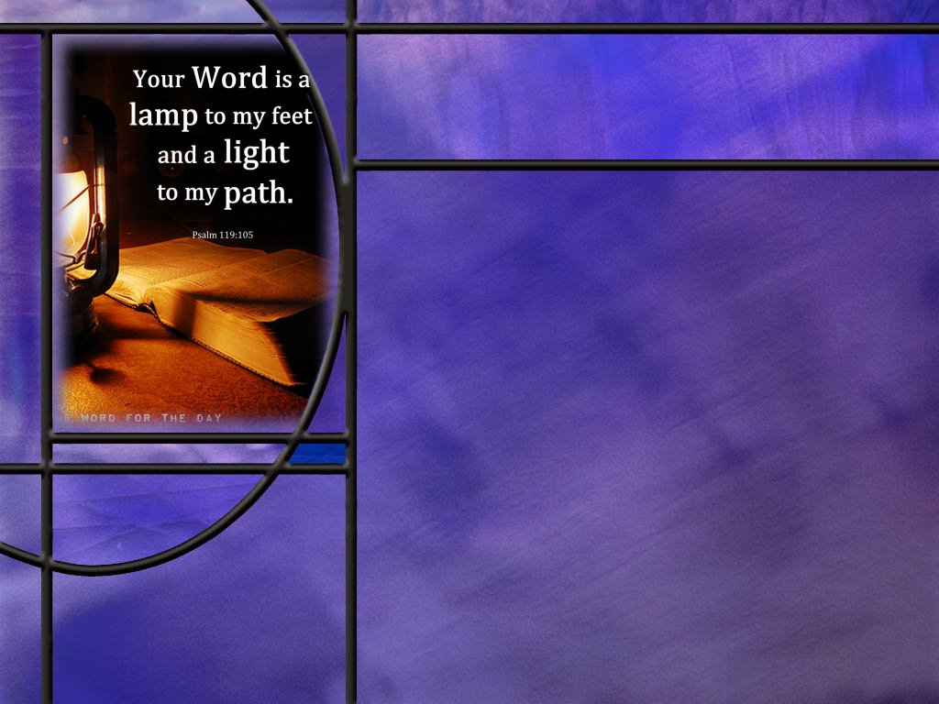
Memory Text
Romans 15:4 NIV
For everything that was written in the past was written to teach us, so that through endurance and the encouragement of the Scriptures we might have hope.
What does this text tell us about why the Scriptures were written?
What benefits do the Scriptures bring us if we read, learn, and follow their instruction?
Notes:
B2:
1. They were written in the past, but they are for our benefit today.
2. The Scriptures were written to teach us.
3. The Scriptures contain God’s truth, His word, His communications to us.
4. They were written down so that His word to us would not be lost.
5. We have a permanent record of what God wants us to know.
6. And it is recorded in the Scriptures.
B3:
1. Paul says here that the Scriptures bring us endurance in the faith and encouragement in the faith so that we have hope.
2. We have in the Scriptures the written word of God.
3. This is not some oracle handed down by word of mouth from who knows where.
4. These are inspired words written in known languages: Hebrew, Greek and Aramaic, that can be read, understood, and translated.
5. They have been written by prophets and apostles and other inspired writers and collected into the 66 books of the Bible that we accept today as the canon of Scripture.
6. The Scriptures provide us the knowledge on which to base our faith in God
7. When doubts arise, go back to the word; read it again; hang on to what it says; because God’s word is truth.
8. We can patiently endure the difficulties and doubts in life as we stand on the rock of the word of God.
9. We can be encouraged in the faith, knowing that God is faithful to His covenant promises and that He will work out the plan He has laid out in His Word.
10. So we can look forward to the future with hope.
11. Hope is standing on the promises of God.
12. Biblical hope is the firm assurance that God will do what He says in His word.
13. He will redeem His people and give them eternal life.
14. So we look for our Blessed Hope, the return of our Lord and Savior Jesus Christ.
15. And if we are willing to follow what is written in the Word of God and receive Jesus as our Savior and Lord, we will be part of that great multitude that He is coming to save.
16. The greatest thing we can learn from the Scriptures is how to be saved by trusting Jesus as a living Person for the forgiveness of our sins and eternal life with God.
17. As Paul wrote in:
Romans 10:17 NKJV – So then faith comes by hearing, and hearing by the word of God.
18. Or the translation I like even better:
Romans 10:17 NLT – So faith [saving faith] comes from hearing, that is, hearing the Good News about Christ.
19. And it is in the Scriptures that we hear the Gospel of salvation in Christ Jesus.

Slide 3
Overview
Scripture is nearly always the combination of the divine and human. God entrusted His revelation to His people who recorded His revelations under the guidance of the Holy Spirit but in their own writing styles. God preserved as His word the canon of Scripture and provided for its accurate transmission.
  The Canon
  Literary Forms, Devices, & Structures
  Sources and Secretaries
  Summary

Slide 4

The Canon
How did Paul define inspired Scripture? (2 Tim 3:16-17)
What do we mean when we talk about the “canon” of Scripture?
How do we know which books of the OT are inspired and belong in the OT canon of scripture?
What indication do we have that the apostles knew they were speaking and writing the word of God? (1 Thes 2:13; 2 Peter 3:16; Gal 1:11-12; 1 Cor 14:37)
How do we know that the 27 books of the NT are canonical?
Notes:
B1:
[See notes on linked slide.]
B2:
1. The word canon means reed or measuring stick.
2. Only those books that measure up to the standard of divine communication are included in scripture.
3. For Protestants, the canon is the 39 books of the OT and the 27 books of the NT giving 66 books of the Bible that are considered to be inspired.
4. Catholics accept 11 additional books in the OT that Protestants consider to be apocryphal or non-inspired.
5. These include such books as 1 and 2 Maccabees, Judith, Tobit, 1 & 2 Esdras, Baruch, Letter of Jeremiah, etc.
6. It is from some of these apocryphal books that Catholics have adopted some false doctrines.
7. In particular, they get the doctrine of purgatory from 2 Maccabees 12:43–46.
8. Based on that apocryphal non-inspired book, they believe you can pray for the dead, they can be forgiven and purified, and their souls can go from purgatory to heaven.
9. This is total nonsense for Protestants.
10. These OT apocryphal books were never in the OT canon.
11. But they were included in the Greek translation of the OT known as the Septuagint.
12. They were declared to be Scripture by the Council of Trent in 1546 AD (some 1,500 years after the canon was established).
13. Protestants deny that these books are canonical based on external evidence and internal evidence (what they say in contrast to canonical scripture).
14. They were never recognized as scripture by the Jews, nor by Jesus, nor by the apostles, nor by the NT, nor by any of the Church Fathers.
B3:
1. The best indication we have is what the NT writers and Jesus himself considered to be inspired scripture.
2. We get some indication of that from what OT scriptures are quoted in the NT.
3. Virtually all Protestant churches accept the Hebrew Massoretic text as inspired.
4. The Hebrew Bible based on this text is called the Tenakh in Hebrew.
5. It consisted of three sections: the Torah or law (first 5 books of Moses), the prophets (all the prophets) and the writings (the historical and poetic books).
6. It is clear that Jesus accepted all three of these section of Scripture in the OT.
7. Here’s what He said in
Luke 24:44 ESV – Then he said to them, "These are my words that I spoke to you while I was still with you, that everything written about me in the Law of Moses and the Prophets and the Psalms must be fulfilled."
8. The Tanakh had 24 books which are identical to our 39 books of the OT.
9. However, they combined all the minor prophets into one book and numbered as one book all the “1st and 2nd” OT books (also Ezra and Nehemiah were one book).
10. Since Jesus and the Apostles quoted from the OT canon and did not dispute it, we accept the Tanakh for our OT.
11. So, our Protestant OT is exactly the same as the OT that Jesus and the apostles accepted.
B4:
[See notes on linked slide.]
B5:
1. In the collection of the NT canon, we have to exercise faith that God was watching over the process.
2. When it comes to the NT, there is really no dispute: all branches of Christianity (Protestant, RC, Eastern Orthodox, Coptic, Syriac, etc.) accept the same canonical books for the NT.
3. Here is the basis of deciding if a book is canonical:
Apostolic authority: Was it written by an apostle or a close associate (e.g, Luke, Mark, writer to the Hebrews)?
Content. Was it consistent in subject matter and content with other Scripture?
Inspiration: Did the book give evidence of being inspired and consistent with other Scripture?
Acceptance: Was it universally accepted by the church as being genuine.
4. A number of books were in question, but eventually all came to be universally accepted by about 400 AD.
5. Books that were questioned were: Hebrews, James, 2 Peter, 2 and 3 John, Jude, and Revelation.
6. Certainly, it seams reasonable to conclude that God watched over the selection of the canonical books of Scripture and preserved their accurate transmission.
7. We know that the OT scribes were very particular in copying the OT Scriptures.
8. The Dead Sea Scrolls allow us to compare manuscripts that were about 1000 years apart in age.
9. And over those thousand years of copying, there were no substantive changes in the meaning of the text.
10. Maybe a few spelling changes or word order but nothing that changed the meaning.
11. For NT writings, the Lord saw fit to preserve a very large number of early Greek manuscripts, thousands of them.
12. So by the process of textual criticism, scholars could work back to get very close to the original autographs, written by the apostles or their associates.

Slide 5

Literary Forms, Devices, and Structures
What are some of the literary forms used in Scripture? [Literary Forms]
What are some of the literary devices used in Scripture? [Literary Devices]
What literary structures can we find in Scripture? [Literary Structure]
Notes:
1. Folks, just let me give you a heads up.
2. There is a lot of information on this slide.
3. I have tried to summarize the information on tables that we can puruse without spending much time on any one thing.
4. My thanks to Perplexity AI for much of this information.
5. I hope it’s not too boring, but we will end on what I think is a very interesting structural arrangement.
B1:
[See notes on linked slide.]
B2:
[See notes on linked slide.]
B3:
[See notes on linked slide.]

Slide 6
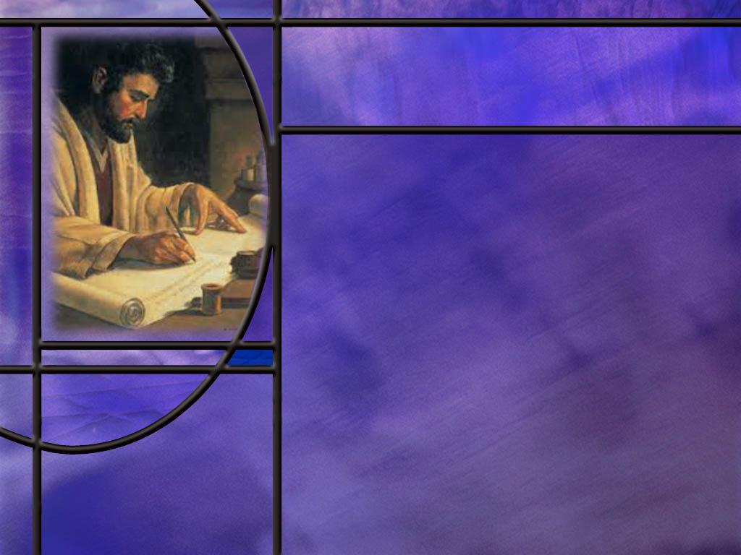
Sources and Secretaries
How does Luke explain the origin of his information for the gospel that he wrote? (Luke 1:1-4)
How did Paul authenticate his epistles? (2 Thes 3:17)
Who helped Jeremiah write His prophetic book? (Jer 36:17-18)
Notes:
B1:
[See notes on linked slide.]
B2:
[See notes on linked slide.]
B3:
[See notes on linked slide.]

Slide 7
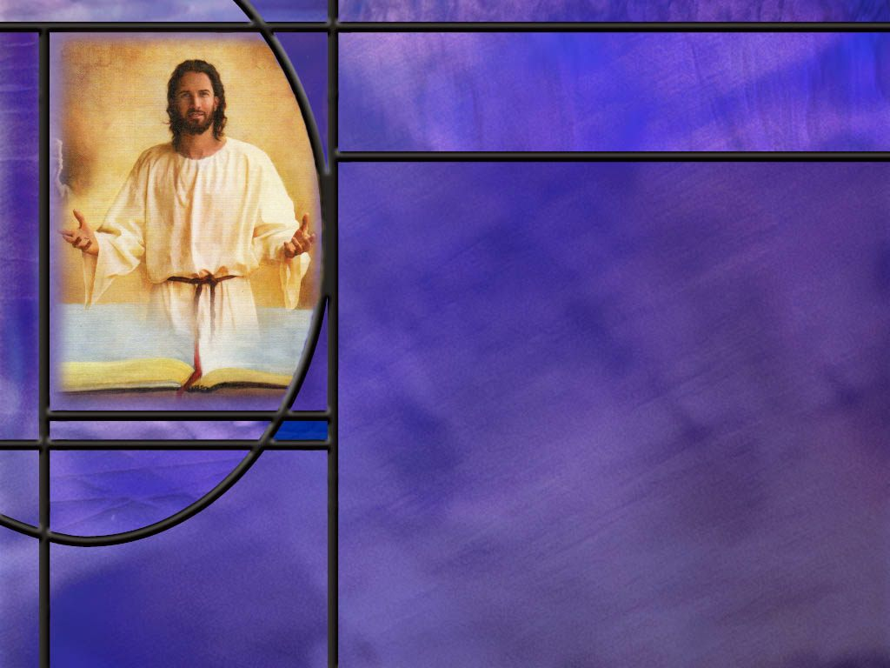
Summary
As Christians we believe that all Scripture is inspired by God.
God entrusted His revelation to His people who recorded His revelations under the guidance of the Holy Spirit but in their own writing styles.
Protestants accept exactly the same OT that Jesus and the apostles accepted. However, Catholics accept 11 additional apocryphal books that were never accepted as canonical by the Jews, Jesus, the apostles, or the early church fathers.
The 27 canonical books of the NT have been accepted by essentially all Christians faiths as having apostolic authority and having content consistent with other inspired Scripture.

Slide 8
Summary
As the NT canon of Scripture was developing, the apostles were aware that their writings carried the authority of the Lord as the word of God.
Forms of biblical writing include: historical narrative, commandments, proverbs, psalms, prophecy, apocalyptic prophecy, gospels, parables, epistles, sermons, and prayers.
Biblical literary devices include: metaphor, simile, personification, hyperbole, paradox, rhetorical questions, wordplay and symbolism.
Biblical literary structures include poetic parallelism (synonymous, antithetical, and climatic), repetition, and chiasms.

Slide 9
Summary
It is clear that Bible writers often used reliable human resources to provide information they recorded in Scripture.
Luke developed his gospel from reliable eyewitness accounts and considerable overlap can be seen in Matthew’s and Mark’s gospels.
However, the Holy Spirit was always in charge of making sure their written words reflected God’s truth.
Both prophets in the OT and apostles in the NT made use of penmen who recorded their dictation.
Recognizing Scripture as God-breathed, will you make it your practice to read it, study it, memorize it, meditate on it, teach it, love it, and obey it?

Slide 11
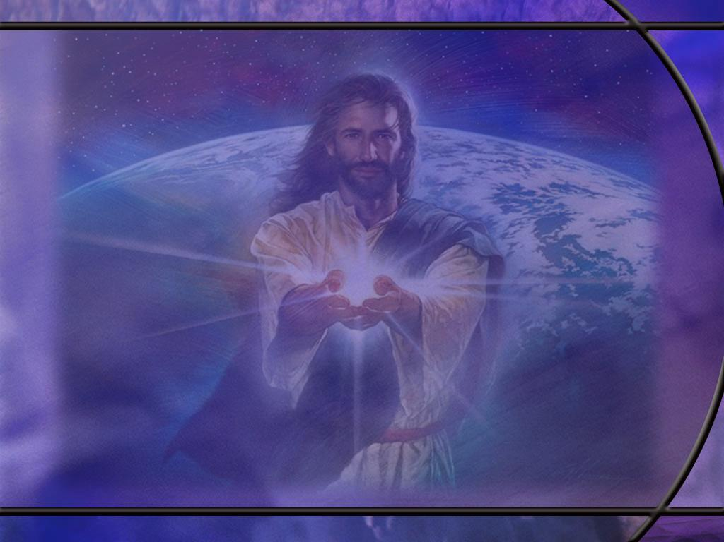
2 Timothy 3:16-17 ESV
All Scripture is breathed out by God and profitable for teaching, for reproof, for correction, and for training in righteousness, ¹⁷ that the man of God may be complete, equipped for every good work.
Notes:
Q1: What defines Scripture according to this verse?
Scripture is inspired by God; it is literally “God-breathed.”
So there is a divine component as well as human to the words of Scripture.
God is at work in producing Scripture so that it conveys divine truth that is good for teaching, reproof, correction, and training in righteousness.
In the previous verse, Paul says of Timothy:
2 Timothy 3:15 ESV –how from childhood you have been acquainted with the sacred writings [or Scriptures], which are able to make you wise for salvation through faith in Christ Jesus.
So Scripture is God’s truth that brings us to Christ and equips us to live for Him.
Peter adds his witness to Paul’s with these words:
2 Peter 1:21 NKJV –holy men of God spoke as they were moved by the Holy Spirit.
So, Scripture was recognized by the apostles as being inspired or God-breathed.
It was the work of the Holy Spirit in placing thoughts in the minds of men that they would write down as a permanent record of God’s word.

Slide 12
1 Thessalonians 2:13 NIV
And we also thank God continually because, when you received the word of God, which you heard from us, you accepted it not as a human word, but as it actually is, the word of God, which is indeed at work in you who believe.
Notes:
Q1: What is Paul claiming here for the words that he spoke to the Thessalonians?
1. He is thanking God that they accepted his words, not as human words, but as the word of God.
2. Presumably Paul is referring to the words he spoke to them in preaching the gospel to them.
3. When he, as an apostle, speaks on behalf of the Lord, his words carry the authority of the Lord Himself.
4. His words were actually the word of God.
5. And the word that he spoke to them is at work in them who believe making changes in their lives through the power of the HS.
[Go to next slide]

Slide 13
2 Peter 3:16 NIV
He [Paul] writes the same way in all his letters, speaking in them of these matters. His letters contain some things that are hard to understand, which ignorant and unstable people distort, as they do the other Scriptures, to their own destruction.
Notes:
Q1: How does Peter categorize Paul’s letters in this passage?
1. He refers to them as Scripture.
2. Some distort Paul’s writings as they do other Scriptures.
3. So Peter considers Paul to be writing Scripture.
[Go to next slide.]

Slide 14
Galatians 1:11-12; 1 Corinthians 14:47
Galatians 1:11-12 NIV I want you to know, brothers and sisters, that the gospel I preached is not of human origin. ¹² I did not receive it from any man, nor was I taught it; rather, I received it by revelation from Jesus Christ.
1 Corinthians 14:37 NIV –If anyone thinks they are a prophet or otherwise gifted by the Spirit, let them acknowledge that what I am writing to you is the Lord's command. [R]
Notes:
[Hold second click]
Q1: What claim is Paul making here?
1. He is saying that the gospel he preaches of righteousness by faith is of divine origin.
2. It is not something he thought up or heard from others.
3. It comes directly by revelation from Jesus Christ Himself.
4. So his gospel message is not just thought inspiration by the HS.
5. It is direct revelation from Jesus Christ Himself.
[Click second bullet]
Q2: With what authority does Paul instruct the Corinthian church on the proper way to hold a worship service?
1. This is pretty clear, isn’t it.
2. What Paul writes as an apostle should be considered by the church as the Lord’s command.
3. The authority of the OT prophets passed in the Christian era to the NT apostles.
4. Here Paul writes with the authority of the Lord Himself.

Slide 15
Literary Forms in Scripture
Literary form | What it does | Where to find examples
Narrative | Relates events through characters, setting, dialogue, conflict, and resolution. Biblical narratives also communicate theological and moral meaning. | Genesis 37–50, the story of Joseph; Ruth 1–4; 1–2 Samuel; Acts.
Law and instruction | Gives commandments and directions concerning worship, justice, community life, and conduct. | Exodus 20:1–17, the Ten Commandments; Leviticus; Numbers 35:16–34, laws concerning homicide.

Slide 16
Literary Forms 2
Literary form | What it does | Where to find examples
Poetry and song | Uses concentrated language, imagery, and patterned lines to express worship, emotion, and reflection. | Exodus 15:1–18, the song after the sea crossing; Psalm 23; Song of Songs; Luke 1:46–55, Mary’s song.
Wisdom and proverbs | Offers memorable observations and explores questions about wise living, suffering, justice, and the meaning of life. | Proverbs; Job; Ecclesiastes. Proverbs commonly express general principles rather than unconditional guarantees.

Slide 17
Literary form | What it does | Where to find examples
Prophecy or oracle | Presents a message spoken on God’s behalf, including warning, judgment, instruction, and hope—not simply prediction. | Isaiah; Jeremiah; Amos; Isaiah 22:15 introduces an oracle with a formula identifying the Lord as its source.
Apocalyptic vision | Uses visions, heavenly figures, and dense symbolism to reveal divine judgment, deliverance, and the ultimate outcome of conflict. | Daniel 7–12; Revelation; visionary passages in Ezekiel.

Slide 18
Literary form | What it does | Where to find examples
Gospel | Presents Jesus’ life, teaching, deeds, death, and resurrection through a purposeful narrative. | Matthew, Mark, Luke, and John. Compare Luke 2:1–21’s birth narrative with John 1:1–14’s poetic presentation of the Word becoming flesh.
Parable | Uses a brief story or everyday comparison to communicate spiritual or moral truth and challenge the hearer. | Luke 15, the lost sheep, lost coin, and lost son; Ezekiel 17:1–10, the eagles and vine.

Slide 19
Literary form | What it does | Where to find examples
Letter or epistle | Addresses particular communities or individuals through instruction, argument, encouragement, and correction. | Romans; 1–2 Corinthians; the letter preserved within Acts 15:23–29.
Sermon or discourse | Develops teaching or persuasion through an extended speech. | Deuteronomy 1–4; Matthew 5–7, the Sermon on the Mount; Acts 7, Stephen’s speech.

Slide 20
Literary Forms 6
Literary form | What it does | Where to find examples
Genealogy | Lists generations and family relationships, locating people within a larger story. | 1 Chronicles 1–9; Matthew 1:1–17; Luke 3:23–38.
Prayer and devotional lyric | Addresses God in praise, petition, thanksgiving, or distress. This form often appears within poetry or narrative. | Psalms 23, 46, 90, and 139; Jonah 2:2–9; Luke 1:46–55.
[R]

Slide 21
Literary Devices
Literary device | Definition | Biblical example
Metaphor | Describes one thing as another to transfer qualities between them. | Psalm 23:1: the Lord is described as a shepherd.
Simile | Makes an explicit comparison, often using “like” or “as.” | Matthew 23:27–28: hypocritical religious leaders are compared to whitewashed tombs.
Personification | Gives human characteristics or actions to something nonhuman or abstract. | Psalm 85:10: love and faithfulness meet; righteousness and peace kiss.
Hyperbole | Uses deliberate exaggeration for emphasis. | Matthew 23:24: straining out a gnat while swallowing a camel.

Slide 22
Literary device | Definition | Biblical example
Paradox | Presents an apparent contradiction that invites deeper understanding. | Mark 10:43–44: greatness comes through service; the first must be slave of all.
Rhetorical question | Asks a question to make a point rather than obtain information. | Mark 7:18–19: Jesus questions the disciples about defilement.
Counterquestion | Responds to a question with another question. | Mark 11:27–33: Jesus answers a challenge to his authority by asking about John’s baptism.

Slide 23
Literary device | Definition | Biblical example
Wordplay or pun | Uses similar sounds or multiple meanings to connect ideas. | Matthew 16:18: Peter and “rock”; John 3:8: wind and Spirit.
Argument from the lesser to the greater | Reasons that what is true in a lesser case applies even more strongly in a greater case. | Matthew 6:28–30: God clothes the grass and lilies; how much more will he care for people?
Symbolism | Uses an image, object, or figure to communicate meaning beyond itself. | Daniel 7: visionary beasts; Revelation: symbolic visions.
[R]

Slide 24
Literary Structure
Literary structure | Definition or pattern | Biblical example
Synonymous parallelism | A second line echoes the thought of the first in different words. | Ps 117:1 “Praise the LORD, all you nations! Give glory, all you peoples!”.
Antithetical parallelism | Two lines express a point through contrasting ideas. | Prov 10:1 “A wise son makes a glad father, but a foolish son is a sorrow to his mother.”
Climactic or step parallelism | Successive statements build on the preceding thought. | Ps 119:11“Your word I have hidden in my heart, That I might not sin against You.”

Slide 25
Literary Structures 2
Literary structure | Definition or pattern | Biblical example
Repetition | Repeats words, phrases, or patterns. | Matthew 7:7–8: ask and receive; seek and find; knock and the door opens.
Chiasm | Arranges corresponding ideas in reverse order, often A–B–B′–A′. | Matthew 23:12: exalted → humbled; humbled → exalted.
Notes:
Let me show you a really amazing chiasm from the gospel of Luke.
[Go to next slide.]

Slide 26
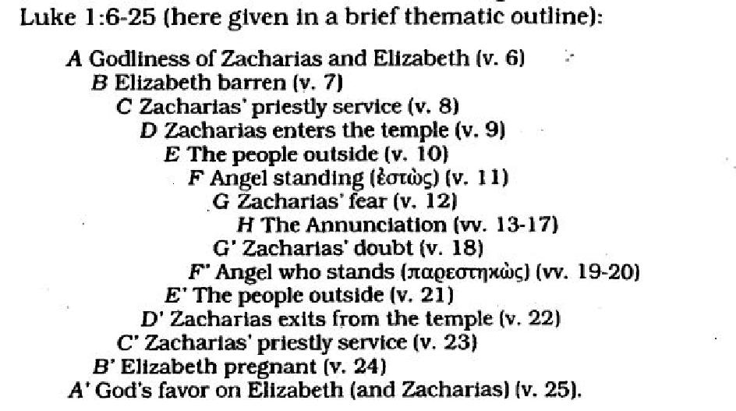
Luke 1:6-25 [R]
Notes:
1. Here we have a 15 element chiasm.
2. We have pairs of related verses from A through G.
3. And at the center of the chiasm is element H.
4. Often in a chiasm, it will be so arranged that the most important element is at the center.
5. Element H is the announcement by Gabriel of the Birth of John the Baptist.
6. At the left of the arrangement you can see the left half of the letter “X”.
7. Also note the mirror image repetition of the elements.

Slide 27
Luke 1:1-4 NLT
Many people have set out to write accounts about the events that have been fulfilled among us. ² They used the eyewitness reports circulating among us from the early disciples. ³ Having carefully investigated everything from the beginning, I also have decided to write an accurate account for you, most honorable Theophilus, ⁴ so you can be certain of the truth of everything you were taught. [R]
Notes:
Q1: How does Luke describe his experience in writing his gospel?
1. We looked at these verses last week when we were talking about the Holy Spirit and thought inspiration.
2. This is Luke’s explanation of how he came to write his gospel.
3. Luke says that he carefully researched and investigated eyewitness reports circulated by the early disciples or apostles.
4. He believes he has come up with an accurate and orderly account of the life of Christ.
5. Here we see Luke doing his best from a human perspective to organize and validate the accounts of eyewitnesses.
6. And we see the Holy Spirit, working on Luke’s thinking to make sure the account is accurate.
7. We see something very similar in Matthew’s account.
8. It appears that Matthew relied heavily on Mark’s gospel to write his own gospel.
9. All three of the synoptic gospels, Matthew, Mark, and Luke report much the same sequence of events, but give different perspectives and include unique information not found in the others.
10. The gospel of John is more of a unique presentation of the life of Christ.
11. We can see the Holy Spirit at work in all of the gospels inspiring the writers to give their accounts that emphasize the important events of His life.
12. While we may be able to find what appear to be minor discrepancies between these gospel writers, their overall messages agree.
13. We can be confident that Jesus, the Son of God, died for our sins, was buried, and rose again the third day.
14. And He has promised to return to save us and give us eternal life.

Slide 28
2 Thessalonians 3:17 NIV
I, Paul, write this greeting in my own hand, which is the distinguishing mark in all my letters. This is how I write. [R]
Notes:
Q1: What does this tell you about who wrote this letter?
1. It was somebody other than Paul.
2. Paul just takes the quill at the end and writes the final greeting.
3. It was like signing his name. It authenticated him as the author.
4. At the end of Galatians, he comments on how big he writes.
Galatians 6:11 NIV – See what large letters I use as I write to you with my own hand!
5. This would go along with the idea that his thorn in the flesh was poor vision.
6. So it is likely that Paul used a secretary or scribe to write all of his epistles.
7. In Romans, he actually gives the name of his scribe:
Romans 16:22 NIV – I, Tertius, who wrote down this letter, greet you in the Lord.
8. This is nothing new for inspired writers.

Slide 29
Jeremiah 36:17-18 NIV
Then they asked Baruch, "Tell us, how did you come to write all this? Did Jeremiah dictate it?" ¹⁸ "Yes," Baruch replied, "he dictated all these words to me, and I wrote them in ink on the scroll." [R]
Notes:
Q1: What was Baruch’s job?
1. He was the scribe, on penman for the prophet Jeremiah.
2. He took dictation and wrote all Jeremiah’s words on a scroll.
3. So the Scripture can be faithfully recorded by those who write down the inspired words of the prophet or the apostle.

