Slide 1
Isaiah
Lesson 5
Noble Prince of Peace

Slide 2
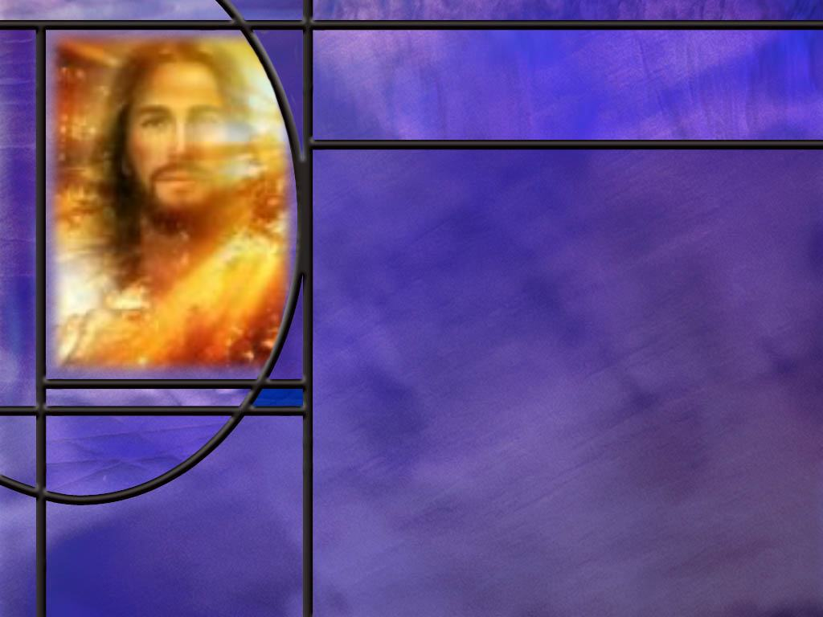
Memory Text
Isaiah 9:6 NKJV
For unto us a Child is born, unto us a Son is given; and the government will be upon His shoulder. And His name will be called Wonderful, Counselor, Mighty God, Everlasting Father, Prince of Peace.
Who is the only one who would qualify as the person described in this verse?
How did Jesus qualify as a Child born and a Son given?
In what sense was the government to be upon His shoulders? Should we look for a political leader to fulfill this prophecy?
Notes:
B2:
1. Jesus Christ.
2. God incarnate.
3. Emmanuel, God with us.
4. The unique God-man
5. We see his humanity in the first part of this verse and His divinity in the last part.
6. Let’s look first at the humanity of Christ.
B3:
1. The angel Gabriel explained the incarnation to Mary in these words:
Luke 1:35 NKJV And the angel answered and said to her, "The Holy Spirit will come upon you, and the power of the Highest will overshadow you; therefore, also, that Holy One who is to be born will be called the Son of God.
2. That incarnation is prefigured and predicted in our memory verse.
3. “A child is born” and “a Son is given.”
4. And to whom is the Son given? He is given to “us.”
5. Isaiah is here speaking for his people, God’s chosen people.
6. He came to literal Israel, but He saves all of spiritual Israel, both Jew and Gentile.
7. Gabriel was specific in the name that God had chosen for His Son,
8. He said:
Matthew 1:21 NKJV "And she will bring forth a Son, and you shall call His name JESUS, for He will save His people from their sins.“
9. In the original, the Hebrew name given to Jesus was Yashuah, or Joshua, meaning “Yahweh is salvation.”
10. So Jesus was given to us, to “His people,” so our sins could be forgiven through His precious blood.
11. And who gave this Son to us?
John 3:16 KJV For God so loved the world, that he gave his only begotten Son, that whosoever believeth in him should not perish, but have everlasting life.
12. The Son was given to us by God the Father.
B4:
1. Jesus was born as King of the Jews and was worshipped as such by the wise men.
2. Jesus died as king of the Jews with a sign over His head that declared, “Jesus of Nazareth, the King of the Jews.”
3. But what did Jesus reply when Pilate asked Him about His kingdom? (My kingdom is not of this world.)
4. Jesus was a King of something much greater and more exalted than the Jewish nation.
5. He was King of kings and Lord of lords in an eternal kingdom that would have no end.
6. At the conclusion of His work on earth, He would be exalted to the highest position in the Kingdom of God where He will reign forever.
7. We will come back later in our lesson to consider the second half of this verse and the verse that follows.

Slide 3
Overview
While Isaiah predicted dark days and severe discipline for God’s people, he also proclaimed a message of hope for the remnant: the Messiah would bring a great light to the world and ultimately establish His Kingdom on earth.
  Darkness to Light
  Prince of Peace
  Root and Branch
  Summary

Slide 4
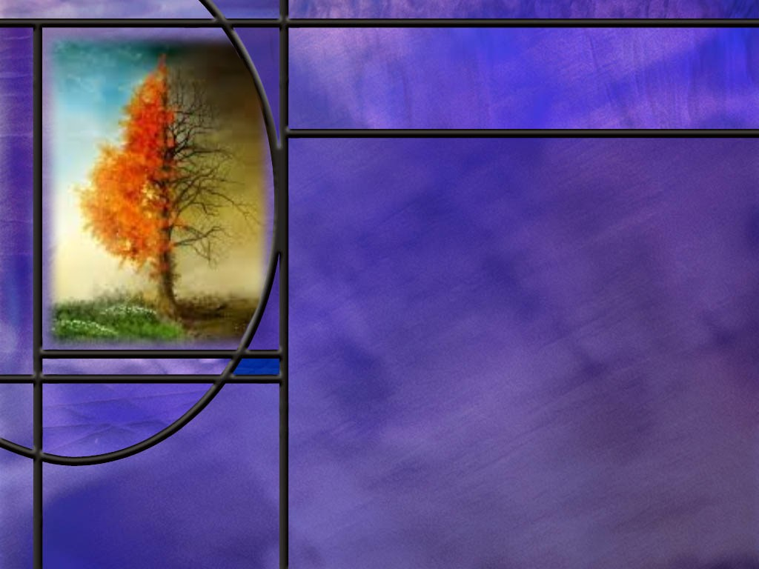
Darkness to Light
What has brought the people into the darkness with which Chapter 8 ends? (Isaiah 8:22)
What light does Isaiah foresee as coming to the region of Galilee? (Isa 9:1-2)
What would be an additional result of this great light shining to all the world? (Isa 9:3-4)
Notes:
B1:
[See notes on linked slides.]
B2:
[See notes on linked slides.]
B3:
[See notes on linked slides.]

Slide 5
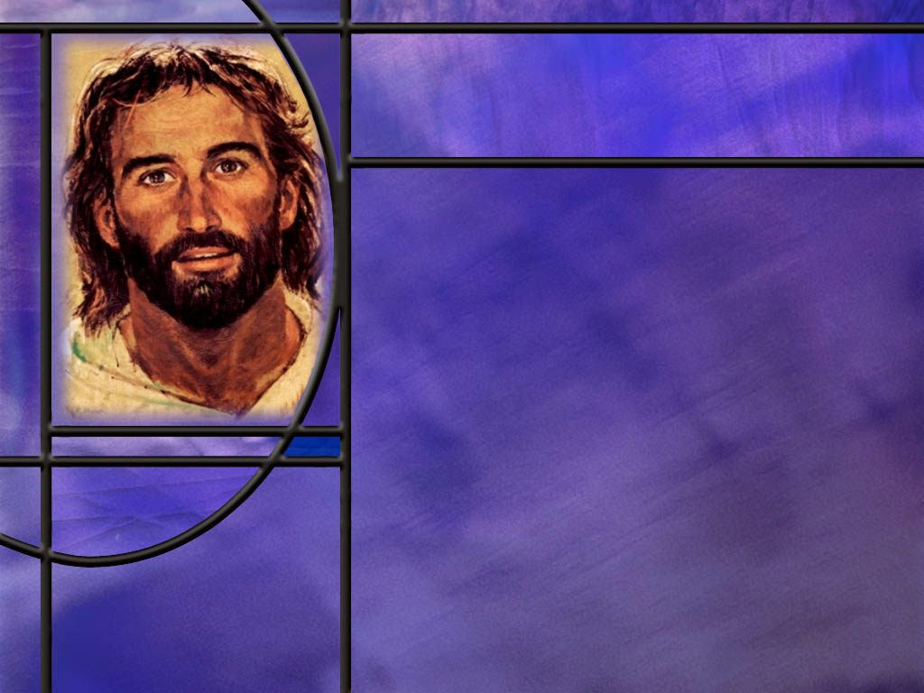
Prince of Peace
How does Isaiah conclude this section on the great Galilean light that would expand the nation and defeat the oppressor? (Isaiah 9:6-7)
What additional characteristics of the Messiah do we find in Isaiah 9:7?
Notes:
B1:
[See notes on linked slide.]
B2:
[See notes on linked slide.]

Slide 6

Root and Branch
Read Isaiah 11:1
How did this same unique relationship to David allow Jesus to silence the Pharisees of His day? (Matthew 22:42-45)
What preview of the Messianic kingdom does Isaiah provide? (Isaiah 11:2-9)
Notes:
B1:
[See notes on linked slide.]
B2:
[See notes on linked slide.]
B3:
[See notes on linked slide.]

Slide 7
Summary
In the midst of warnings of divine discipline against Israel and Judah, Isaiah breaks in with words of encouragement and hope in our lesson this week.
He foresees a time when people who walk in darkness will see a great light beginning in Galilee.
This light became a reality when Jesus began his ministry in Capernaum in Galilee.
Jesus enlarged the nation of Israel, not by political or military conquest, but by establishing spiritual Israel that now encompasses both Jew and Gentile.
He broke the oppressor’s rod, not by defeating the Romans, but by defeating the devil and his dominion and freeing us from the guilt and slavery to sin.

Slide 8
Summary
While the incarnation is still shrouded in mystery to us, Isaiah’s prophecy in Isa 9:6-7 clearly points to the Messiah as the God-Man.
He would be a child born and a Son given to us and yet He would be the Mighty God, the Everlasting Father, the Prince of Peace.
He would be the descendant of David and yet the ruler of an eternal kingdom.
Only Jesus, the incarnate Son of God could fulfill this prophecy.
Isaiah goes on to point to the pedigree of the Messiah as both the root and the branch of Jesse, the father of David.
Christ is both David’s Creator and David’s offspring.

Slide 9
Summary
Isaiah looks forward to the Messianic Kingdom and to the restoration of God’s original design for mankind’s happiness in Eden restored.
God invites us to be a part of the kingdom He is preparing for us, and He has given us His Son to die for our sins so that we can be forgiven and be credited with His righteousness.
Will you choose to trust the Prince of Peace today, confident that His precious blood is sufficient to cover your sins and give you peace with God and the hope of sharing glory with Him?

Slide 11
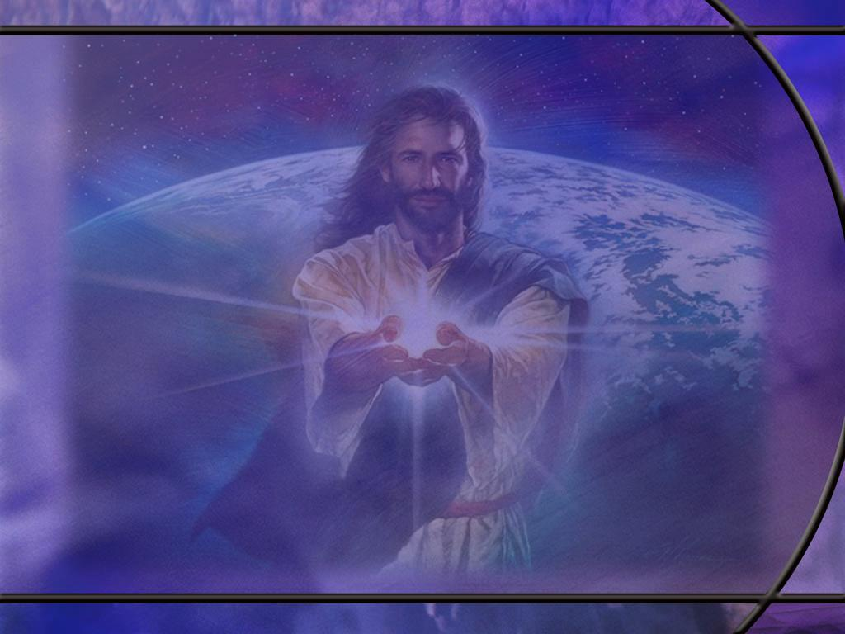
Isaiah 8:22 NLT
…but wherever they look, there will be trouble and anguish and dark despair. They will be thrown out into the darkness. [R]
Notes:
Q1: Who are these people that will be thrown out into the darkness?
1. These are people who have rebelled against God and His truth.
2. The reason people end up in darkness is that they choose darkness rather than light.
John 3:19 KJV And this is the condemnation, that light is come into the world, and men loved darkness rather than light, because their deeds were evil.
3. And at the end of chapter 8 we see the end result of those who have rebelled against the true God.
4. The people have gone off into idolatry and rebellion until they are seeking guidance through the occult and demonic influences that use their idol worship to entrap them.
5. In verse 19 Isaiah asks: “Should the living seek guidance from the dead?”
6. Isaiah answers this question in verse, 20, that we all know.
Isaiah 8:20 NKJV To the law and to the testimony! If they do not speak according to this word, it is because there is no light in them.
7. God’s people must seek their guidance from the Scriptures, the holy word of God.
Psalm 119:105 KJV - Thy word is a lamp unto my feet, and a light unto my path.
8. If you want to walk in the light, you have to walk in the word, otherwise, you walk in darkness.

Slide 12
Isaiah 9:1-2 NLT
Nevertheless, that time of darkness and despair will not go on forever. The land of Zebulun and Naphtali will be humbled, but there will be a time in the future when Galilee of the Gentiles, which lies along the road that runs between the Jordan and the sea, will be filled with glory. ² The people who walk in darkness will see a great light. For those who live in a land of deep darkness, a light will shine. [R]
Notes:
Q1: What are the promise of these verses?
1. First, the darkness and despair of God’s people will not go on forever.
2. Second, the land of Galilee will be filled with glory.
3. Third, the people who walk in darkness will see a great light.
4. Fourth, a light will shine in a land of deep darkness.
Q2: What do you think happened in Galilee to bring this prophecy to pass?
1. In His early ministry, Jesus focused on the land of Galilee.
Matthew 4:13 NKJV And leaving Nazareth, He [Jesus] came and dwelt in Capernaum, which is by the sea, in the regions of Zebulun and Naphtali,
2. Matthew goes on in the next verse to point out that, in doing that, Jesus fulfilled this prophecy by Isaiah.
3. He writes:
Matthew 4:14 NKJV that it might be fulfilled which was spoken by Isaiah the prophet, saying:
4. And then Mathew goes on to quote the passage in this slide from Isaiah.
5. So Jesus is the light that dispelled the darkness and despair from the land.
6. He is the One that filled Galilee with glory.
7. He is the great light that arose on the people who walked in darkness.
8. He was the light of the world bringing the truth of God and dispelling the darkness of sin and error.

Slide 13
Isaiah 9:3-4 NLT
You will enlarge the nation of Israel, and its people will rejoice. They will rejoice before you as people rejoice at the harvest and like warriors dividing the plunder. ⁴For you will break the yoke of their slavery and lift the heavy burden from their shoulders. You will break the oppressor's rod, just as you did when you destroyed the army of Midian. [R]
Notes:
Q1: How did the great light that began to shine from Galilee enlarge the nation of Israel.
1. If we understand the great light of Galilee as Jesus, then we need to look for a way that Jesus enlarged the nation of Israel.
2. How did Jesus do that?
3. He began a new Israel of faith called spiritual Israel.
4. That Israel included all who would believe in Him by faith, Jew and Gentile.
5. Paul would write to the Galatians:
Galatians 3:28-29 KJV - There is neither Jew nor Greek, there is neither bond nor free, there is neither male nor female: for ye are all one in Christ Jesus. ²⁹ And if ye be Christ's, then are ye Abraham's seed, and heirs according to the promise.
6. At the end of the same book, Paul would refer to the churches in Galatia, which included Gentiles, as the “Israel of God.”
Q2: What is this reference to the defeat of Midian? Who defeated Midian?
1. Does anyone remember the story of Gideon and how he defeated the Midianites?
2. Who was it that promised to be with Gideon and give him the victory?
3. This was one of those OT appearances of the Angel of the LORD or of the LORD himself.
Judges 6:12 ¹² And the angel of the LORD appeared unto him, and said unto him, The LORD is with thee, thou mighty man of valour. ... ¹⁶ And the LORD said unto him, Surely I will be with thee, and thou shalt smite the Midianites as one man.
4. How many men did Gideon end up with after he got his army down to fighting size? (300)
5. And how did they get the victory over the Midianites?
6. When they broke their clay jars and blew their rams horns, the Lord caused the Midianites to fight against each other until they were destroyed or retreated.
7. So that victory was really the victory of the Lord of hosts, the pre-incarnate Son of God.
8. And in this verse, we can say also that the One who will break the oppressor’s rod with be Jesus Christ, and the oppressor of God’s people in that day will be Satan and his angels.
9. So this fits into the picture that Isaiah is painting here of the coming Messiah who would deliver His people, not from Roman rule, but from the slavery and oppression of sin.

Slide 14
Isaiah 9:6-7 NKJV
For unto us a Child is born, unto us a Son is given; and the government will be upon His shoulder. And His name will be called Wonderful, Counselor, Mighty God, Everlasting Father, Prince of Peace. ⁷ Of the increase of His government and peace there will be no end, upon the throne of David and over His kingdom, to order it and establish it with judgment and justice from that time forward, even forever. The zeal of the LORD of hosts will perform this. [R]
Notes:
1. Verse 6 is our memory text and we have already looked at the first part of that verse.
2. So let’s pick up with the titles we see in the second sentence.
3. There are four or five titles here: 5 according to the NKJV.
4. Some translations combine the first two.
5. The NIV, for example renders the second sentence of verse 6 as
Isaiah 9:6 NIV And he will be called Wonderful Counselor, Mighty God, Everlasting Father, Prince of Peace.
6. Some claim that it fits the poetry better to have them all double titles rather than two single titles (wonderful and counselor) and three double titles (mighty God, Everlasting Father, and Prince of Peace.)
Q1: What can we learn about the Messiah and His character from these titles?
1. How about Wonderful?
2. Do you like that chorus: His name is wonderful… Jesus my Lord.
3. Wonderful is a word in Scripture that describes the things of God, particularly the mysterious things of God that cause us to wonder
4. On the day of Pentecost, the disciples spoke about the wonderful works of God.
5. The Angel of the LORD spoke of his name as “wonderful” to Manoah, the father of Samson.
Judges 13:18 NKJV And the Angel of the LORD said to him, "Why do you ask My name, seeing it is wonderful?“
6. This was the divine preincarnate Son of God that visited Manoah and his wife.
7. So here we see the title of Wonderful especially fits the Son of God who would be the Messiah.
What does it mean to be a wonderful counselor?
1. Well a counselor is someone who guides us and gives us wise advice.
2. It can be an advocate who pleads our case in court
3. Jesus intercedes for us in the heavenly sanctuary.
Romans 8:34 KJV - 34 … It is Christ that died, yea rather, that is risen again, who is even at the right hand of God, who also maketh intercession for us.
1 John 2:1 KJV - …if any man sin, we have an advocate with the Father, Jesus Christ the righteous:
4. And it is Jesus who is our wisdom.
1 Corinthians 1:30 NKJV But of Him you are in Christ Jesus, who became for us wisdom from God--and righteousness and sanctification and redemption--
Q2: What do these last three titles indicate about the Son who was given to us?
1. He is God; in fact, He is the “mighty God.”
2. This should remove any doubt that we are talking about God incarnate.
3. And John the apostle presents Jesus as the Word who made all things “and without Him was not anything made that was made.”
4. Talk about mighty God, How about almighty Creator God?
5. How about the Everlasting Father?
6. The fact that this One is everlasting, again indicates His deity.
7. It is not to say that the Messiah would be the same person as the Father, but to indicate that He would be a loving care giver to His people in the same way that the Father loves us.
8. Jesus could say, “If you have seen me, you have seen the Father.”
Q3: What about the final title? Who would be our Prince of Peace?
1. Jesus.
2. In what sense did Jesus bring us peace? It certainly wasn’t peace with the Romans was it?
3. Jesus’ greatest peace initiative is to bring us peace with God.
4. When we rebel against God we become children of wrath; our sins separate us from Him.
5. Paul says “the carnal mind is enmity against God. It is not subject to the law of God, neither indeed can be. (Rom 8:7)
6. So we start out as enemies toward God, but justification brings us peace with God.
Romans 5:1 KJV - Therefore being justified by faith, we have peace with God through our Lord Jesus Christ:
7. And we are justified when our sins are forgiven through the blood of Jesus and His righteousness is imputed to our account.

Slide 15
Isaiah 9:7 NKJV
Of the increase of His government and peace there will be no end, upon the throne of David and over His kingdom, to order it and establish it with judgment and justice from that time forward, even forever. The zeal of the LORD of hosts will perform this. [R]
Notes:
Q1: What can we learn about the Messiah and His characteristics from this verse?
1. No end to His government.
2. No end to the peace that He will bring to His people.
3. His kingdom He will establish will be based on judgment and justice forever.
4. As Daniel later told Nebuchadnezzar,
Daniel 2:44 NKJV … the God of heaven will set up a kingdom which shall never be destroyed;
Q2: What do you make of the fact that this prophecy mentions “the throne of David.”
1. This is just one more piece of evidence to establish that the Messiah would be a descendant of King David as prophesied in Scripture.
2. Indeed, both Matthew and Luke trace the ancestry of Jesus back to King David.
3. Matthew gives Joseph’s genealogy through Solomon; Luke gives Mary’s genealogy through Nathan.
Q3: Who is the LORD of Hosts?
1. LORD is the name of God that we pronounce Yahweh.
2. Yahweh means the ever present I AM.
3. “Hosts” is from a Hebrew word that means armies.
4. So Lord of Hosts is the leader of the heavenly armies of Yahweh.
5. In OT times, this was the pre-incarnate Son of God we sometimes call Michael.
Revelation 12:7 KJV And there was war in heaven: Michael and his angels fought against the dragon; and the dragon fought and his angels,
6. We see the Captain of the LORD’s host as the divine figure who confronted Joshua.
Joshua 5:15 KJV - 15 And the captain of the LORD'S host said unto Joshua, Loose thy shoe from off thy foot; for the place whereon thou standest is holy. And Joshua did so.
7. So this prophecy all fits together with Jesus Christ as the Messiah, the Son of God who will fulfill all these things.

Slide 16
Isaiah 11:1 NIV
A shoot will come up from the stump of Jesse; from his roots a Branch will bear fruit. [R]
Notes:
Q1: What is strange about this description of a stump.
1. Although the tree is cut down, the stump is not dead.
2. It puts out a shoot from the stump and a branch that bears fruit from the root.
3. Could this be a reference to the remnant that would survive the Babylonian captivity and come back to the land of Judah?
4. It was out of the tribe of Judah, out of the house of David, that the Messiah would come.
5. This is a reference to the fact that the Messianic line would not be extinguished.
Q2: Is there significance to the fact that the Messiah would come from both the root and the branch of Jesse, David’s Father?
1. Our lesson points out that Jesus was unique in His relation to David.
Revelation 22:16 NIV - "I, Jesus, have sent my angel to give you this testimony for the churches. I am the Root and the Offspring of David, and the bright Morning Star."
2. So Jesus is the Root and offspring of David.
3. He is the creator of David but He is also his offspring.
4. This is a description that could only fit the divine Son of God / Son of Man.

Slide 17
Matthew 22:42-45 (NIV)
⁴² “What do you think about the Messiah? Whose son is he?”
“The son of David,” they replied.
⁴³ He said to them, “How is it then that David, speaking by the Spirit, calls him ‘Lord’? For he says,
⁴⁴ “‘The LORD said to my Lord:
“Sit at my right hand
until I put your enemies
under your feet.”’^{[a]}
⁴⁵ If then David calls him ‘Lord,’ how can he [the Messiah] be his son?” [R]
Notes:
1. Here is a conversation between Jesus and the Pharisees.
2. Jesus is asking the Pharisees a question in verse 42.
Q1: How dies Jesus’ argument here fit together with Isaiah’s picture of a root and branch?
1. Verse 44 is a quote from Ps 110:1 written by David.
2. It was understood as a Messianic psalm.
3. In it, David calls the Messiah “my Lord.”
4. So Jesus question to the Pharisees was how can the Messiah be merely the son of David?
5. David calls the Messiah “Lord” which implies that the Messiah would be not just David’s son but also his ancestor.
6. In other words, the Messiah would be the Creator of David in addition to being David’s offspring.
7. This fits in perfectly with the idea that the Messiah would be both the root and branch of David’s house (the stump of Jesse).
8. This can only be explained through the incarnation in which the Creator God took upon Himself human flesh.
9. After this, Matthew notes:
Matthew 22:46 NIV No one could say a word in reply, and from that day on no one dared to ask him any more questions.

Slide 18
Isaiah 11:2-4, 6-9 NIV
The Spirit of the LORD will rest on Him--the Spirit of wisdom and of understanding, the Spirit of counsel and of might, the Spirit of the knowledge and fear of the LORD-- ³ and he will delight in the fear of the LORD…. ⁴ but with righteousness he will judge the needy, with justice he will give decisions for the poor of the earth. He will strike the earth with the rod of his mouth; with the breath of his lips he will slay the wicked…
Notes:
1. Here Isaiah is looking forward to the Messianic kingdom.
Q1: What are some of the things Isaiah foresees for this Messianic King?
1. He will manifest the Spirit of the Lord in all that He does.
2. He will judge and bring justice in righteousness.
3. He will destroy all the wicked at His second coming.
4. The apostle Paul describes it in 2 Thes 1:7
2 Thessalonians 1:7-9 KJV – 7…the Lord Jesus shall be revealed from heaven with his mighty angels, ⁸ In flaming fire taking vengeance on them that know not God, and that obey not the gospel of our Lord Jesus Christ: ⁹ Who shall be punished with everlasting destruction from the presence of the Lord, and from the glory of his power;
5. Only the righteous dwell in the heavenly kingdom.
[Go to next slide]

Slide 19
Isaiah 11:2-4, 6-9 NIV
The wolf will live with the lamb, the leopard will lie down with the goat, the calf and the lion and the yearling together; and a little child will lead them. ⁷ The cow will feed with the bear, their young will lie down together, and the lion will eat straw like the ox. ⁸ The infant will play near the cobra's den, and the young child will put its hand into the viper's nest. ⁹ They will neither harm nor destroy on all my holy mountain, for the earth will be filled with the knowledge of the LORD as the waters cover the sea. [R]
Notes:
1. Here we see the conditions that will prevail in the final consummation of the Messianic kingdom.
2. Instead of eating each other or eating us, animals will go back to the vegetarian diet of Eden.
3. This is the promise of restoration of the very good creation that was lost with the fall and the curse.
4. This gives us a glimpse of God’s plan for His creation.
5. Are you looking forward to the place that God has prepared for you?
6. He is going to make a new heaven and a new earth. We can count on His promise.
7. Peter writes:
2 Peter 3:13 KJV - ¹³ Nevertheless we, according to his promise, look for new heavens and a new earth, wherein dwelleth righteousness.
8. Let’s make sure we have the righteousness of Christ through justification by faith that will entitle us to a dwelling place there.

