Slide 1
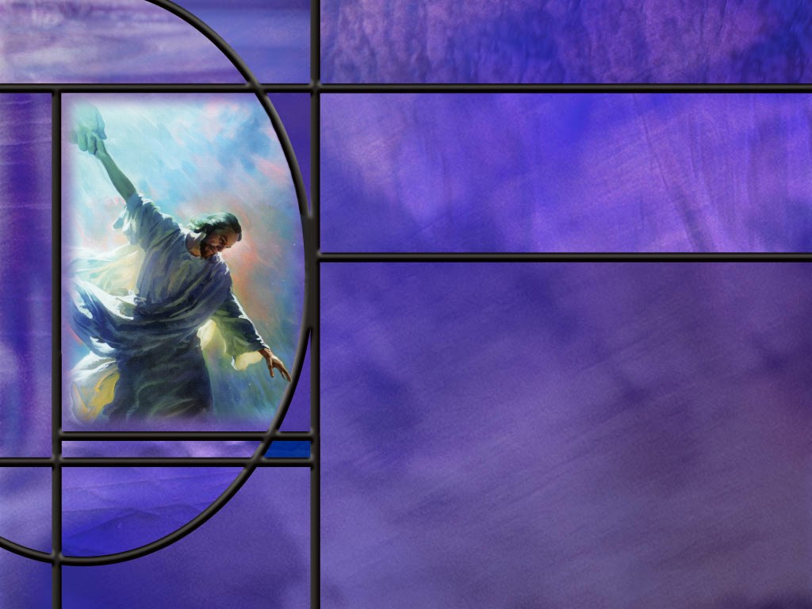
Uniting Heaven and Earth: Christ in Philippians and Colossians
Lesson 10
Complete in Christ

Slide 2
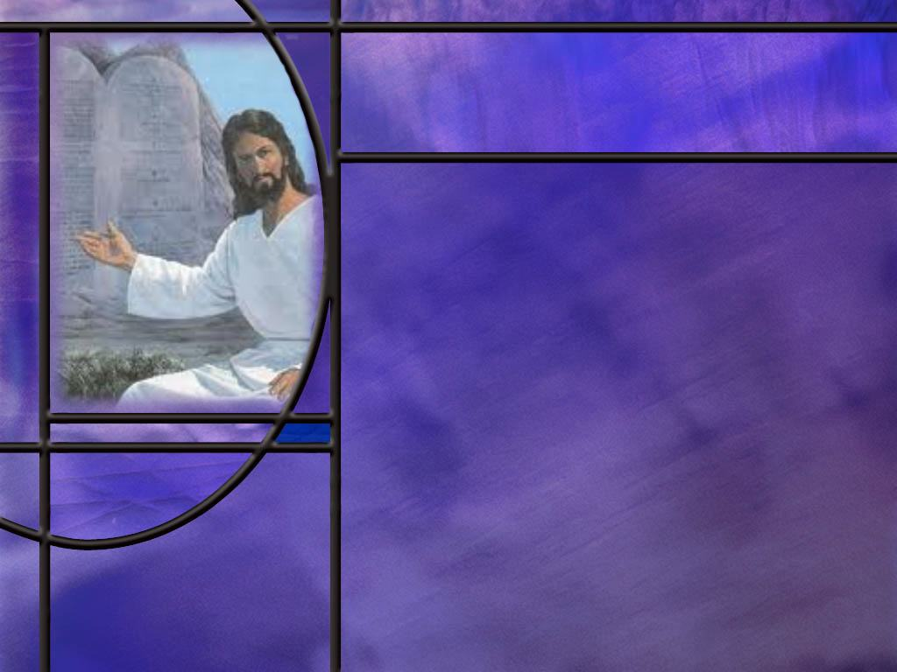
Memory Text
Colossians 2:16-17 NKJV
So let no one judge you in food or in drink, or regarding a festival or a new moon or sabbaths, ¹⁷ which are a shadow of things to come, but the substance is of Christ.
How is this text used by evangelicals and others to cast shade on the Sabbath commandment?
Is that what Paul is doing here in this text?
Who is it that is judging the Colossian believers?
What does Isaiah say about New Moon and Sabbath celebrations in the new heaven and earth? (Isa 66:22-23)
Notes:
B1:
1. For the sake of argument, let’s assume that the sabbaths mentioned in this verse are the weekly Sabbath not the annual sabbaths of the Levitical feasts.
B2:
1. Here they claim that the weekly Sabbath is just a ceremonial law that found its fulfillment in Christ like so many of the other OT types and rituals.
2. They claim that Paul here is doing away with all of these OT restrictions and observances including the observance of Sabbath.
3. They take this as a warning from Paul against the annual feasts, the monthly New Moons, and the weekly Sabbath.
B3:
1. No!
2. Paul always maintained a high regard for the moral law of God.
Romans 7:12 NIV - So then, the law is holy, and the commandment is holy, righteous and good.
3. The weekly Sabbath commandment was written with the finger of God on tables of stone.
4. It is a Creation ordinance established at the end of creation week by God himself before sin entered His perfect creation.
5. Paul himself kept the Sabbath throughout his life.
6. The book of Acts specifically refers to six different occasions where Paul kept the Sabbath.
7. And in Corinth, Luke records that he kept the Sabbath every week for a year and a half.
8. So, Paul is specifically mentioned as keeping Sabbath about 85 times.
9. There is not one mention of him worshipping on Sunday.
10. The same is true for Jesus.
11. So, it is very unlikely that Paul is doing away with a moral commandment of God in this verse.
B4:
1. Paul begins verse 16 by saying, “Let no one judge you…”
2. Paul is not saying that he is judging them in regard to these practices.
3. If you read the context of the whole passage, Paul is warning his readers against false teachers, who are trying to add ascetic practices to the gospel.
4. Paul is warning the Colossians, not against the observances of these sacred memorials as such, but against “anyone” who passes judgement on how to eat, drink and observe sacred times.
5. In others words, the judge is not Paul but Colossian false teachers who impose “regulations” on how to observe these celebrations.
6. Paul gives us a little more insight into their teaching in:
Colossians 2:20-21 NIV - Since you died with Christ to the elemental spiritual forces of this world, why, as though you still belonged to the world, do you submit to its rules: ²¹ "Do not handle! Do not taste! Do not touch!"?
7. These appear to be ascetic practices where the idea is that denying the physical appetites of the body leads to a greater spiritual experience.
8. Paul is saying, you don’t need to add any restrictive superstitious practices to your lifestyle or to your religious observances.
9. He is not doing away with any of these things, he is approving of them as they come from the word of God and as they honor Christ.
10. He is warning against false teachers that would lead them to incorporate pagan superstitions into their lives and worship experience.
11. While the exact false teachings are not fully laid out by Paul, his words, “Let no one pass judgement on you,” indicates that no stringent regulations are to be laid down over the use of festivals, yearly, monthly, or weekly.”
12. Remember Paul’s admonition on the Passover in 1 Cor 5:7-8
1 Corinthians 5:7-8 KJV - For even Christ our Passover is sacrificed for us: 8 Therefore let us keep the feast, not with old leaven, neither with the leaven of malice and wickedness; but with the unleavened bread of sincerity and truth.
13. Paul is not against celebrating this annual festival as long as it is centered in Christ who is our Passover Lamb.
B5:
[See notes on linked slide.]

Slide 3
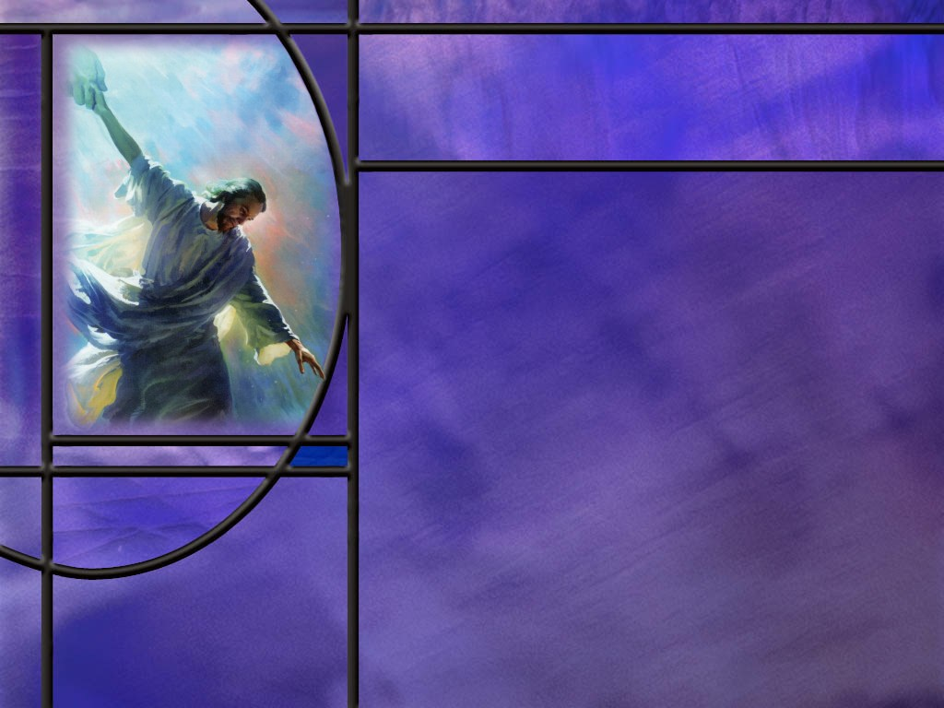
Overview
In Colossians 2, Paul calls his readers to live out the gospel that they have received: “Christ in you, the hope of glory.” In Christ, they are to be unified in love, find wisdom in Him, be rooted in Him, walk in Him, realize they are complete in Him. He warns them against false teachers that try to add to the all sufficiency of Christ and so compromise the gospel.
  Response to the gospel
  Complete in Him
  False teachers
  Summary

Slide 4
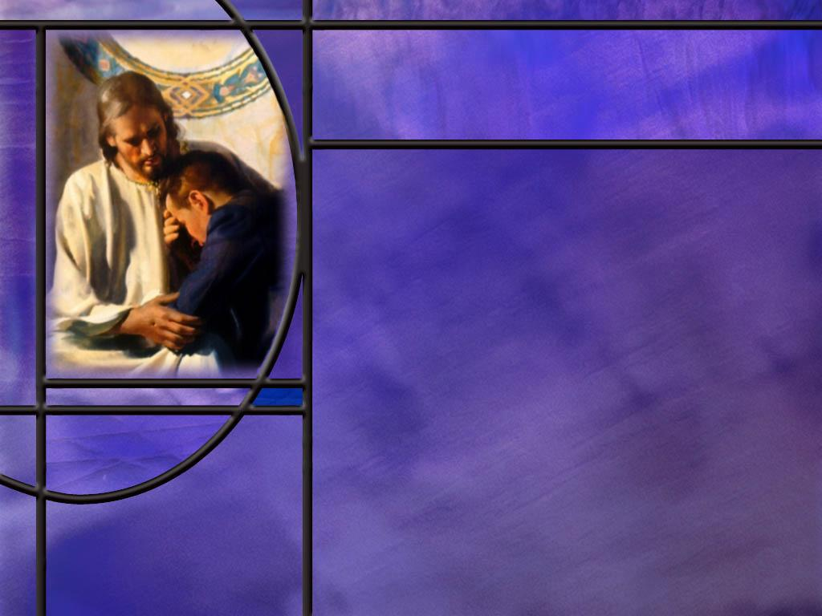
Response to the Gospel
What is Paul longing to see in the lives of the Colossian believers? (Col 2:1-3)
How should those who have received Jesus be living? (Col 2:6-7)
What warning does Paul give to keep Christians from trying to add anything to the gospel? (Col 2:8)
Notes:
B1:
[See notes on linked slide.]
B2:
[See notes on linked slide.]
B3:
[See notes on linked slide.]

Slide 5
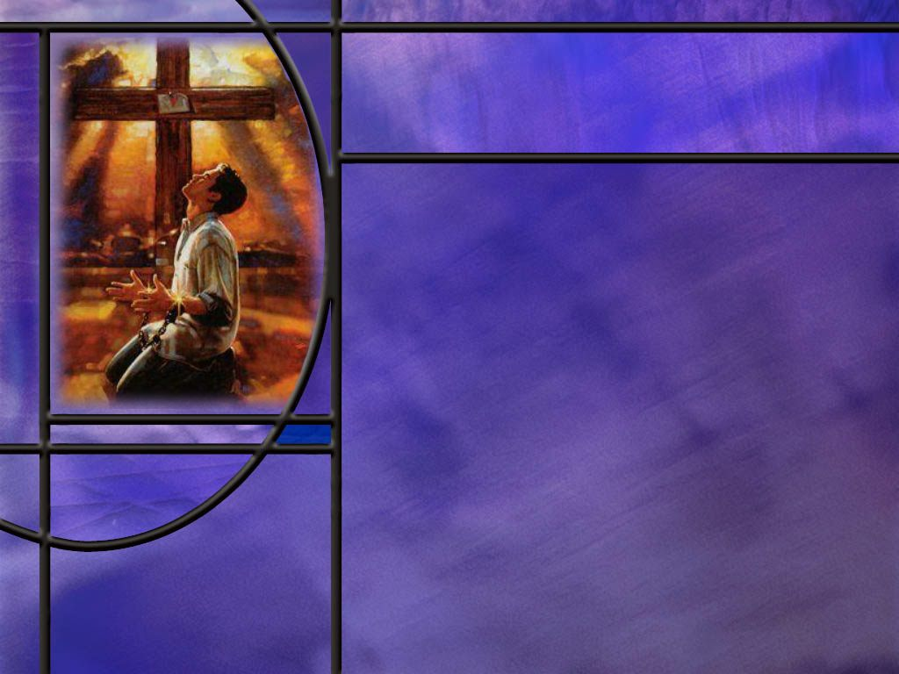
Complete n Christ
How does Paul point to the all-sufficiency of Christ for our salvation? (Col 2:9-10)
How does Paul explain what was nailed to the cross? (Col 2:13-14)
Notes:
B1:
B2:
[See notes on linked slide.]
B3:
B4:
[See notes on linked slide.]

Slide 6
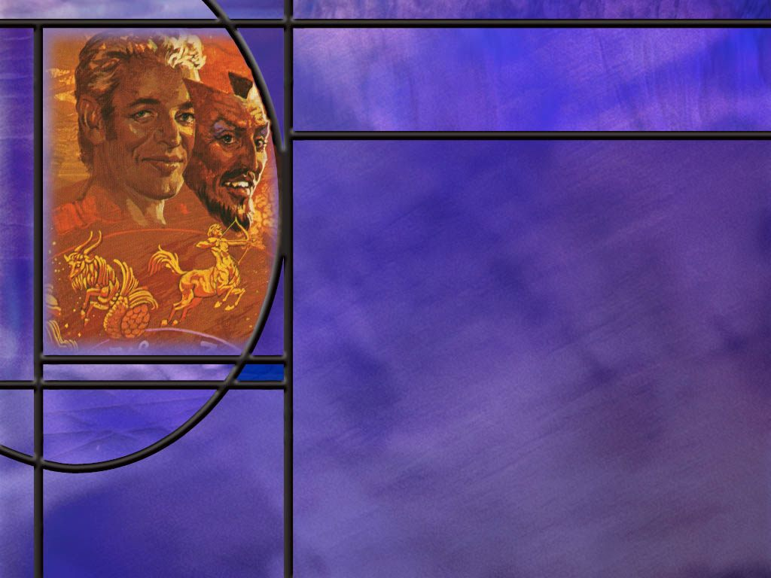
False Teachers
Where and how did Jesus defeat the principalities and powers of evil? (Col 2:15)
What issues arise for the traditional Adventist explanation of Col 2:16-17?
What further details does Paul give us on the false teachers of his day? (Col 2:20-23)
Notes:
B1:
[See notes on linked slide.]
B2:
[See notes on linked slide.]

Slide 7
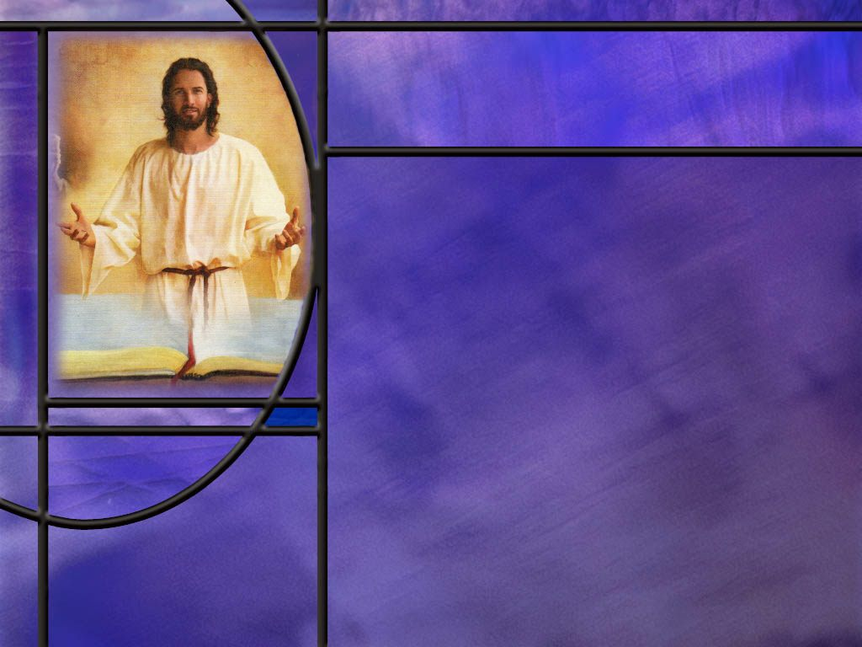
Summary
Paul’s goal in this letter is to encourage his readers to unite in love and know that Christ is all sufficient for their salvation.
Paul warns them against false teachers, some of which may be Gnostics that teach salvation through secret, experiential knowledge rather than through faith in Christ. Paul insists that all he treasures of wisdom and knowledge are hidden in Christ.
Paul encourages his readers to develop a loving, living, growing relationship with Christ as Savior and Lord.
He warns against human philosophies influenced by the spiritual powers of this world rather than divinely revealed truth in Christ.

Slide 8
Summary
Paul may be combating Gnostic philosophy when he declares that all the fulness of the Godhead dwells bodily in Christ and we are complete in Him.
He is able to save us to the uttermost by grace through faith.
What was nailed to the cross was not the law, as some try to teach, but the record of our sins. The whole context of the passage is the forgiveness of our sins and wiping out the record of our debt by dying on the cross for us.
Colossians 2:16 has caused some difficulties for Adventist to explain. Those who reject the Sabbath use this text to claim that Paul is doing away with the Sabbath along with the ceremonial law.

Slide 9
Summary
The traditional Adventist explanation of this text, that “Sabbaths” refers to the annual Levitical feast days can be criticized on several grounds.
A better approach may be to argue that Paul was not opposed to any of these celebrations and was not judging them for observing them.
It was the false teachers that were judging them for not keeping these celebrations according to their rigorous ascetic requirements. Paul’s point was that the false teachers were focused on meaningless shadows while the reality in every celebration should be centered in Christ.
Will you put Christ our Creator and Redeemer at the center of your Sabbath each week?

Slide 11
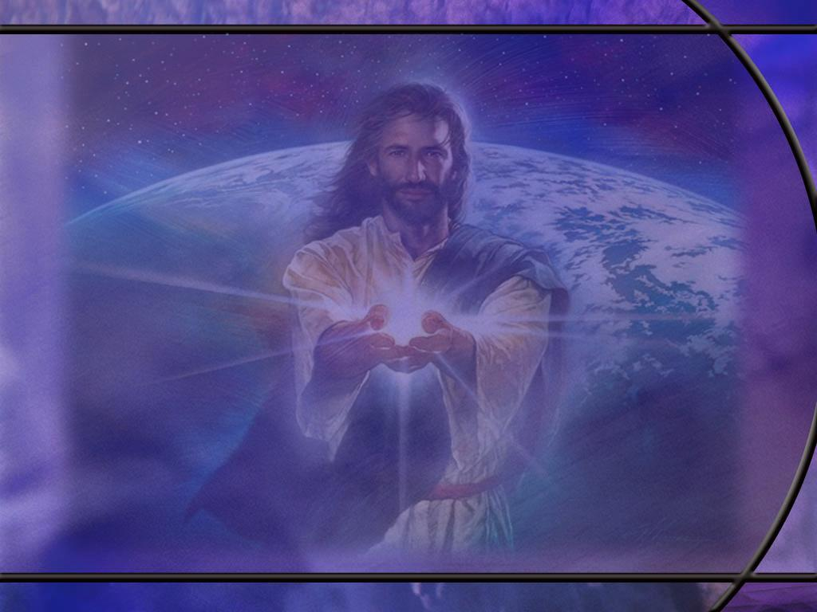
Isaiah 66:22-23 NIV
"As the new heavens and the new earth that I make will endure before me," declares the LORD, "so will your name and descendants endure. ²³ From one New Moon to another and from one Sabbath to another, all mankind will come and bow down before me," says the LORD. [R]
Notes:
Q1: What celebrations will endure in the new heavens and new earth?
1. It looks like we will be celebrating both the New Moon and the Sabbath in the kingdom.
2. Therefore, it very unlikely that Paul would intend to do away with them in our memory text in Colossians.

Slide 12
Colossians 2:1-3 NIV
I want you to know how hard I am contending for you and for those at Laodicea, and for all who have not met me personally. ² My goal is that they may be encouraged in heart and united in love, so that they may have the full riches of complete understanding, in order that they may know the mystery of God, namely, Christ, ³ in whom are hidden all the treasures of wisdom and knowledge. [R]
Notes:
Q1: What is Paul’s goal here in writing this letter?
1. First, he wants to encourage them and see them united in love for each other.
2. Second, he wants them to know Christ in a personal way.
3. As we ended chapter 1, he explained to them the mystery of God that had been hidden for ages past.
4. It was that the Gospel of salvation by faith in Christ was for the Gentiles too.
5. He put it in these words: “Christ in you the hope of Glory.”
6. Here again he mentions the mystery of God, saying it is Christ.
7. Christ, the Messiah, the Son of God, Jesus, is the center of the Gospel of salvation by grace through faith.
Q2: What kind of wisdom and knowledge is found in Jesus?
1. All the wisdom and knowledge we need in order to be saved and be reconciled to God is found in Christ.
2. Here it appears that Paul is countering the pagan beliefs of Gnosticism.
3. Here is a definition of Gnosticism from Perplexity AI”
“Gnosticism was a family of loosely related religious-philosophical movements in antiquity that emphasized salvation through secret, experiential knowledge (gnōsis) rather than through faith … alone.”
4. Here’s what the Gnostics believed about salvation:
“Salvation as gnōsis: Redemption comes not primarily by forgiveness of sin but by awakening—receiving secret, revelatory knowledge of one’s true divine origin and of the path back through the cosmic powers to the supreme God.”
5. Here in verse 3 and other verses in our study today, Paul is countering the Gnostic heresy that we need some kind of secret knowledge from the gnostic philosophers to be reconciled to God.
6. Paul declares that all the wisdom and knowledge we need for salvation and reconciliation with God is found in Jesus Christ.

Slide 13
Colossians 2:6-7 NIV
So then, just as you received Christ Jesus as Lord, continue to live your lives in him, ⁷ rooted and built up in him, strengthened in the faith as you were taught, and overflowing with thankfulness. [R]
Notes:
Q1: How does Paul describe the Christian life here?
1. Paul here is speaking about a living, loving, growing relationship with the Lord Jesus.
Q2: How did we first receive Christ Jesus as Lord?
1. We heard the good news of how He died for our sins, how He could forgive us by the blood He shed for us, and how we could have eternal life in His kingdom.
2. We loved Him because He first loved us.
3. We trusted Him and confessed our sins to Him and asked for forgiveness.
4. We received the Holy Spirit and were born again.
5. We were baptized as a public expression of our love for Jesus and our desire to live a life surrendered to Him.
6. And Paul is saying keep living that same relationship of love for Jesus and obedience to Him as Lord of your life.
7. Keep trusting in His merits and confessing your sins to Him.
8. Keep growing in grace and persevering in the faith.
9. Keep praising His name and giving Him thanks for all He has done.
10. Take time in the Word of God and time in prayer to commune with the Lord.
11. Sink your roots down and grow your relationship with Him.

Slide 14
Colossians 2:8 NLT
Don't let anyone capture you with empty philosophies and high-sounding nonsense that come from human thinking and from the spiritual powers of this world, rather than from Christ. [R]
Notes:
Q1: What is Paul warning against here?
1. He is warning against non-biblical philosophies about spiritual truth.
2. These may be the gnostic philosophies that we mentioned previously.
3. He says they come from human thinking rather than from biblical revelation.
4. He calls them high-sounding nonsense because they oppose biblical truth.
5. They come from the spiritual powers of this world rather than from Christ.
Q2: What kind of spiritual powers are of this world?
1. Satanic powers promoting doctrines of devils.
2. The Bible tells us of only one spiritual power that was cast to this earth.
3. It was Lucifer who rebelled in heaven.
Revelation 12:9 NKJV - So the great dragon was cast out, that serpent of old, called the Devil and Satan, who deceives the whole world; he was cast to the earth, and his angels were cast out with him.
4. So all the non-biblical philosophies of men find their origin in the spiritual powers of this world.
5. Satan has always been the great deceiver, and in Paul’s day, one of his deceptions was the gnostic heresy.

Slide 15
Colossians 2:9-10 NKJV
For in Him dwells all the fullness of the Godhead bodily; ¹⁰ and you are complete in Him, who is the head of all principality and power. [R]
Notes:
Q1: What do you think Paul means by saying we are complete in Christ?
1. Christ is all we need in order to be saved.
2. Nothing needs to be added to His sacrifice to make atonement for our sins.
3. We cannot be any more righteous than what we are by having His righteousness placed to our account.
4. When we are saved by Christ, we are completely saved.
5. The book of Hebrews says this:
Hebrews 7:25 NKJV - Therefore He is also able to save to the uttermost those who come to God through Him, since He always lives to make intercession for them.
6. Jesus saves to the uttermost and you can’t get more saved than that.
Q2: Could Paul also be opposing gnostic teaching here as well?
1. I think so.
2. First, if you are complete in Christ, you don’t need any secret knowledge as claimed by the Gnostics.
3. Second, all the fullness of the Godhead was present in Christ.
4. The Gnostics had some strange philosophies.
5. Again, from Perplexity AI, they believed:
Radical dualism: Spirit is good; matter is evil or at best a tragic mistake. The visible cosmos is not the good creation of the highest God but a realm of bondage and ignorance.
The demiurge: The material world is fashioned not by the supreme, hidden God, but by a lower, ignorant, or even malevolent creator (often identified with the God of Genesis) sometimes called the demiurge.
The supreme, hidden God and the plērōma: Above the demiurge stands the transcendent, unknowable God and a realm of divine emanations (aeons) called the plērōma (“fullness”)
6. “In Gnostic thought, the plerōma is the “fullness” of the divine realm, and the emanations (aeons) are the divine beings that collectively constitute that fullness.”
7. But here Paul is using the same word “fullness” (Pleroma in Greek) to describe Christ as having the fulness of the Godhead in bodily form.
8. So this seems to be a direct contradiction of the Gnostic philosophy.
9. The fulness of the most-high God is found in the physical body of Christ.

Slide 16
Colossians 2:13-14 NKJV
And you, being dead in your trespasses and the uncircumcision of your flesh, He has made alive together with Him, having forgiven you all trespasses, ¹⁴ having wiped out the handwriting of requirements that was against us, which was contrary to us. And He has taken it out of the way, having nailed it to the cross. [R]
Notes:
Q1: What has Christ done for those who have received Him as their Savior and Lord?
1. He has taken us from death to life.
2. (The uncircumcision of our flesh is just a figurative way of saying the sinfulness of our flesh.)
3. We were dead because of our trespasses and sins, having no hope of eternal life.
4. He has made us alive together with Him in His resurrection.
5. And He has done it by forgiving us for all our trespasses and sins.
Q2: What does Paul say has been nailed to the cross in verse 14?
1. The NKJV says “the handwriting of requirements” was nailed to the cross.
2. The KJV says: “the handwriting of ordinances.”
3. The NIV says: “the charge of our legal indebtedness.”
4. The ESV says: “ the record of debt that stood against us with its legal demands.”
5. The NASB says: “the certificate of debt consisting of decrees against us.”
6. People reading the KJV look at “the handwriting of ordinances” and think that is the law.
7. So, they conclude that Paul is saying here that the law was nailed to the cross!
8. But if you look at the context from verse 13, it is that Jesus has forgiven all of our trespasses.
9. He did that by taking our punishment for sin, not by nailing the law to the cross so there would be no law to condemn us!
10. So the modern translations are much better.
11. What was nailed to the cross was the record of our sins that condemned us.
12. They were forgiven by His shed blood on the cross.
13. In that sense, the record of our sin was nailed to the cross, taken care of by the death of Jesus for them.
14. The Greek word here is for handwriting is “cheirographon.”
15. This is the only place in the NT where it is used.
16. The late Adventist scholar, Dr. Sam Bacchiocchi writes:
“Recent research has shown that the term cheirographon was used to denote either a ‘certificate of indebtedness’ resulting from our transgressions or a ‘book containing the record of our sin’ used for the condemnation of mankind. Both renderings … can be supported from rabbinic and apocalyptic literature.”
17. So what God has nailed to the cross is the written record of our sins consisting of the decrees which we had broken and was the evidence against us.
18. Certainly, the record of our sins was hostile to us because it demanded our death.
19. But God removed it, crucified it, obliterated it, nailed it to the cross.

Slide 17
Colossians 2:15 ESV
He disarmed the rulers and authorities and put them to open shame, by triumphing over them in him. [R]
Notes:
Q1: Where did Christ win the victory over the forces of darkness?
1. Most translations of this verse say that it was by triumphing over them in the cross.
2. But if you look at the Greek, the triumph is “through Him.”
3. So, we may speculate here that it wasn’t just the cross, but the cross plus the resurrection.
4. The powers of darkness were only too happy to see Jesus suffer and die.
5. But the victory that put them to open shame was the resurrection.
6. That was the decisive event that guaranteed that the sacrifice was sufficient.
7. Christ’s blood was accepted for the forgiveness of sins, the price was fully paid, redemption was fully provided, and we have a living Savior to return to save us.
8. Satan has been defeated for all who will receive Jesus as Savior and Lord.

Slide 18
Colossians 2:16-17 ESV
Therefore let no one pass judgment on you in questions of food and drink, or with regard to a festival or a new moon or a Sabbath. These are a shadow of the things to come, but the substance belongs to Christ. [R]
Notes:
Q1: How have Adventists traditionally explained these verses in a way that maintains the validity of the weekly Sabbath?
1. The traditional explanation is that the festivals, the New Moons, and the Sabbath all refer to ceremonial laws.
2. The Sabbath can also be translated as sabbaths, and they would say these referred to the annual Levitical feast days.
3. All of these were shadows of things to come.
4. There are several problems with this explanation.
5. First, the annual Levitical feast days are already listed as “festivals.”
6. It is unlikely that Paul would refer to these both as festivals and sabbaths.
7. Second, in the Septuagint, the Greek translation of the OT, the word sabbath alone was never used to refer to the annual feast days.
8. These ceremonial sabbaths were always referred to as “Sabbath of Sabbaths.” (Sabbata Sabbaton in Greek)
9. Third, there is a progressive sequence in the words Paul uses here to cover the whole range of sacred days.
10. The festivals are annual days, the New Moons are monthly days, and Sabbath are weekly days.
11. Paul uses a similar sequence in Gal 4:10 but in reverse order:
Galatians 4:10 ESV - You observe days and months and seasons and years!
12. So for these reasons, the traditional explanation of this text is not based on the best hermeneutics.
Q2: Is it possible that Paul uses sabbath here as days in general as in Gal 4:10?
1. That is possible.
2. In Luke 24:1, Luke seems to use it this way in describing the day of the week that the women went to the tomb.
3. In English, the translation is “on the first of the week.”
4. But the Greek actually says, “on the first of the sabbaton”
5. We have exactly the same construction in Acts 20:7.
6. So, Paul could be using “sabaton” here as weekdays in general rather than the seventh day in particular.
7. So, these could refer to particular fast days of the week rather than to the Sabbath of the fourth commandment.
Q3: What would be a better explanation for Adventists on this passage.
1. I quote here from the Andrews Bible Commentary, p 1753:
“Paul is not opposed to keeping Sabbath, but to keeping it as an occasion to honor powers who have already been defeated by Christ and are not worthy of reverence. It is not the use of festivals new moon celebrations, or Sabbath that he decries, but their misuse.”
2. As Creator and Redeemer, Christ needs to be at the center of all of our religious celebrations and disciplines.
3. Adding ideas from philosophies already defeated by Christ are useless shadows while Christ is the ultimate reality of God’s saving grace.

Slide 19
Colossians 2:20-23 NLT
You have died with Christ, and he has set you free from the spiritual powers of this world. So why do you keep on following the rules of the world, such as, ²¹ "Don't handle! Don't taste! Don't touch!"? ²² Such rules are mere human teachings about things that deteriorate as we use them. ²³ These rules may seem wise because they require strong devotion, pious self-denial, and severe bodily discipline. But they provide no help in conquering a person's evil desires. [R]
Notes:
Q1: What seems to be the approach of the false teachers described here?
1. They are imposing a rigorous discipline on the people, saying they need to deny themselves and devote themselves more fully to God.
2. But the problem is that these instructions come not from the word of God, but from the spiritual powers of this world.
3. Perhaps this is Satan’s way of placing burdens on them that will discourage them and rob them of the joy and peace they have in Christ.
4. Paul is saying, “Consider the source!”
5. Christ has set you free.
6. Enjoy your freedom in Him.
7. You can’t beat your body into submission to kill its evil desires.
8. But you can trust in Jesus to deliver you from the penalty and the power of sin.
John 8:36 KJV - If the Son therefore shall make you free, ye shall be free indeed.

