Slide 1
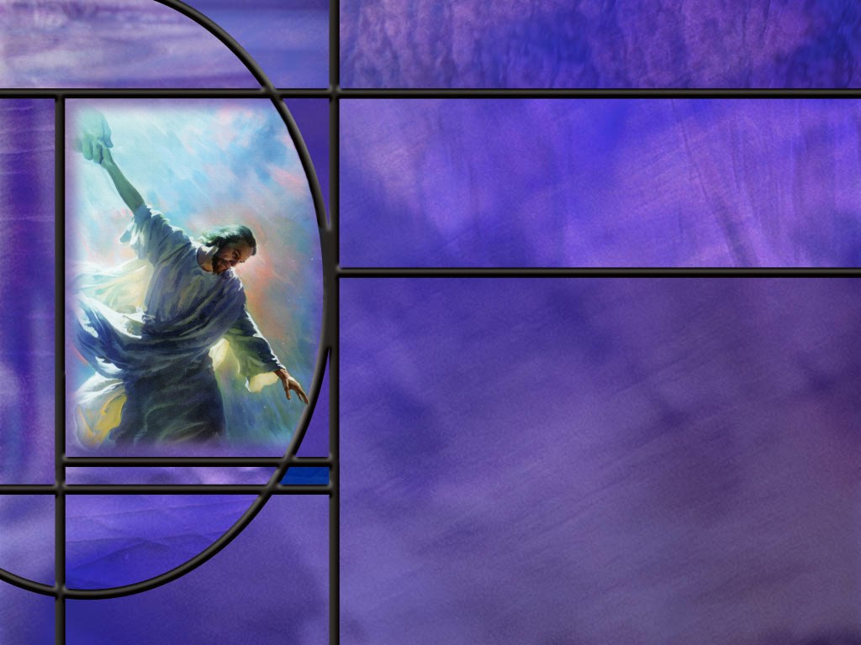
Uniting Heaven and Earth: Christ in Philippians and Colossians
Lesson 8
The Preeminence of Christ

Slide 2
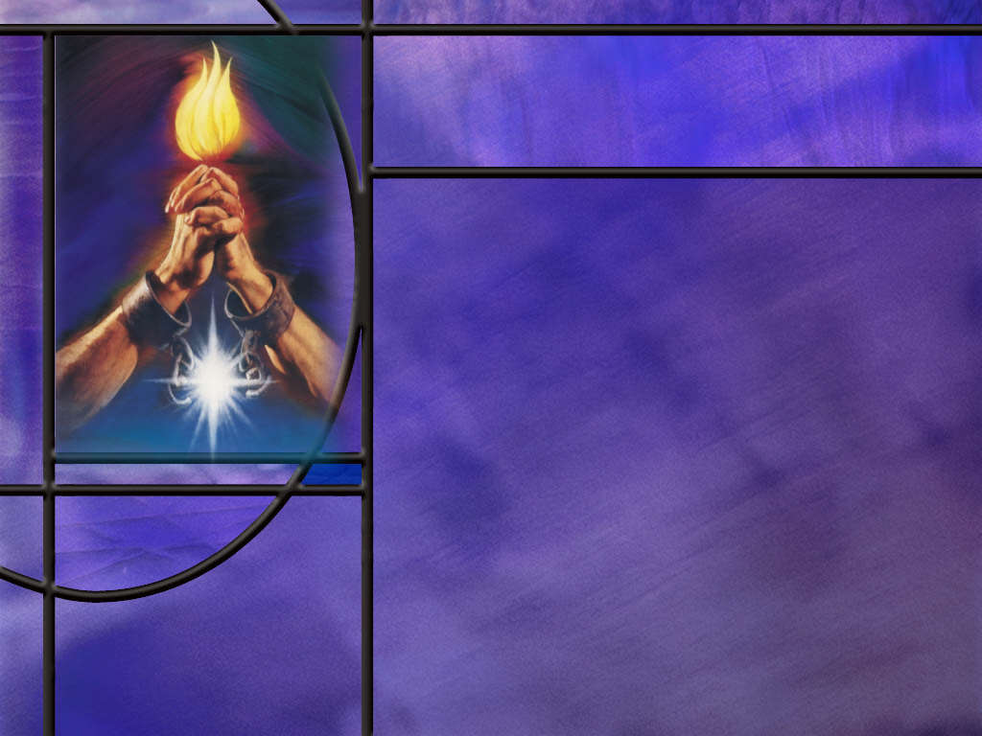
Memory Text
Colossians 1:13-14 ESV
He [God] has delivered us from the domain of darkness and transferred us to the kingdom of his beloved Son, ¹⁴ in whom we have redemption, the forgiveness of sins.
What three important things has the Godhead done for us according to this text?
What is the condition for being transferred from the kingdom of darkness to the kingdom of light?
Notes:
1. You may note that our lesson begins by discussing these verses in the introduction.
2. But the actual memory text comes in verses 15 – 17, which we will get to in our lesson study today.
3. We want to begin our lesson today with verse 13 of Colossians 1, so I have selected this alternate memory text for today.
4. And, indeed, it is a good text to memorize.
B2:
1. First, God has delivered us from the domain of darkness.
2. Whose domain is that?
3. It is Satan’s domain.
4. As sinners, that’s where we all start out.
5. All have sinned and fall short of the glory of God. (Rom 3:23)
6. And the wages of sin is death (Rom 6:23)
7. We start out as children or wrath, captives of Satan, held in the kingdom of darkness.
8. Paul describes our condition in:
Ephesians 2:3 ESV - …we all once lived in the passions of our flesh, carrying out the desires of the flesh and the mind, and were by nature children of wrath, like the rest of mankind.
9. Our condition was hopeless.
10. We could only look forward to the wrath of the omnipotent God and eternal death for our sins.
11. But, thank God, we have been delivered from Satan’s domain of darkness! Praise God!
12. What is the second important thing that God has done for us?
13. He has transferred us to the kingdom of His beloved Son.
14. Satan rules the kingdom of darkness; Jesus rules the kingdom of light, the kingdom of God, the kingdom of righteousness.
15. Could there be any greater change in our dwelling place?
16. Could there be any greater difference in our destiny?
17. From darkness to light; from hopelessness to assurance; from eternal death to eternal life!
18. Daniel 7 describes Jesus, the Son of Man coming to the Ancient of Days and receiving the kingdom.
Daniel 7:14 ESV - And to him was given dominion and glory and a kingdom, that all peoples, nations, and languages should serve him; his dominion is an everlasting dominion, which shall not pass away, and his kingdom one that shall not be destroyed.
19. Jesus , King of kings and Lord of lords, shall reign forever and ever.
20. What is the third thing the Godhead does for us?
21. He redeems us by forgiving our sins.
22. Here we see the amazing grace of God toward us sinners.
23. We deserve eternal death.
24. But God sends His only Son to take our sins and die the death we deserve.
25. He pays the price of redemption with His own life’s blood.
B3:
1. Take a look at verse 14: “In whom we have…”
2. The “in whom” there refers back to the One who has redeemed us: God’s beloved Son.
3. Again, the is Paul’s favorite expression for the redeemed: they are “in Christ.”
4. They have their sins forgiven by being in a saving relationship with Jesus.
5. The only way we can be transferred from the kingdom of darkness to the kingdom of light is to receive Jesus as our Savior and Lord, confess our sins, and ask Him to forgive us by His grace.
6. And the promise is:
1 John 1:9 ESV - If we confess our sins, he is faithful and just to forgive us our sins and to cleanse us from all unrighteousness.
7. When we are cleansed from all unrighteousness, we are justified and redeemed.
8. God adopts us as His Children and transfers us into His kingdom.
9. Hallelujah!!
10. Our greatest need is to have our sins forgiven.

Slide 3
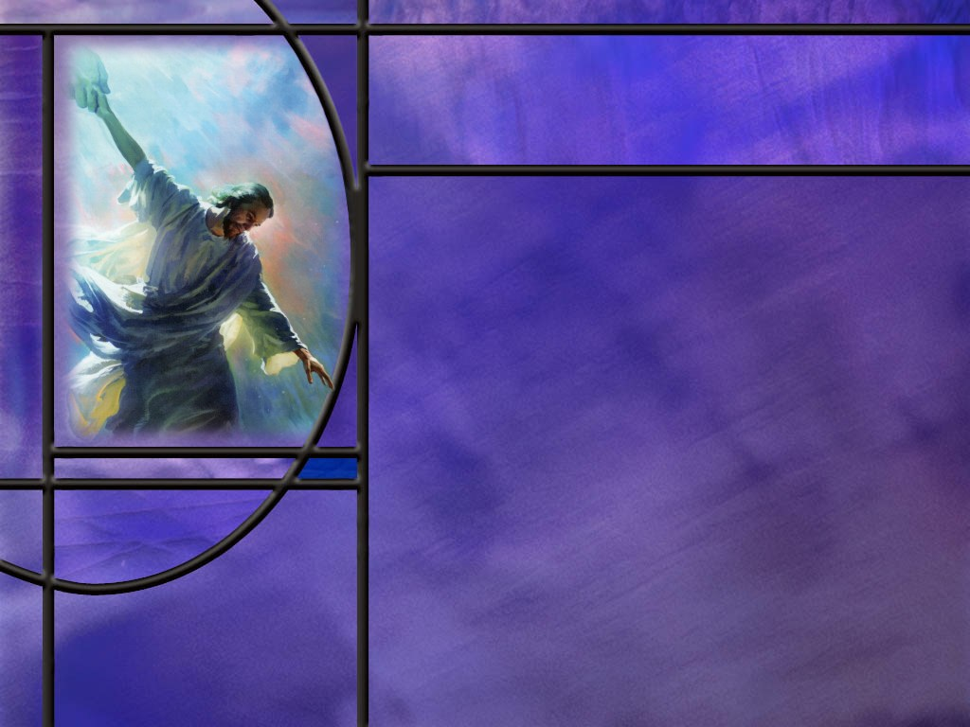
Overview
Our lesson this week presents a stunning picture of Jesus as both Creator and Redeemer the preeminent Son of God, head of the church, first fruits of the resurrection who will reconcile all things through His sacrifice on the cross.
  Christ the Creator
  Christ the Head
  Christ the Reconciler
  Summary

Slide 4
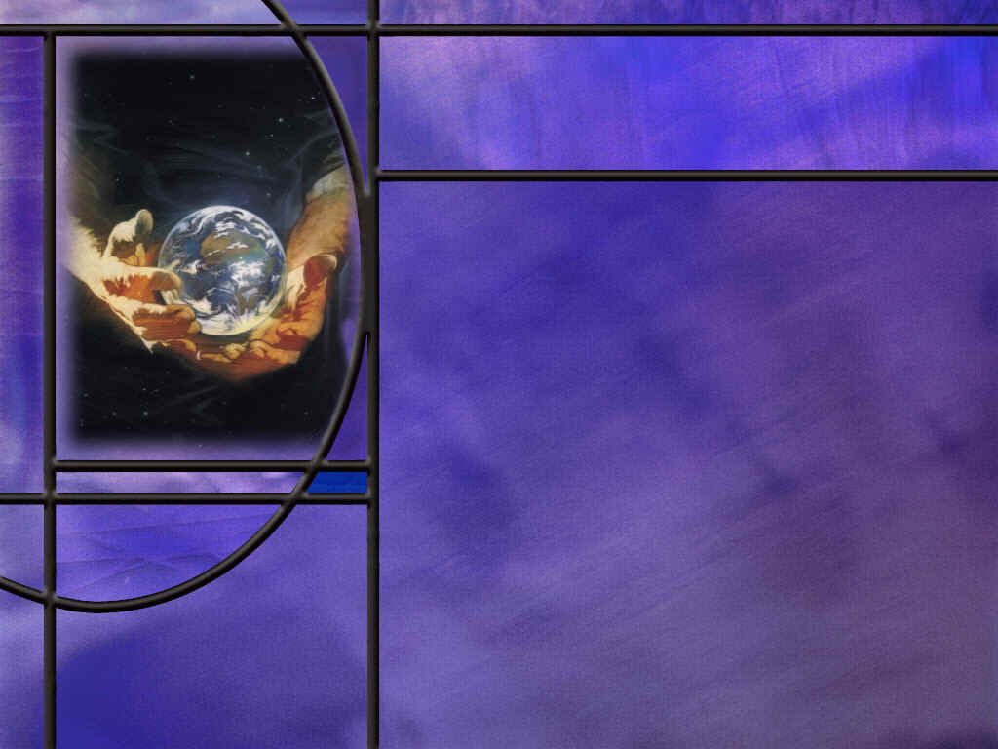
Christ the Creator
How does Paul begin his description of Christ as Creator? (Col 1:15)
For how much of creation was the Son responsible? (Col 1:16)
What final description does Paul give of Christ as Creator? (Col 1:17)
Notes:
B1:
[See notes on linked slide.]
B2:
[See notes on linked slide.]
B3:
[See notes on linked slide.]

Slide 5
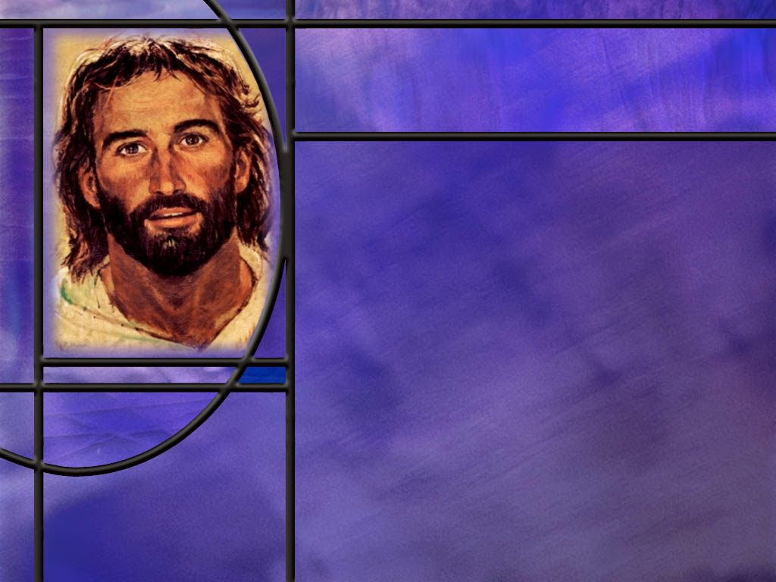
Christ the Head
Of what is “the body” supposed to be a metaphor?
What part of the body is Christ? (Col 1:18)
What are some of the practical implications of the doctrine that Christ is the head of the church and we are members of His body?
How else is Christ preeminent as the first fruits of a new humanity? (Col 1:18)
Notes:
B1:
1. The body is supposed to be a metaphor of the church.
2. This is Paul’s favorite metaphor for explaining the unity of the church despite the diversity of it’s members.
B2:
[See notes on linked slide.]
B3:
1. First, the body has only one head.
2. No person can claim that he is the head of the church: That is Christ’s position alone.
3. Christ did not appoint a vicar or a substitute for himself.
4. The title that the pope takes as “Vicar of Christ” is a title he assumes without biblical sanction.
5. His continuing use of this usurped title is an act of blasphemy against God.
6. No pope, no priest, no pastor, no elder, no prophet, no president of the General Conference can claim to be the head of the church.
Paul wrote:
1 Corinthians 3:11 (NASB)
¹¹ For no man can lay a foundation other than the one which is laid, which is Jesus Christ.
7. Second, it is the head, the brain, that defines and expresses the character of the whole body.
8. What is God’s most important relational characteristic? (Agape love.)
9. It is through His church that Jesus wants to continue to demonstrate His character of love to the world.
John 13:34-35 (NKJV)
³⁴ A new commandment I give to you, that you love one another; as I have loved you, that you also love one another. ³⁵ By this all will know that you are My disciples, if you have love for one another.”
10. Third, it is the head that directs the actions of the whole body.
11. Jesus continues to direct His church in the work He has called us to do.
12. When Jesus ascended to heaven He sent the HS to direct His church in mission and nurture.
13. It is through His Spirit that He continues to guide us as individuals and as a church.
14. Fourth, the head continues to feed and nourish the whole body.
Ephesians 5:29 (NKJV)
²⁹ For no one ever hated his own flesh, but nourishes and cherishes it, just as the Lord does the church.
15. One of the ways He does this is by giving spiritual gifts to members of the church “for the equipping of the saints for the work of ministry, for the edifying of the body of Christ,:
17. To edify means to build up.
18. We use our gifts in the church to build one another up in the faith.
19. Fifth, the head is the source of life for the entire body.
20. It is the head that makes the life of the body worthwhile.
22. When someone is on life support and they are brain dead, we mercifully pull the plug.
23. It is Christ the head that animates His body and gives them purpose, meaning, and direction in life.
24. Paul wrote:
Galatians 2:20 (KJV)
²⁰ I am crucified with Christ: nevertheless I live; yet not I, but Christ liveth in me: and the life which I now live in the flesh I live by the faith of the Son of God, who loved me, and gave himself for me.
B4:
[See notes on linked slide.]

Slide 6
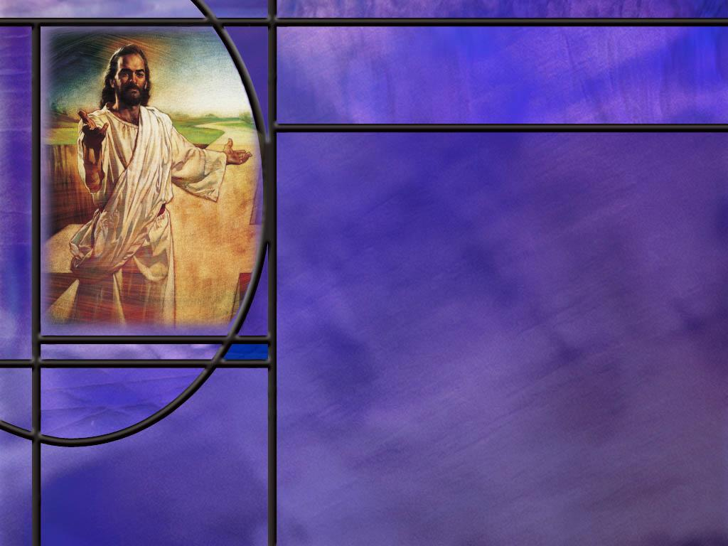
Christ the Reconciler
What does it mean to reconcile?
To whom does Paul point as the great Reconciler in this passage? (Col 1:19-20)
Notes:
B1:
1. Reconcile is to bring together two parties that are separated.
2. If two friends have a fight or an argument, they can reconcile by forgiving each other and being friends again.
3. Here ae some definitions from AI:
a. Restoring a broken relationship so that people become friendly again.
b. Settling a disagreement or dispute so that the conflict is resolved.
c. Making two things that seem different or opposed fit together.
B2:
[See notes on linked slide.]

Slide 7
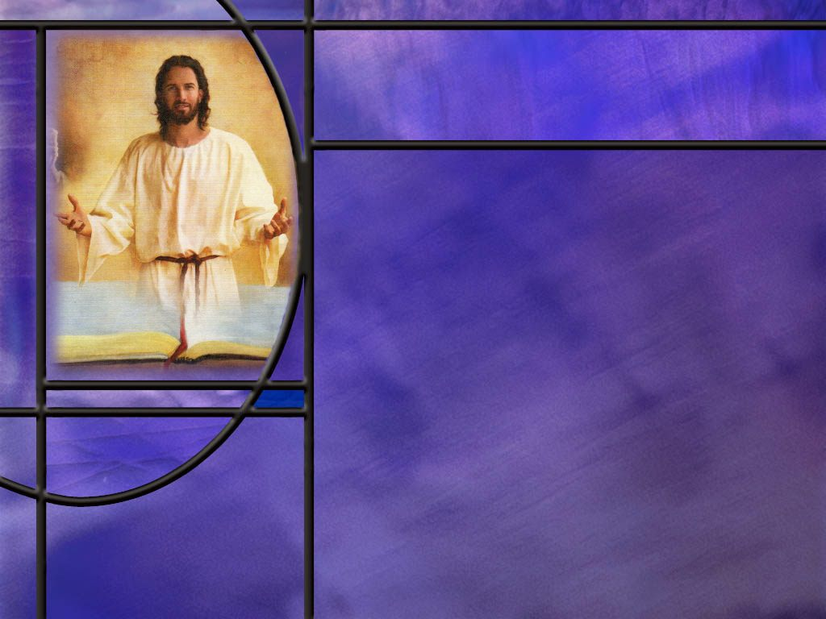
Summary
Paul introduces his word picture of Jesus with a description of the effect of His redemption: It delivers us from the kingdom of darkness and transfers us to the kingdom of Christ.
Nothing could be more important than that transfer in making a success of our lives.
Paul gives us a striking description of Christ as Creator.
As the image of the invisible God, Christ manifested the character of God.
As the firstborn over creation, Christ is the preeminent power to bring it about.
His divinity and authority are affirmed by declaring that all the fulness of God was pleased to dwell in Him,

Slide 8
Summary
Paul then declares that all things were made by Him and for Him.
As Creator, He is before all things in time and importance, and in Him, all things hold together, perhaps a reference to the design and fine tuning required to make the physical universe work.
Paul rounds out his description of Christ as the Redeemer who reconciles us to God.
Not only is He preeminent in creation but also in salvation.
He is the head of the church, His body, redeemed by His shed blood.
Since the head of the body is the source of planning, direction, character, nourishment, and life, so Christ provides these things for His church.

Slide 9
Summary
Christ is also the preeminent firstborn from the dead, making Him a living Savior who, at His coming, will be the resurrection and the life for all those who believe.
Sin has separated us from God, and It is through Christ and the blood of the cross that God reconciles all things to Himself.
When we are justified by faith, we have peace with God, our sins are forgiven, we are reconciled to God, we are no longer enemies, we are transferred from the domain of darkness into the Kingdom of Christ, we are adopted as children of God.
Having seen this beautiful picture of Christ as our Creator and Redeemer, will you seek to walk closer to Him this week, growing in love for the one who has created you and redeemed you?

Slide 11
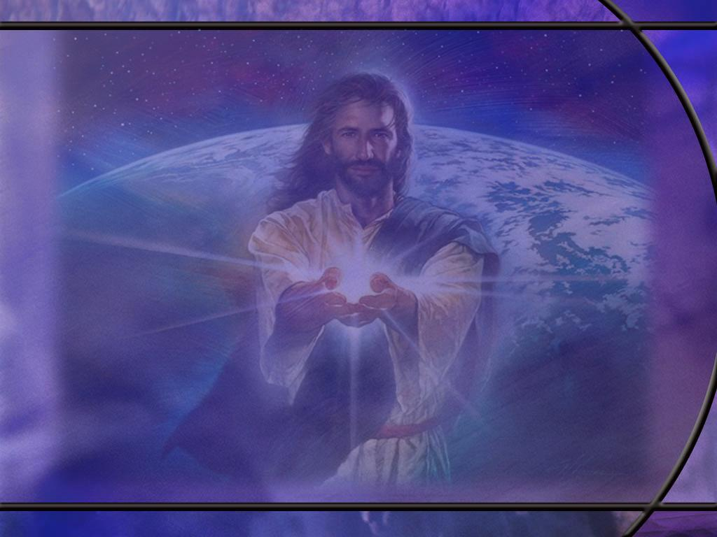
Colossians 1:15 ESV
He is the image of the invisible God, the firstborn of all creation. [R]
Notes:
Q1: How is Jesus Christ the image of the invisible God?
1. Jesus was the Son of God who took on human flesh in the incarnation.
2. The apostle John told the woman at the well:
John 4:24 ESV - God is spirit, and those who worship him must worship in spirit and truth.“
3. If God is spirit, He is, in essence, non-physical, so He is invisible to our eyes.
4. But Jesus, as God’s Son, was the physical manifestation of God the Father.
5. How did Jesus express His relationship to the Father?
John 10:30 KJV - I and my Father are one.
John 14:9 KJV - he that hath seen me hath seen the Father; and how sayest thou then, Shew us the Father?
6. And when John described Jesus as the Word he ends by saying:
John 1:18 ESV - 18 No one has ever seen God; God the only Son, who is in the Father’s bosom, he has made him known.
7. So, we see in Jesus the character of God the Father, the invisible God.
Q2: What does Paul mean by describing Jesus as the “firstborn of all creation?”
1. Does that mean He was the first to be created?
2. If so, that would make Him a created being instead of God.
3. The apostle John insists in the very first verse of his gospel:
John 1:1-3 ESV - 1 In the beginning was the Word, and the Word was with God, and the Word was God. ² He was in the beginning with God. ³ All things were made through him, and without him was not any thing made that was made.
4. The NT description of Jesus is that He is the incarnation of the Son of God who existed from all eternity with the Father as God.
5. So here we must understand the firstborn of all creation as describing, not the origin of Christ but His preeminence and position.
6. The firstborn in Hebrew thought was the preeminent son who caried the authority and honor of the family into future generations.
7. Christ as the “firstborn of all creation” affirms His importance and supreme position over all creation.

Slide 12
Colossians 1:16 ESV
For by him all things were created, in heaven and on earth, visible and invisible, whether thrones or dominions or rulers or authorities--all things were created through him and for him. [R]
Notes:
Q1: How much was created by the pre-incarnate Christ?
1. All things in heaven and on earth.
2. If we think of heaven as the dwelling place of God, it would include all the angels and other beings in heaven.
3. Specifically, the verse says things visible and invisible, covering both the physical and spiritual realms.
4. A footnote on the second word of this verse, “by” indicates that the original Greek means “by means of.”
5. This agrees with the closing words of the verse that says that “all things were created through Him.”
Q2: How do the Jehovah Witnesses get around this verse?
1. They claim that Christ was the first created being who created everything else.
2. But this verse says that Christ created all things that were created.
3. If Christ was created, as they believe, they would have to exclude Him from the “all things” that were created.
4. So, in their New World Translation they insert the word “other” into the translation where it is not found in the Greek.
5. For example, they translate this verse as beginning this way: “By means of him, all other things were created.”
6. That’s not what the verse says in the original Greek.
Q3: What do you suppose Paul means by saying all things were created “for Him?”
1. That’s an amazing thought!
2. All things, including this universe, were created for Christ, the Son of God.
3. So He is the central Person that the whole creation revolves around.
4. He is the active agent in its creation and the active agent in its destiny.
5. Christ is the unifying Person tying together all creation and bringing it into unity with the plans and purposes of God.
6. Here’s what Paul wrote in:
Ephesians 1:10 ESV - [God’s] plan for the fullness of time, to unite all things in Christ, things in heaven and things on earth in him.

Slide 13
Colossians 1:17 ESV
And he is before all things, and in him all things hold together. [R]
Notes:
Q1: What does it mean that Christ is before all things.
1. Since Christ is co-eternal with the Father, He is before all things in the order of creation.
2. Since He created all things, He must have existed before anything else was created.
3. So, first, He is before all things in time.
4. But we can also understand this in another way.
5. He is before all things in order of importance.
6. Nothing that was created is greater than the Creator who created it.
7. There is nothing in all creation that exceeds the value of the One who created it all.
Q2: What do you think he means by saying all things hold together in Him?
1. There are several things that Paul may mean by this.
2. First, if we look at the physical universe, it is amazing that it exists rather than that nothing exists.
3. It had to be created with amazing precision in order for it not to fly apart or collapse in on itself.
4. Our Creator has ordained the laws of physics and balanced the physical constants of the universe on a knife edge that it might exist in time and space.
5. Based on our current physical models, there are about 30 physical constants that must be specified.
6. About a dozen of these must be precisely fixed or the universe and life does not exist.
7. For example, here’s what AI told me:
Typical fine‑tuning estimates say gravity [the gravitational force constant] must lie within roughly 1 part in ${10}^{40}$–${10}^{50}$ of its present value for long‑lived, life‑permitting structure to exist, assuming other parameters are held fixed.
8. How small is one part in 10⁵⁰?
9. It is 1 divided by the number one with 50 zeroes after it.
10. Other constants like the cosmological constant must be fine tuned and precise to even a much smaller tolerance.
11. This required precise tolerance for these physical constants is evidence of an intelligent Designer who created the universe to be stable and support life.
12. So, in this sense Christ created all things in a way that they hold together and exist for times sufficient for history to unfold.
13. A second possible meaning is that Christ is the unifying factor that unites all of creation.
14. Going back to Eph 1:10: God’s plan is to unite in Christ all things in heaven and earth.
15. This is the goal to which we are moving according to God’s plan.
16. And the only way we can be part of that plan is to be “in Him” and have our sins forgiven.

Slide 14
Colossians 1:18 ESV
And he is the head of the body, the church. He is the beginning, the firstborn from the dead, that in everything he might be preeminent. [R]
Notes:
Q1: What is Christ’s relationship to His church in this verse?
1. He is the head of the body.
2. Paul uses the body metaphor in Romans 12 and 1 Corinthians 12.
3. But here in Colossians and also in Ephesians, He specifically places Christ at the head of the body.
4. In Ephesians he writes:
Ephesians 4:15-16 ESV - Rather, speaking the truth in love, we are to grow up in every way into him who is the head, into Christ, ¹⁶ from whom the whole body, joined and held together by every joint with which it is equipped, when each part is working properly, makes the body grow so that it builds itself up in love.
5. Here again, Christ is the head which directs the body to make it grow in love.

Slide 15
Colossians 1:18 NKJV
And He is the head of the body, the church, who is the beginning, the firstborn from the dead, that in all things He may have the preeminence. [R]
Notes:
Q1: Looking at the second part of this verse, how else is Jesus the preeminent One?
1. He is not only the firstborn over all creation as Paul states in Col 1:15, He is the firstborn from the dead by virtue of His resurrection.
2. Paul calls Him the first fruits of the resurrection:
1 Corinthians 15:20-23 NKJV - But now Christ is risen from the dead, and has become the firstfruits of those who have fallen asleep. 21 For since by man came death, by Man also came the resurrection of the dead. 22 For as in Adam all die, even so in Christ all shall be made alive. 23 But each one in his own order: Christ the firstfruits, afterward those who are Christ's at His coming.
3. So Christ is preeminent as the firstborn over all creation and firstborn of the new creation of those who are raised when He comes back.
4. He is the head of a new humanity called out by faith in Him.
5. As in Adam all die, even so, in Christ shall all be made alive.
6. The resurrection of the just at His coming is only for those saved by grace through faith.
7. It is only because of the resurrection of Christ that we can look forward to our own resurrection.
8. Without His resurrection, we have a dead Savior, our faith is in vain, we are yet in our sins, those who have died are perished, we have no hope.
Q3: What about Moses? Wasn’t he resurrected before Christ?
1. He appeared with Elijh on the Mt. of Transfiguration, and his resurrection is alluded to in the book of Jude.
2. But our resurrection does not depend on that of Moses.
3. In fact, Moses’ resurrection depends on that of Jesus too.
4. If Christ did not rise, Moses would have to perished in his sins along with Elijah.
5. It is Christ’s resurrection that makes every other resurrection of the redeemed possible.
6. In creation and recreation, Christ is preeminent, the head, the source of life, the life giver.

Slide 16
Colossians 1:19-20 ESV
For in him all the fullness of God was pleased to dwell, ²⁰ and through him to reconcile to himself all things, whether on earth or in heaven, making peace by the blood of his cross. [R]
Notes:
Q1: How does Paul describe Jesus here in verse 19?
1. All the fulness of God was pleased to dwell in Christ.
2. Here we have another statement of the divinity and authority of Christ.
3. He fully represented the character of God and fully obeyed His Father’s will.
4. In Jesus we see God’s glory, His name and character on display.
5. In John’s description of the incarnation, he writes:
John 1:14 ESV - And the Word became flesh and dwelt among us, and we have seen his glory, glory as of the only Son from the Father, full of grace and truth.
Q2: Why did God need to reconcile all things to Himself?
1. Something separated us from God. What was it? (Sin)
2. Isaiah writes:
Isaiah 59:2 KJV - 2 But your iniquities have separated between you and your God, and your sins have hid his face from you, that he will not hear.
Romans 8:7 KJV - 7 Because the carnal mind is enmity against God: for it is not subject to the law of God, neither indeed can be.
James 4:4 KJV - 4 Ye adulterers and adulteresses, know ye not that the friendship of the world is enmity with God? whosoever therefore will be a friend of the world is the enemy of God.
3. Sin separates us from God and makes us enemies, so to speak, that need to be reconciled.
4. We are by nature children of wrath; we need to become children of God.
Q3: How does God reconcile us to Himself?
1. This verse says that Christ makes peace by the blood of His cross.
2. Paul expands on this in Romans 5:
[Go to next slide.]

Slide 17
Romans 5:1,10 KJV
Therefore being justified by faith, we have peace with God through our Lord Jesus Christ:
For if, when we were enemies, we were reconciled to God by the death of his Son, much more, being reconciled, we shall be saved by his life. [R]
Notes:
Q1: According to Rom 5:1, how does Christ make peace with God through the blood of His cross?
1. It is when we are justified by faith that we have peace with God.
2. Justified means “just-as-if-I had not sinned.”
3. Justification is being declared not guilty in the courts of heaven.
4. We are justified by faith in Jesus for the forgiveness of our sins.
5. We receive Him as our Savior and Lord, repent and confess our sins, and trust in His shed blood to cover them and forgive them.
6. When we do that, we have peace with God rather than His wrath.
7. We are adopted into His family.
8. We are transferred from the kingdom of darkness to His kingdom of grace.
9. And we can look forward to being ushered into His kingdom of glory when He returns to save us.
1. Paul describes our being reconciled to God further in verse 10.
[click here for second verse on slide.]
2. When we are reconciled to God, we are no longer enemies but friends.
3. Through the doing and dying of Jesus, we have peace with God, we are reconciled to God, and we are saved when the resurrected living Christ returns for us.

