Slide 1
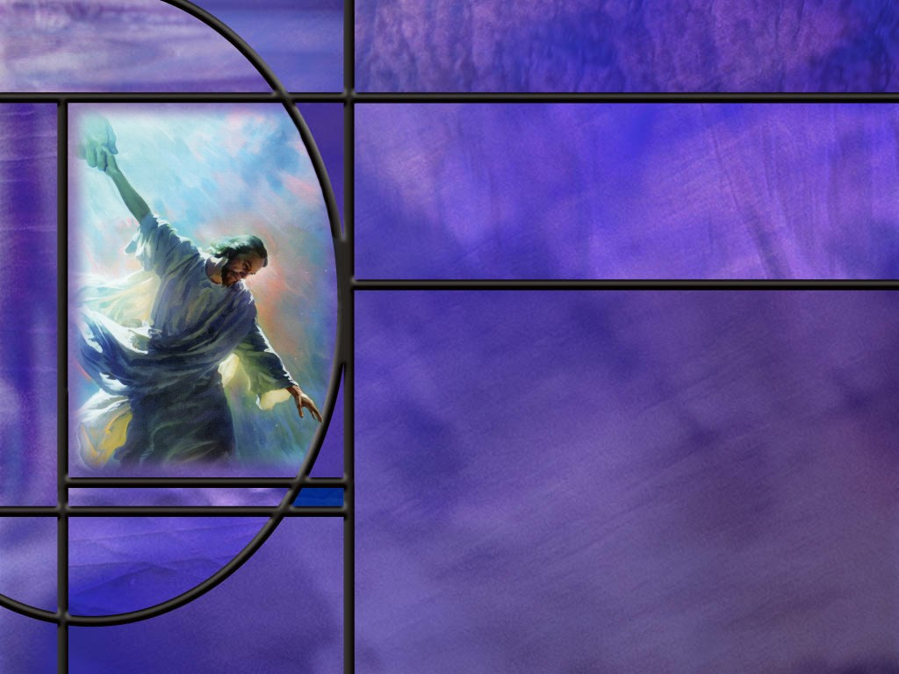
Uniting Heaven and Earth: Christ in Philippians and Colossians
Lesson 5
Shining as Lights in the Night

Slide 2

Memory Text
Philippians 2:14-15 NKJV
Do all things without complaining and disputing, ¹⁵ that you may become blameless and harmless, children of God without fault in the midst of a crooked and perverse generation, among whom you shine as lights in the world.
How much should we do without complaining and disputing?
What can we do instead of complaining and arguing about things that upset us?
What reason does this verse give us for not complaining?
Notes:
B2:
1. Paul’s instruction to the Philippians is to do ALL THINGS without complaining and disputing.
2. The KJV says:
Philippians 2:14 KJV - Do all things without murmurings and disputings:
3. The NIV says:
Philippians 2:14 NIV - 14 Do everything without grumbling or arguing,
4. Having just studied the book of Exodus, who comes to mind when you think of people who had a proclivity from murmuring, grumbling, and complaining?
5. We think of the Children of Israel in rebellion against the Lord and against Moses.
6. “Why have you brought us out here into the wilderness to kill us? Let’s choose a different leader and go back to Egypt.”
7. The Lord was always displeased with their grumbling and complaining.
8. If you look for things to complain about, will you find them? (Absolutely.)
9. We can complain about the weather, about our job, about our boss, about our co-workers, about our spouse, about our children, about the price of food, and gas and fuel oil, about our schools, and about our government and our political adversaries.
10. I confess that I have frequently complained about the amount of taxes I have to pay.
11. We can even complain about our church and our leadership and our pastor and our fellow members and worshippers. (Let’s hope that doesn’t happen here!)
12. If you look for things to complain about, you will be sure to find them.
13. In addition, if we are looking for an argument, we will be sure to find that too.
14. Arguments lead to division and disunity, hurt feelings, and bruised relationships.
15. Rather than disputings and arguments, we want to see love and unity and agreement in our church, our families, and our workplaces.
16. Let’s remember Paul’s advice earlier on in this chapter:
Philippians 2:3 NIV - Do nothing out of selfish ambition or vain conceit. Rather, in humility value others above yourselves,
B3:
1. We have a Friend to whom we can take our burdens and complaints.
What a Friend we have in Jesus!
All our sins and griefs to bear.
What a privilege to carry,
Everything to Him in prayer!
2. In a few weeks, we will come to this wonderful verse in Phil 4:6
Philippians 4:6 NLT - Don't worry about anything; instead, pray about everything. Tell God what you need, and thank him for all he has done.
3. Do you have a complaint? Don’t grumble about it! Take it to the Lord in prayer.
B4:
1. Being a prayer warrior rather than a complainer is a way of letting our light shine in the darkness.
2. Paul encouraged them and us to shine in this world of darkness.
3. Jesus told us to do the same in the Sermon on the Mount.
4. Do you remember His words?
Matthew 5:16 KJV - Let your light so shine before men, that they may see your good works, and glorify your Father which is in heaven.
5. We fulfill our mission in life by bringing glory to God.
6. The chief end of man is to glorify God and enjoy Him forever.
7. And we glorify God when we live as His children, and point to Him as the source of all that is good in our lives.

Slide 3
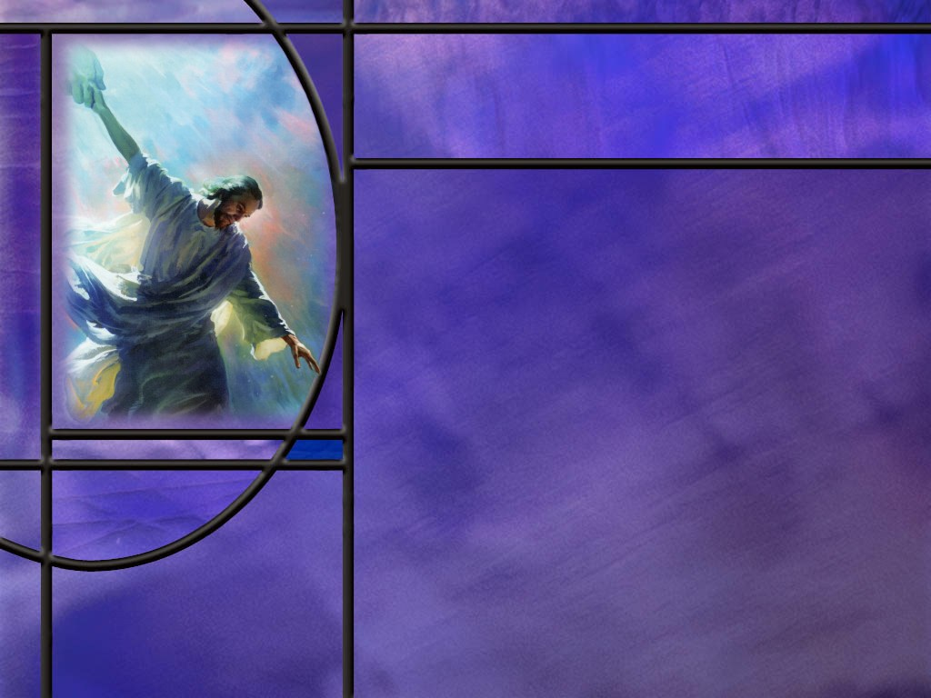
Overview
In our lesson this week Paul calls the Philippians to holy living that magnifies the contrast between the redeemed and the lost, to make their lives living sacrifices pleasing to God. He also encourages them to receive in Christian love two fellow workers in the gospel.
  Living Lights
  Living Sacrifices
  Fellow Gospel Workers
  Summary

Slide 4

Living Lights
In view of what God has done for us in Christ, How does Paul encourage them to live? (Phil 2:12-13)
What kind of lives will be produced by following the example of Christ? (Phil 2:14-15)
Where did the spirit of murmuring and disputing originate?
Notes:
B1:
[See notes on linked slide.]
B2:
[See notes on linked slide.]
B3:
1. We can trace this spirit back to the start of the Great Controversy when war broke out in heaven.
2. There was iniquity that arose in the heart of Lucifer who became proud and coveted the position of God and the worship He alone deserved.
3. Can you imagine the amount of murmuring and grumbling that went on there to convince one third of the angels to follow Him in rebellion against God?
4. Some people today who claim to be Christians think they have to be always complaining and grumbling.
5. They may think they have the “gift of complaining,” and they are always exercising it.
6. The gift of complaining is NOT a gift of the Holy Spirit! (It may be the gift of another spirit)
7. Where does the gift of complaining come from?
8. It comes from feelings of discontent and dissatisfaction with life.
9. Discontent identifies us with Satan who was discontent with his position in heaven.
10. He was the first grumbler, complainer, and murmurer, spreading discontent in heaven.
11. How much better to be “children of God,” spreading peace, joy, and contentment in our relationship with the Lord and others.
[See notes on linked slide.]

Slide 5
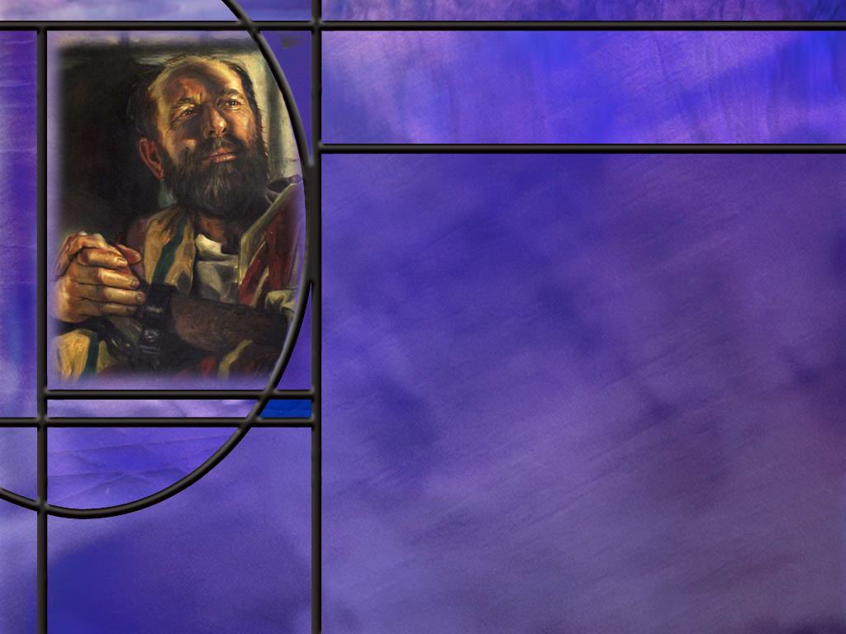
Living Sacrifices
How does Paul again stress the importance of persevering in the faith? (Phil 2:16)
What metaphor does Paul use for a life surrendered to the Lord Jesus? (Phil 2:17)
What did Paul write to the Romans about becoming living sacrifices? (Rom 12:1-2)
Notes:
B1:
[See notes on linked slide.]
B2:
[See notes on linked slide.]
B3:
[See notes on linked slide.]

Slide 6
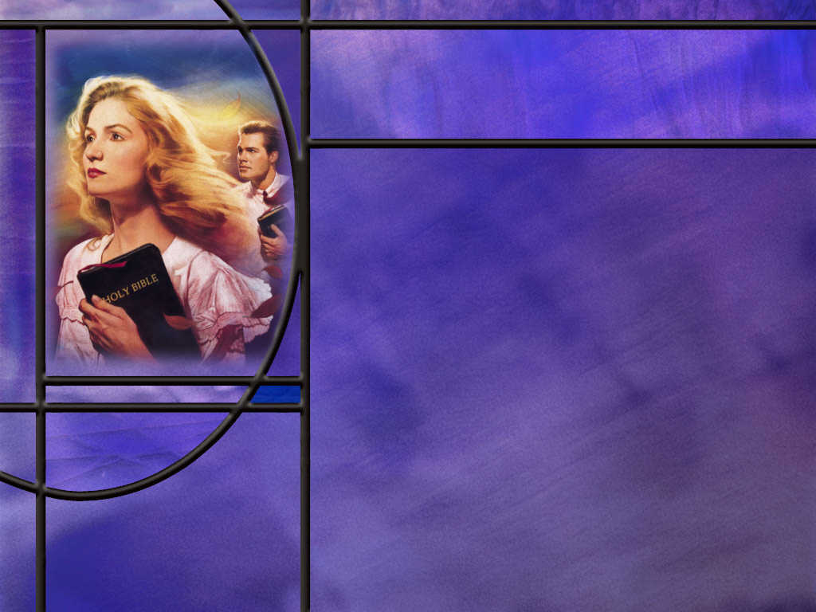
Fellow Gospel Workers
What plans does Paul have for Timothy to visit the church at Philippi? (Phil 2:19,23-24)
Who was Epaphroditus and what plans did Paul have for him? (Phil 2:25-26,29-30)
Notes:
B1:
[See notes on linked slide.]
B2:
[See notes on linked slide.]

Slide 7
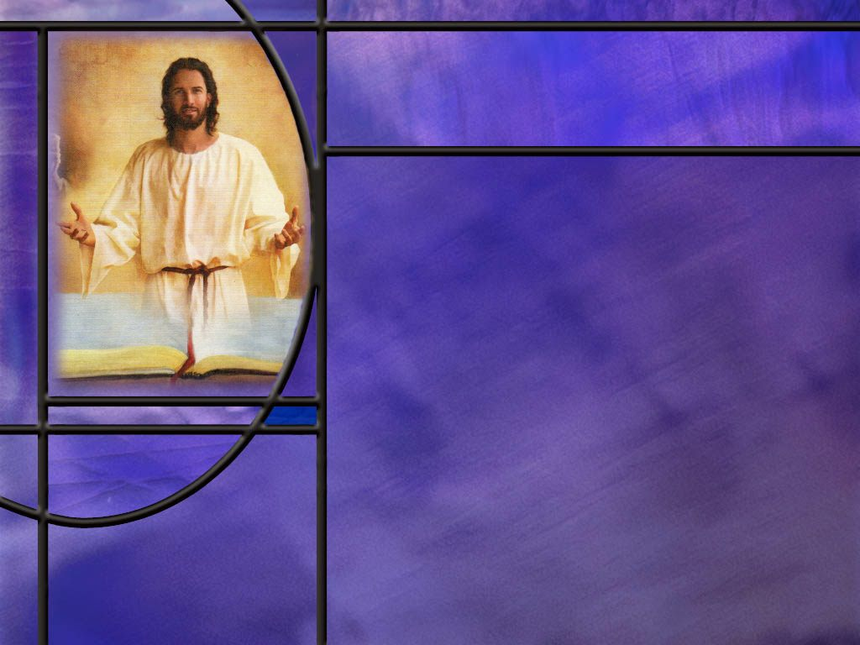
Summary
In view of Christ’s humble condescension, from God to crucified criminal, Paul urged his readers to follow Christ’s example and live holy lives.
When he urges them to work out their own salvation, he is not suggesting that they can be saved by works. Rather he is instructing them to persevere in faith.
We are saved by grace through faith. Grace is God’s part; Faith is our part. God sends Jesus to die for our sins; we trust His shed blood for forgiveness and salvation.
We can only work out our own salvation by continuing to trust in Jesus and hold on to our saving relationship with Him. Our faith must persevere to the end.

Slide 8
Summary
The apostle says it in other words in verse 16: “Hold firmly to the word of life.” Don’t let go of Jesus and the gospel of salvation in Him.
If we follow Christ’s example of love and humility, complaining and arguing will be left behind and His character traits of being blameless, pure, and without fault will begin to grow, so that we can shine as His lights in this dark world.
Paul reminds us that God is at work in the hearts of believers leading them to understand His will and giving them the power to do it through the Holy Spirit.
Paul reaffirms his belief in the unconscious state of the dead by declaring he will only know if his work of saving souls was a success or failure when Christ returns.

Slide 9
Summary
Paul uses the sacrifice metaphor to represent giving his own life for Christ, but looks at the faith of the church as a living sacrifice that would continue to spread the Gospel.
Paul’s famous charge to the Christians at Rome was for them to offer themselves to God as living sacrifices, dying to self to live unto Christ.
Paul had plans to send Timothy to Philippi shortly Epaphroditus immediately, and to come himself eventually. He wanted to make sure his fellow workers were well received and welcomed with love, joy and honor.
Will you hold firmly to the word of life this week so that you can anticipate being welcomed into the Kingdom with love, joy, and honor?

Slide 11
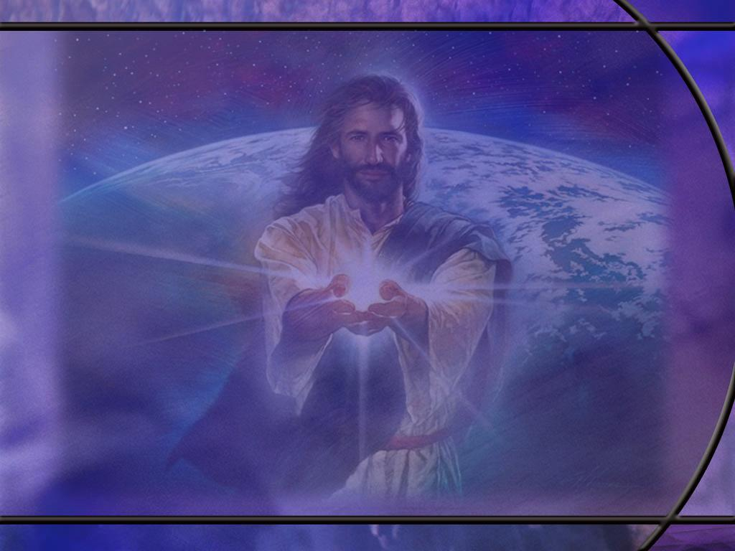
Philippians 2:12-13 ESV
Therefore, my beloved, as you have always obeyed, so now, not only as in my presence but much more in my absence, work out your own salvation with fear and trembling, ¹³ for it is God who works in you, both to will and to work for his good pleasure. [R]
Notes:
Q1: What is the “therefore” there for?
1. This “therefore” points back to the previous section of Scripture that we studied last week.
2. It was Paul’s call for love and unity based on humility and pointing to Jesus as our great example of humility.
3. He humbled Himself by stepping down from His position in heaven as God and taking on the form of a servant and dying for our sins.
4. With this example in mind, he calls them to holy living.
Q2: What do you think Paul means by “as you have always obeyed?”
1. First, we may be thinking of their obedience to the commandments of God.
2. But here, it may refer back to the example of Christ who was obedient in all He did.
3. If we go back a few verse to Phil 2:8 it refers to the obedience of Christ.
Philippians 2:8 ESV - And being found in human form, he humbled himself by becoming obedient to the point of death, even death on a cross.
4. In His humility, Christ was obedient to the Father’s will to the point of dying the excruciatingly painful death of the cross.
5. By calling for their obedience here he may be calling them to be obedient to Christ’s example of humility and love.
Q2: What do you think Paul means by telling them to work out their own salvation?
1. Paul is not telling them to be saved by their good works.
2. That would contradict everything else Paul wrote on salvation.
3. Paul was very clear in Romans, Galatians, and Ephesians that we are saved by grace through faith.
4. For example, in Ephesians:
Ephesians 2:8-9 ESV - 8 For by grace you have been saved through faith. And this is not your own doing; it is the gift of God, ⁹ not a result of works, so that no one may boast.
5. And in Galatians we have this wonderful verse:
Galatians 2:16 ESV - yet we know that a person is not justified by works of the law but through faith in Jesus Christ, so we also have believed in Christ Jesus, in order to be justified by faith in Christ and not by works of the law, because by works of the law no one will be justified.
6. So whatever Paul is saying in Phil 2:12, he is NOT saying that works of the law are the way to be saved.
7. We can take his words “work out your own salvation” as a command to “make sure you are continuing in a saving relationship.”
8. The way we do that is by continuing to trust in the Lord Jesus Christ as our Savior and Lord.
9. So by persevering in faith we work out our own salvation and maintain a saving relationship with Jesus.
10. God’s part in saving us is grace; our part in being saved is faith.
11. God loves us and gives us His Son who dies for our sins. (That’s grace!)
12. We receive Him by faith and trust His blood for our forgiveness and eternal life with God. (That’s faith!)
13. Is there something we need to do in order to be saved? YES
14. We need to do what Paul and Silas told the Philippian jailer to do.
Acts 16:31 KJV - 31 And they said, Believe on the Lord Jesus Christ, and thou shalt be saved, and thy house.
15. And we work out our own salvation by continuing to believe on the Lord Jesus Christ every day of our lives.
16. Jesus said:
Matthew 24:13 KJV - 13 But he that shall endure unto the end, the same shall be saved.
Q3: How does God work in us to will and do His good pleasure?
1. When we trust in Jesus and receive Him as our Savior and Lord, God forgives our sins and declares us righteous based on the merits of Jesus.
2. To everyone who is justified, God gives the Holy Spirit to sanctify us.
3. We are born again by the Spirit and given a new direction in live.
4. The Spirit pours out the agape love of God in our hearts (Rom 5:5) and begins to grow the fruit of the Spirit in our characters.
5. The Holy Spirit writes the law of God on our hearts and puts it in their minds.
6. The gifts of the Spirit empower us to be effective workers to do the will of God.
7. As we grow in the Spirit, we will understand the will of God and have the power to do it.
8. The apostles put it this way:
Acts 5:32 NIV - 32 We are witnesses of these things, and so is the Holy Spirit, whom God has given to those who obey him.“
9. Obedience to God’s truth in Christ is evidence that He has given you the Holy Spirit.

Slide 12
Philippians 2:14-15 ESV
Do all things without grumbling or disputing, ¹⁵ that you may be blameless and innocent, children of God without blemish in the midst of a crooked and twisted generation, among whom you shine as lights in the world, [R]
Notes:
Q1: If we are faithful in following the humble example of Christ, what things will we leave behind?
1. Paul’s implication here is that, if we are following the example of Christ we will not be grumbling and disputing.
2. Remember that Paul began his description of the condescension of Christ with these words:
Philippians 2:5 NKJV - Let this mind be in you which was also in Christ Jesus,
3. If we are behaving with the character of Christ, we won’t be grumbling and complaining about how things are going in the church.
4. We won’t be disputing and arguing over inconsequential details of the Christian faith.
5. We won’t be stumbling blocks; rather we will be building blocks.
6. If we follow His humility, we will be promoting love and unity.
Q2: As we seek to follow the example of Jesus, what positive character traits should be growing in our lives?
1. We should be growing in the likeness of Jesus as Children of God.
2. Here Paul gives three positive virtues: blameless, innocent, and without blemish.
3. The NIV says: blameless, pure, and without fault.
4. We can clearly see how these apply to Jesus, the sinless Son of God.
5. But for us? At least for me, they don’t seem like words that I would use to describe my life.
6. But I am thankful that our salvation is not based on our own righteousness.
7. Instead, it is based on Christ’s righteousness which we receive by faith.
8. So we have a positional righteousness which is from God and is perfect, and we have a practical righteousness that the Holy Spirit is working out in our lives.
9. This practical righteousness is spoken of by the apostle Paul in Rom 8:4
Romans 8:4 KJV - That the righteousness of the law might be fulfilled in us, who walk not after the flesh, but after the Spirit.
10. We are called to live holy and obedient lives.
11. And we should all be growing in practical righteousness as the Holy Spirit makes us more like Jesus.
Q3: How will becoming like Jesus make us stand out from the world around us?
1. Now more than ever, we live in a crooked and twisted generation.
2. Our culture has long since abandoned biblical morality.
3. The darker the world becomes, the greater the contrast between the Children of God and the Children of Wrath.
4. Loving Jesus, following His example, and walking in the Spirit makes a difference in the way we live.
5. The more we become like Jesus, the brighter we shine in contrast to this world of darkness.
6. So let you light shine that our good works may be seen and our Father in heaven my receive the glory, because all our good comes from Him.

Slide 13
Philippians 2:16 NLT
Hold firmly to the word of life; then, on the day of Christ's return, I will be proud that I did not run the race in vain and that my work was not useless. [R]
Notes:
Q1: What does this verse tell us we need to do in order to be saved?
1. Hold firmly to the word of life.
Q2: What is the word of life?
1. The word of life in this passage is something that saves us.
2. And the thing that saves us is the Gospel of justification by faith in Jesus Christ.
3. Paul points this out as he begins the book of Romans:
Romans 1:16-17 ESV - For I am not ashamed of the gospel, for it is the power of God for salvation to everyone who believes, to the Jew first and also to the Greek. ¹⁷ For in it the righteousness of God is revealed from faith for faith, as it is written, "The one who by faith is righteous shall live. “
4. So the word that brings eternal life is the gospel: we are saved by grace through faith, trusting in Jesus for the forgiveness of our sins and for eternal life with God.
5. And Paul is saying here that we need to firmly hold on to that wonderful truth that brings us eternal life.
6. Don’t let go! Don’t give up the faith!
7. We may also think of the word of life as Jesus Himself.
8. In his gospel, John introduces Jesus as the eternal Word, and we find our eternal life in Him.
9. John wrote:
1 John 5:12 ESV - Whoever has the Son has life; whoever does not have the Son of God does not have life.
10. So the Word of life is Jesus. Hold firmly to Him; never let Him go!
Q3: How does this go along with what Paul said a few verses earlier: “work out your own salvation with fear and trembling?”
1. The way we work out our own salvation is to hold firmly to the word of life: the gospel that saves and the one who saves us.
2. And he says we should do this with fear and trembling.
Q4: What do you think Paul means by working out our salvation with fear and trembling?
1. Here our fear and trembling is not that Christ will let go of us, but that we will let go of Him.
2. If we do so, we have no hope.
3. I like the comment on this phrase from the SDA Bible Commentary:
The Christian should fear lest his will not be continually surrendered to Christ, or lest the carnal traits of character should control the life. He must fear to trust his own strength, to withdraw his hand from the hand of Christ, or to attempt to walk the Christian pathway alone. Such fear leads to vigilance against temptation, to humility of mind, to taking heed lest we fall.
4. Hold firmly to the word of life.
Q5: When does Paul indicate that salvation will be accomplished?
1. On the day of Christ’s return.
2. Not until probation is ended and Christ returns will he be able to see for sure the fruit of his labors.
3. Then he will know if his work for them was successful or useless.
4. Here we can see once again Paul’s view of the state of the dead.
5. If they had immortal souls, he would not have to wait until the resurrection to see if they were saved.
6. He would see them in heaven as soon as they died.
7. But here he says it will be on the day of Christ’s return that he knows for sure they are saved, when he sees them in the resurrection.

Slide 14
Philippians 2:17 ESV
Even if I am to be poured out as a drink offering upon the sacrificial offering of your faith, I am glad and rejoice with you all. [R]
Notes:
Q1: What do you think Paul is saying in this verse?
1. It seems that he is considering the possible outcome of his imprisonment of being executed for his faith.
2. He seems willing to joyfully sacrifice his life for the spiritual good of the believers, trusting that they will carry on the work.
3. So if his imprisonment should end in death, he is calling for them to rejoice with him that they will remain living sacrifices carrying on the faith.

Slide 15
Romans 12:1-2 NIV
Therefore, I urge you, brothers and sisters, in view of God's mercy, to offer your bodies as a living sacrifice, holy and pleasing to God--this is your true and proper worship. 2 Do not conform to the pattern of this world, but be transformed by the renewing of your mind. Then you will be able to test and approve what God's will is--his good, pleasing and perfect will. [R]
Notes:
Q1: How does Paul define our “true and proper” worship here?
1. Paul here is talking about individual worship rather than corporate worship.
2. He says the essence of true worship is to become a living sacrifice, holy and pleasing to God.
3. Paul urges us to do this in view of God’s mercy.
4. Mercy is not getting what we deserve.
5. We deserve the wages of sin: eternal death.
6. God’s mercy toward us is seen in allowing His Son to die for our sins in our place.
Q2: What do you think it means to offer our bodies as living sacrifices?
1. The sacrifices of the OT were dead animals.
2. Paul is saying we should offer ourselves to God as living people with all our faculties dedicated to His service.
3. We are sacrifices in the sense that we die to self in order to live to God.
Romans 6:13 (NIV)
¹³Do not offer the parts of your body to sin, as instruments of wickedness, but rather offer yourselves to God, as those who have been brought from death to life; and offer the parts of your body to him as instruments of righteousness.
4. We can either offer our bodies as instruments of wickedness or as instruments of righteousness.
Q3: What does this text say about finding and knowing the will of God?
1. Paul gives us three keys here.
2. First, we must experience God’s mercy by receiving Jesus as Savior and Lord and being justified by His blood.
3. Second, we must offer ourselves as living sacrifices to God to be instruments of righteousness.
4. And third, we must be transformed by the work of the Holy Spirit who brings about a new birth and renews our mind to pursue the things of God.
5. With these three keys the promise of this text is that we will be able to test and approve what God’s will for us is.
6. The NLT says: “Then you will learn to know God’s will for you, which is good and pleasing and perfect.”

Slide 16
Philippians 2:19, 23-24 NLT
If the Lord Jesus is willing, I hope to send Timothy to you soon for a visit. Then he can cheer me up by telling me how you are getting along. ... ²³ I hope to send him to you just as soon as I find out what is going to happen to me here. ²⁴ And I have confidence from the Lord that I myself will come to see you soon. [R]
Notes:
Q1: What is Paul’s plan for Timothy and eventually for himself?
1. His plan is to send Timothy to visit the Philippian church.
2. But first, Paul wants to find out whether on not he is going to be released or be executed.
3. He is confident, based on some word of knowledge from the Lord that he will be released.
4. And when he is released, he plans to come for a visit with them.
5. We don’t know for sure what happened to Paul.
6. The book of Acts ends with him still under house arrest in Rome.
7. But hints in his later letter seem to indicate that he was released and was able to continue his missionary activity.
8. The Pastoral Epistles (1–2 Timothy, Titus) imply travels not recorded in Acts, such as ministry in Crete, Ephesus, Macedonia, and possibly Nicopolis.
9. It is presumed that he was later arrested by Nero, brought back to Rome, and held in a dungeon such as the Mamertine prison.
10. Nero blamed the Christians for a fire which destroyed much of Rome, so he rounded many up and killed them.
11. Unfortunately, Paul appears to be among them. Tradition says he was beheaded under Nero’s reign about 67 AD.
12. We have no inspired record that Paul ever made it back to the Philippian church.

Slide 17
Philippians 2:25-26, 29-30 NLT
Meanwhile, I thought I should send Epaphroditus back to you. He is a true brother, co-worker, and fellow soldier. And he was your messenger to help me in my need. ²⁶ I am sending him because he has been longing to see you, and he was very distressed that you heard he was ill. ... 29 Welcome him with Christian love and with great joy, and give him the honor that people like him deserve. ³⁰ For he risked his life for the work of Christ, and he was at the point of death while doing for me what you couldn't do from far away. [R]
Notes:
Q1: Who was Epaphroditus according to this text?
1. It looks like Epaphroditus was one of the church leaders in Philippi.
2. The church sent him to Rome to help Paul there under house arrest.
3. Paul refers to him as a true brother, co-worker, and fellow soldier.
4. That means he was involved and the missionary work of spreading the good news about Jesus .
5. Just what he did to meet Paul’s needs in Rome is not mentioned here.
6. But here is what Paul writes about him in :
Philippians 4:18 NLT - At the moment I have all I need--and more! I am generously supplied with the gifts you sent me with Epaphroditus. They are a sweet-smelling sacrifice that is acceptable and pleasing to God.
7. So Epaphroditus took gifts of some kind with him from Philippi to Rome.
8. But it looks like he is longing to get back to Philippi, and Paul is happy to send him home.
9. Duning his time in Rome, Epaphroditus became sick and almost died.
10. But Paul records that God had mercy on him and he got well.
Q2: What does Paul ask the believers in Philippi to do for Epaphroditus?
1. He asks them to welcome him home with Christian love and joy and give him the honor he deserves as an evangelist and worker for Jesus.
2. If we are faithful to the Lord Jesus, we too can look forward to being welcomed home with love and joy and the honor of being among the redeemed ushered into the Kingdom of God.
3. Remember Christ’s promise to the Laodicean church:
Revelation 3:21 NIV - To the one who is victorious, I will give the right to sit with me on my throne, just as I was victorious and sat down with my Father on his throne.
Are you interested?
Let’s hold on to the word of life! What do you say?

Slide 18
Outline of Philippians
I. Greeting (1:1-2)
II. Thanksgiving and prayer (1:3-11)
III. Paul’s personal Circumstances (1:12-26)
IV. Exhortations (1:27-2:18)
  A. Living a worthy life (1:27-30)
  B. Being a Servant like Jesus (2:1-18)
V. Fellow Servants in the Gospel (2:19-30)
  A. Timothy (2:19-24)
  B. Epaphroditus (2:25-30)
VI. Warnings (3:1-4:1)
  A. Against legalists (3:1-16)
  B. Against lawlessness (3:17-4:1)
VII. Final exhortations, Thanks, and Conclusions (4:2-23)
Notes:
Not used in this lesson.

