Slide 1
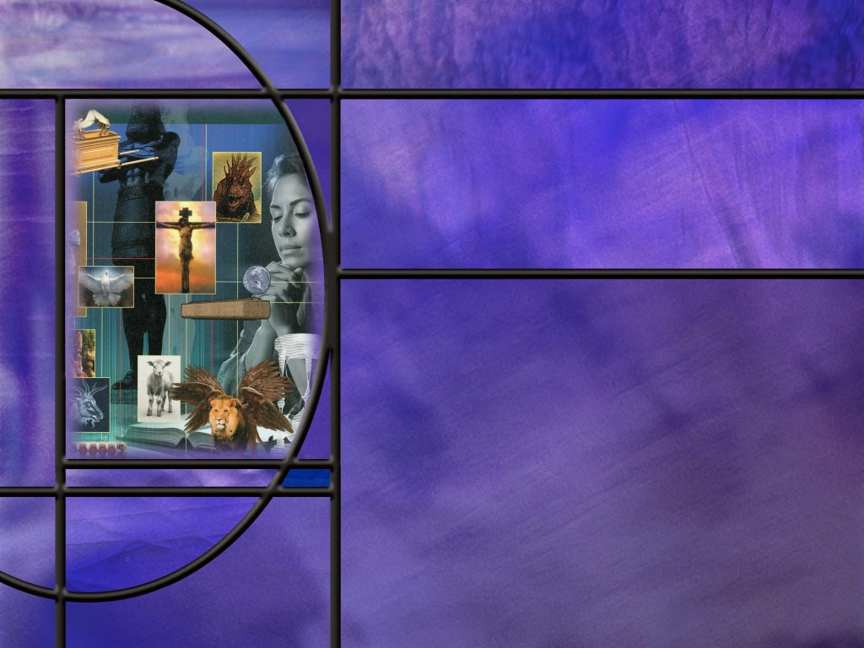
Allusions Images Symbols: How to Study Bible Prophecy
Lesson 2
The Genesis Foundation

Slide 2
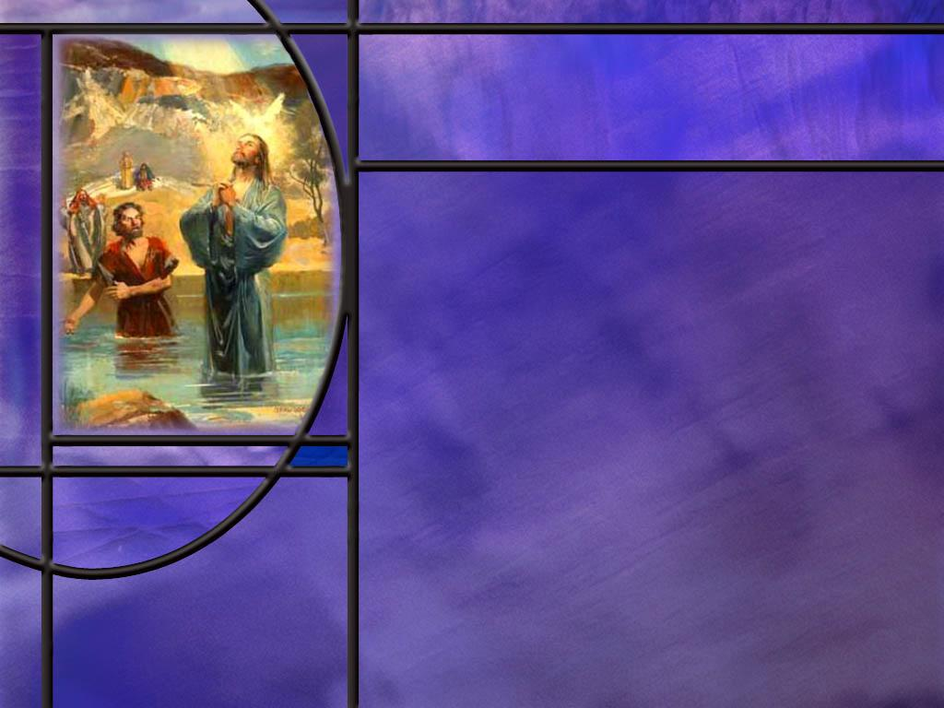
Memory Text
John 1:29 NKJV
The next day John saw Jesus coming toward him, and said, "Behold! The Lamb of God who takes away the sin of the world!”
What symbolism is John the Baptist using in this description of Jesus?
What special work does this Lamb of God do?
What picture would John’s words paint for his Jewish audience?
Notes:
B2:
1. He calls Jesus the Lamb of God.
2. Jesus is symbolized by a lamb.
3. And this is not any lamb of any flock.
4. Whose Lamb is it?
5. It is the Lamb of God.
6. It is the true sacrificial Lamb sent by God.
B3:
1. He takes away the sins of the world.
2. This is an apt description of the mission of Jesus Christ.
3. When He was born, the angel Gabriel told Joseph to name him Jesus.
Matthew 1:21 ESV - She will bear a son, and you shall call his name Jesus, for he will save his people from their sins.“
4. Is there anything more important than this that Jesus could do for us?
5. Our greatest need is to be forgiven of our sins.
6. Without the forgiveness He provides we have eternal death; with forgiveness, we have eternal life.
7. Jesus may do many other wonderful things in our relationship such as bringing us comfort, companionship, peace, purpose, meaning, and value.
8. He gives us fellowship and acceptance in the family of God.
9. But the most important thing He gives us is forgiveness of our sins and justification by faith in His blood.
B4:
1. A lamb that takes away sin would paint a picture of the sanctuary service where sinners would bring a sin offering of a lamb, confess their sins over it, and trust in God to accept the death of the lamb in their place.
2. This is the great principle of substitutionary atonement taught in the sacrificial system.
3. Here John is declaring that Jesus the Messiah is the long-awaited true sacrifice to whom all of the animal sacrifices pointed.
4. The animal sacrifices were only a symbol or type of what God would do.
Hebrews 10:4 (NKJV) ⁴ For it is not possible that the blood of bulls and goats could take away sins.
5. The OT animal sacrifices all pointed to Jesus, who took our sin on Calvary and paid its wages by dying in our place.

Slide 3
Overview
A number of prophetic symbols make their first appearance in the book of Genesis including the Lamb and the Serpent. Genesis also sets the stage for the consequences of following one or the other: the serpent deceives to bring death; the Lamb dies to bring life.
  Principle of First Mention
  Serpent and Death
  Lamb and Life
  Summary

Slide 4
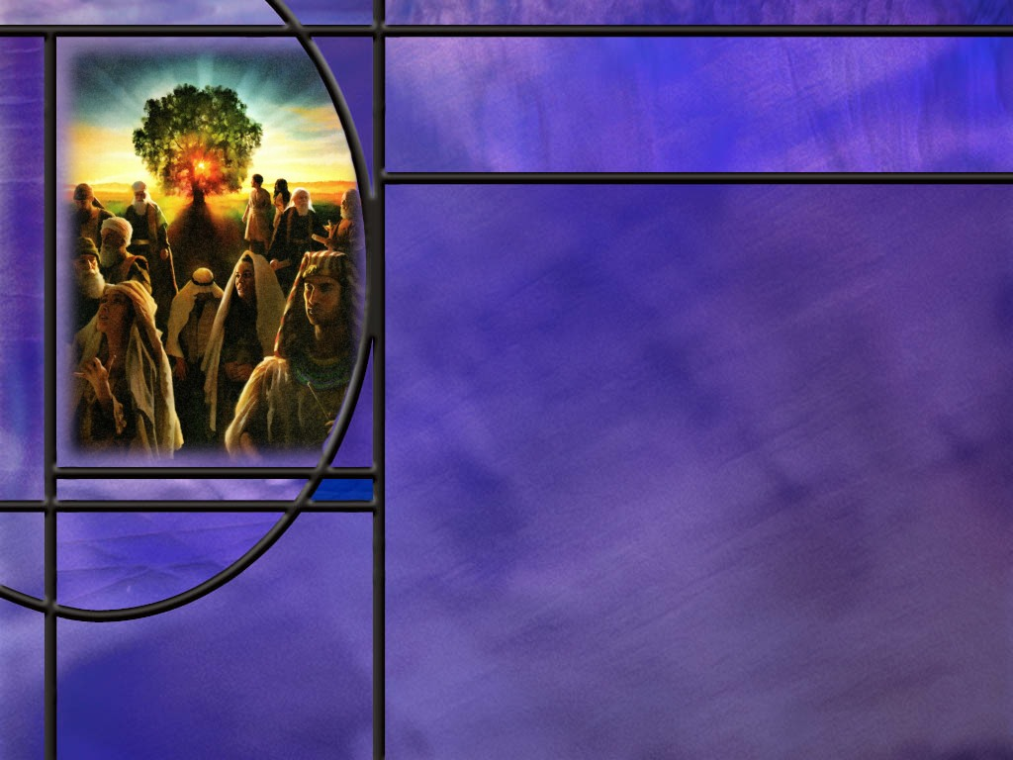
Principle of First Mention
What does God tell us about His word, His truth, His character, His Law? (Isa 40:8; Matt 5:17; Mal 3:6; Heb 13:8)
What is the “principle of first mention?”
How did Jesus use the principle of first mention when asked a question about divorce? (Matt 19:4-5)
Notes:
B1:
[See notes on linked slide.]
B2:
1. The principle of first mention is that the first time a particular word or concept is used in Scripture it sets a pattern or foundation for understanding the same word or concept later in Scripture.
2. The first mention introduces a concept in a simple way, and subsequent Scriptures build upon that simple truth to expand and explain and develop a fuller understanding of it.
3. In the first mention, God indicates the truth that stands in His mind that will not change later on.
4. Genesis introduces many of these truths that form the foundation for subsequent revelation.
5. Examples include: creation, paradise, marriage, family, sin, sacrifice, atonement, angels, prayer, judgment, covenant, death, burial, etc.
6. So to begin a complete study of a particular theological concept, we go back to the first mention and make sure we understand and build upon that foundation.
B3:
[See notes on linked slide.]

Slide 5
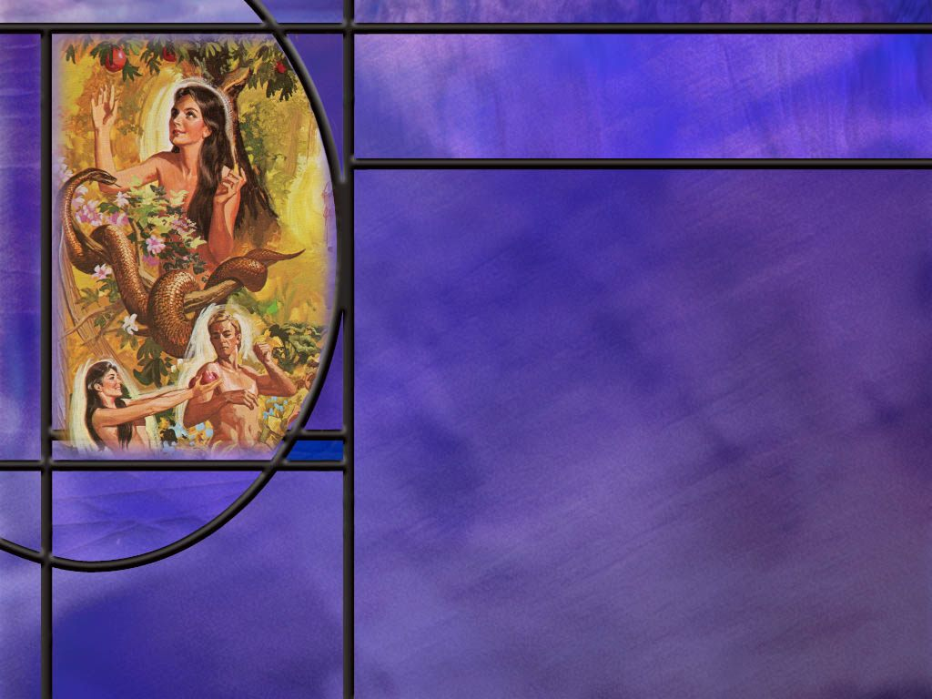
Serpent and Death
What is the first mention of the serpent in scripture? (Gen 3:1)
What other Scriptures confirm that the serpent is a symbol of Satan? (Rev 12:7-9)
What is the first mention of death in Scripture? (Gen 2:16-17)
What is the first mention of blood in Scripture? (Gen 4:10)
Notes:
B1:
[See notes on linked slide.]
B2:
[See notes on linked slide.]
B3:
[See notes on linked slide.]
B4:
[See notes on linked slide.]

Slide 6
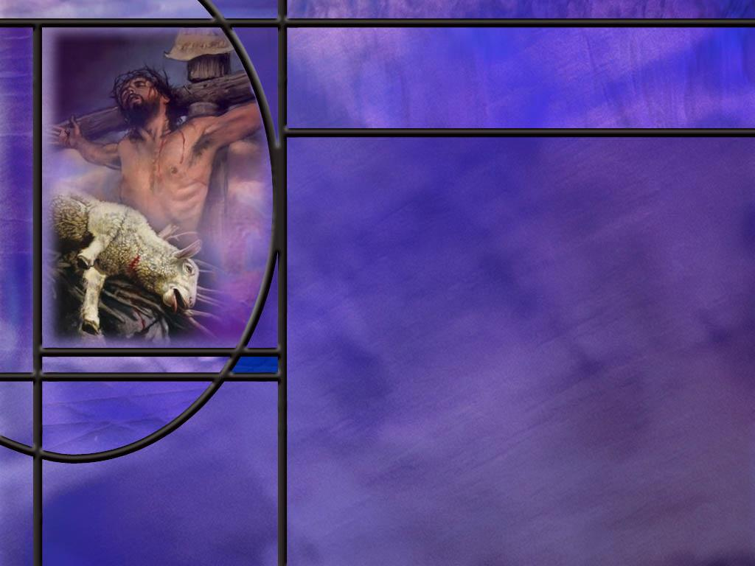
Lamb and Life
Where do we find the first mention of a sacrificial lamb in Scripture? (Gen 22:7)
What hints do we have from Scripture that this would not be the end of Isaac? (Gen 22:5-6)
How did Abraham answer Isaac’s question about the sacrifice? (Gen 22:8)
Who took Isaac’s place on the alter? (Gen 22:13-14)
How did Yahweh provide for Himself a Lamb?
What similarities can we see between Isaac and Christ?
Notes:
B1:
[See notes on linked slide.]
B2:
[See notes on linked slide.]
B3:
[See notes on linked slide.]
B4:
[See notes on linked slide.]
B5:
1. God so loved the world that He… gave His only begotten Son to die on the cross of Calvary for our sins.
2. Jesus is the fulfillment of all the OT blood sacrifices for sin.
3. This is the gospel of substitutionary atonement: Christ died for our sins.
4. God provides the Sacrifice. We receive it by faith.
5. We repent of our sins, confess our sins, ask forgiveness for our sins, trusting in the blood of Jesus to cleanse us from all sin.
6. The Hebrew of Gen 22:8 can also be translated as “God will provide Himself as the lamb.”
7. Here God gives Abraham and us a deeper insight into the plan of salvation.
8. And everyone that reads this story in Genesis can know that God will provide the sacrifice for our sins. Amazing grace!
9. How should we respond to this amazing grace?
10. Believe it! Receive it! Be grateful for it!
B6:
[Go to next slide.]

Slide 7
Isaac as a Type of Christ
Isaac: Gen 22
  Only son of promise (v2)
  To be sacrificed on Mt. Moriah (v2)
  Considered dead by father for 3 days (v4)
  Carried wood for his own sacrifice (v6)
  Submitted willingly to his father (v6,9)
  Raised from the alter, his life spared by God.
Jesus Christ: NT
  Only Son of the Father (John 3:16)
  Sacrificed on Mt. Calvary (Luke 23:33)
  Dead for three days (1 Cor 15:3-4)
  Carried His own cross (John 19:17-18)
  Submitted willingly to His Father (Matt 26:39)
  Raised from the dead by the power of God (Lu 24:6)
Notes:
1. So here we see the gospel being preached to Abraham in a parable acted out by him and his son.
2. Jesus would later say to the Jews:
John 8:56 KJV - Your father Abraham rejoiced to see my day: and he saw it, and was glad.
3. Abraham’s clearest view of the gospel was God’s grace in providing the sacrifice that set Isaac free.
4. In the type, we see a human sacrifice (Isaac) being replaced by an animal sacrifice provided by God (the ram in the thicket).
5. In the antitype, we see the animal sacrifices being replaced by a human/divine sacrifice (Jesus) provided by God, who gave His only Son.
6. In both type and antitype, God provides the sacrifice; we receive it by faith.
7. Isaac was the son of promise through whom all nations would be blessed.
8. Christ was the Son of promise, slain from the foundation of the world, who would bless all nations by providing for them “substitutionary atonement,” salvation by grace through faith.

Slide 8
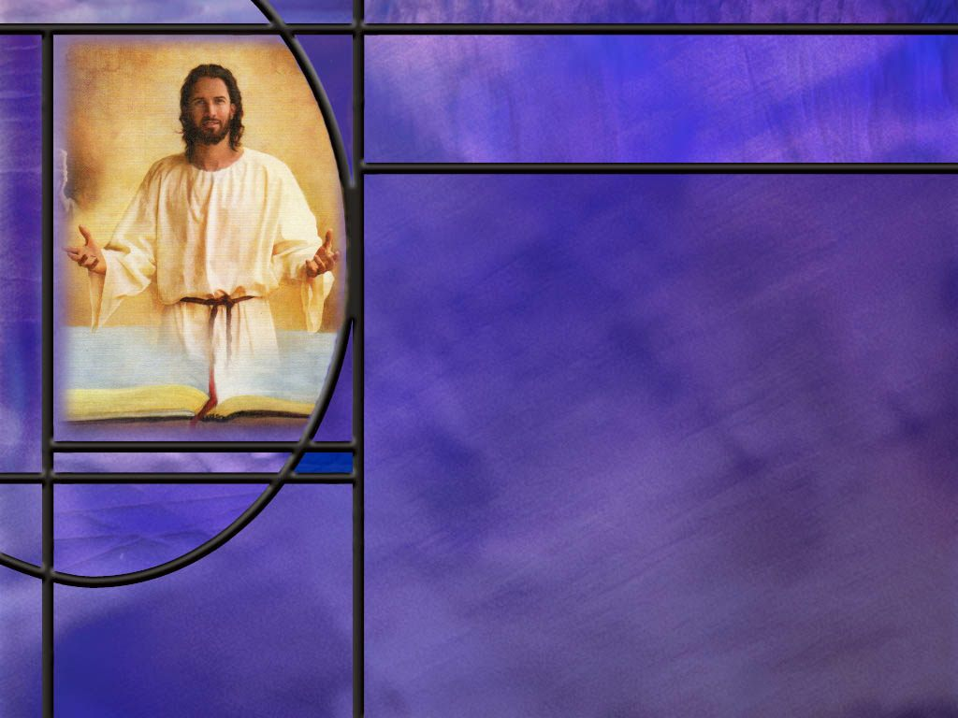
Summary
The principle of first mention is a rule of Bible study that suggests that God’s first mention of a word or concept provides a foundation for truth that is expanded on and amplified in subsequent Scripture.
Genesis, the book of beginnings, contains many first mentions of words and concepts including creation, paradise, marriage, family, sin, sacrifice, atonement, angels, prayer, judgment, covenant, death, burial, etc.
In answering the Pharisees on the question of divorce, Jesus went back to the first mention of marriage in Genesis to point them to God’s ideal in marriage from the beginning: one man, one woman, one flesh. Divorce was not God’s ideal but was permitted because of our sinful hearts.

Slide 9
Summary
The first mention of a serpent comes in the Genesis account of the fall where it is clear that the devil possesses and speaks through the serpent to lie and deceive and misrepresent God.
His character does not change throughout Scripture so in Revelation the old serpent from Eden is clearly identified as the devil and Satan who is still intent on deceiving the whole world.
Death is also first mentioned in Genesis as the penalty for eating the forbidden fruit.
Through Satan’s deception and Eve’s yielding to his temptations, death became the consistent “wages of sin” through the rest of Scripture and death passed upon all for all have sinned.

Slide 10
Summary
God’s test of faith for Abraham on Mt. Moriah was also a beautiful acted parable that teaches the truth of “substitutionary atonement” and is the first mention of a lamb.
In answer to Isaac’s question of “Where is the lamb? Abraham answered: “God himself will provide the Lamb.”
God provided the ram in the thicket for Isaac and He provides for us the Lamb of God that takes away the sin of the world.
This gospel parable prefigured the experience of the Father and Son on Mt. Calvary in which Jesus takes our place on the altar and gives us life instead of death.
Will you trust the Lamb that was slain so that you can live instead of die?

Slide 12
Truth that Doesn’t Change
Isaiah 40:8 NKJV - The grass withers, the flower fades, But the word of our God stands forever.“
Matthew 5:18 KJV - For verily I say unto you, Till heaven and earth pass, one jot or one tittle shall in no wise pass from the law, till all be fulfilled.
Malachi 3:6 KJV - For I am the LORD, I change not.
Hebrews 13:8 KJV - Jesus Christ the same yesterday, and to day, and for ever. [R]
Notes:
Q1: What does Isaiah 40:8 tell us about the word of God?
1. It doesn’t change over time.
2. Grass withers and flowers fade over time, but the word of God doesn’t change.
3. It doesn’t need to change.
Q2: How much of the Law of God would need to be revised according to Jesus?
1. Not a jot or a tittle.
2. A jot is the smallest letter in the Hebrew alphabet, called a yod in Hebrew.
3. It is similar to our apostrophe.
4. A tittle is a little projection of a Hebrew letter that can change it from one letter to another.
5. It is like the difference between our C and G or between our E and F or between O and Q
Q3: Why doesn’t the word of God or the Law of God need to change according to Malichi?
1. Because God doesn’t change.
2. He is the same yesterday, today, and forever.
3. Jesus, according to Hebrews 13:8 is also.
4. This doesn’t mean that God and Jesus are static and immutable, and impassable, never having a new thought or emotion.
5. It simply means that God’s character is fixed.
6. He is not a capricious god that is loving today and uncaring tomorrow.
7. He is faithful and dependable; we can trust His promises.
8. And because God’s character doesn’t change His law doesn’t change.
9. His ideas of right and wrong don’t need to be revised.
10. This means that God’s truth in Genesis is the same as in Revelation.
11. And this provides the basis for the principle of first mention.

Slide 13
Matthew 19:4-5 ESV
He answered, "Have you not read that he who created them from the beginning made them male and female, ⁵ and said, 'Therefore a man shall leave his father and his mother and hold fast to his wife, and the two shall become one flesh'? [R]
Notes:
Q1: From what is Jesus quoting in these verses?
1. He is quoting from the creation account in Genesis: the first mention of male and female, and the first mention of marriage.
2. So the Pharisees asked Him a question here to test Him:
Matthew 19:3 ESV - "Is it lawful to divorce one's wife for any cause?“
3. In answer, Jesus goes back to the first mention of male and female in Gen 1:27
Genesis 1:27 ESV - So God created man in his own image, in the image of God he created him; male and female he created them.
4. Then He goes to the first mention of marriage in Gen 2:24
Genesis 2:24 ESV - Therefore a man shall leave his father and his mother and hold fast to his wife, and they shall become one flesh.
5. Jesus goes back to God’s original intent in marriage and tells the Pharisees:
Matthew 19:6 ESV - So they are no longer two but one flesh. What therefore God has joined together, let not man separate.“
6. He goes on to explain that it was only because of the hardness of their hearts that Moses permitted them to divorce
Matthew 19:8 ESV - 8 He said to them, "Because of your hardness of heart Moses allowed you to divorce your wives, but from the beginning it was not so.
7. So Jesus uses the principle of first mention to point the Pharisees to God’s original intent in marriage.
8. God’s plan was one man, one woman, in one marriage till death do them part.
9. Has God’s plan changed?
10. No! He still wants the same today.
11. God’s ideal for marriage has not changed.
12. The problem is that we are hardhearted sinners that find it difficult to live up to God’s ideal.

Slide 14
Genesis 3:1 ESV
Now the serpent was more crafty than any other beast of the field that the LORD God had made. He said to the woman, "Did God actually say, 'You shall not eat of any tree in the garden'?" [R]
Notes:
Q1: What is going on with this serpent? How is it able to talk to Eve?
1. Here we see that Satan was able to possess this particular serpent and was able to talk to the woman through it.
2. So this is the first mention of a serpent in Scripture.
Q2: What should w learn from this first mention in Scripture of the serpent as a symbol of Satan?
1. First, the serpent was crafty.
2. As a symbol of Satan, what does that tell us? (Satan is crafty!)
3. Does that change throughout Scripture? (No. Satan is always portrayed as crafty.)
4. Paul writes in:
2 Corinthians 11:14-15 ESV - And no wonder, for even Satan disguises himself as an angel of light. ¹⁵ So it is no surprise if his servants, also, disguise themselves as servants of righteousness.
5. Second, Satan is always trying to misrepresent God.
6. He is implying that God is withholding something good from Eve.
7. He is implying in his question to her that God doesn’t want them to eat from any tree in the garden.
8. Does that change throughout Scripture? (No! Satan is always trying to misrepresent God.)

Slide 15
Revelation 12:7-9 NKJV
And war broke out in heaven: Michael and his angels fought with the dragon; and the dragon and his angels fought, ⁸ but they did not prevail, nor was a place found for them in heaven any longer. ⁹ So the great dragon was cast out, that serpent of old, called the Devil and Satan, who deceives the whole world; he was cast to the earth, and his angels were cast out with him. [R]
Notes:
Q1: What clear identification of the serpent does this verse give us?
1. Here we have two symbols: the great red dragon introduced in Rev 12:3 and that serpent of old introduced in Gen 3:1.
2. These two symbols are clearly defined as one power: the devil and Satan.
3. Here we see the great controversy between Christ and Satan resulting in war in heaven with Satan cast out to the earth.
4. We can go back to the first mention of that in Gen 3:15 where the seed of the woman (Christ) would crush the serpent’s head and inflict on him a deadly blow.
5. We can add to this Isaiah’s description of the fall of Lucifer:
Isaiah 14:12 KJV - 12 How art thou fallen from heaven, O Lucifer, son of the morning! how art thou cut down to the ground, which didst weaken the nations!
6. So here we have Lucifer falling from heaven.
7. In Ezekiel’s description of the fall of Satan, he writes “You were in Eden, the garden of God.”
8. The only evil person who could have been in Eden was Satan who possessed the serpent.
9. Ezekiel describes him as the “anointed cherub that covers,” which would be Lucifer.
10. Jesus is recorded as saying in:
Luke 10:18 NKJV - 18 … "I saw Satan fall like lightning from heaven.
11. So the first mention of a serpent possessed by an evil power is filled in throughout Scripture.
12. He deceived Eve in the Garden of Eden and he will attempt to deceive the whole world as we approach the end of the age.
13. He is he great deceiver from beginning to end.

Slide 16
Genesis 2:16-17 ESV
And the LORD God commanded the man, saying, "You may surely eat of every tree of the garden, ¹⁷ but of the tree of the knowledge of good and evil you shall not eat, for in the day that you eat of it you shall surely die." [R]
Notes:
Q1: What was to be the consequence of disobeying the commandment of God?
Death.
Q2: Why didn’t Adam and Eve die in the very day that they ate the forbidden fruit?
1. The Hebrew doesn’t actually say that they would die on that very day.
2. “In the day” refers to the time of eating the fruit not the time of their death.
3. So the NLT translates it this way:
Genesis 2:16-17 NLT - 16 But the LORD God warned him, "You may freely eat the fruit of every tree in the garden-- 17 except the tree of the knowledge of good and evil. If you eat its fruit, you are sure to die.“
4. And indeed, when they ate the fruit, their doom was sealed.
5. Adam lived for 930 years but His death sentence was never in question.
5. When they lost access to the tree of life, death was inevitable.
Q2: What foundation or president did this set for the rest of Scripture?
1. From Genesis to Revelation, God’s truth does not change.
2. Sin is the transgression of God’s commandments and the wages of sins is death.
3. Ezekiel says it in the OT:
Ezekiel 18:20 ESV - The soul who sins shall die.
4. Paul says it in the NT:
Romans 6:23 KJV - For the wages of sin is death; but the gift of God is eternal life through Jesus Christ our Lord.
5. In fact, Paul goes back to the first sin in Eden to explain the origin of death.
Romans 5:12 KJV - Wherefore, as by one man (Adam) sin entered into the world, and death by sin; and so death passed upon all men, for that all have sinned:
6. Again, the first mention sets the stage for truth that endures throughout Scripture.

Slide 17
Genesis 4:10 ESV
And the LORD said, "What have you done? The voice of your brother's blood is crying to me from the ground. [R]
Notes:
Q1: What did Abel’s blood on the ground represent? Of what was it a symbol?
1. Blood was a symbol of life, and the fact that it was on the ground meant that Abel was dead.
2. Of course, the language is figurative.
3. The blood wasn’t actually speaking, but blood on the ground was an allusion to death.
4. So blood as a symbol of life is foundational to the understanding of blood in the rest of Scripture.
Q2: How do subsequent Scriptures fill out this first mention of blood as a symbol of life?
1. After the flood God allowed capital punishment for murder describing it in terms of shedding blood.
Genesis 9:6 ESV - 6 "Whoever sheds the blood of man, by man shall his blood be shed, for God made man in his own image.
2. In the Passover, it was the blood of the Passover lamb on the door posts that saved the life of the first born.
3. In the sanctuary service, it was the blood of the animal that represented its life.
Leviticus 17:11 ESV - For the life of the flesh is in the blood, and I have given it for you on the altar to make atonement for your souls, for it is the blood that makes atonement by the life.
4. The blood symbolized the life of the animal that died to bring atonement to the sinner.
5. This reminds us of
Hebrews 9:22 ESV - Indeed, under the law almost everything is purified with blood, and without the shedding of blood there is no forgiveness of sins.
6. Isaiah points forward to the Suffering Servant who would be pierced for our transgressions (shedding His blood).
7. Our memory verse presents Jesus the Messiah as the Lamb of God whose sacrifice would take away the sin of the world.
8. He was the Lamb of God whose shed blood would be sufficient to cleanse every sinner from every sin.
9. John writes it in:
1 John 1:7 ESV - … the blood of Jesus his Son cleanses us from all sin.
10. And Paul writes that it was by the shedding of His blood that Jesus became our substitute to be received by faith.
Romans 3:25 NIV - God presented Christ as a sacrifice of atonement, through the shedding of his blood--to be received by faith.
11. So throughout Scripture, blood represents the life, and the shedding of blood represents death.
12. So when John writes that the blood of Jesus Christ cleanses us from all sin, we understand that it is the death of Jesus in our place as our substitute that allows us to be forgiven when we trust in Him as our Savior and Lord.

Slide 18
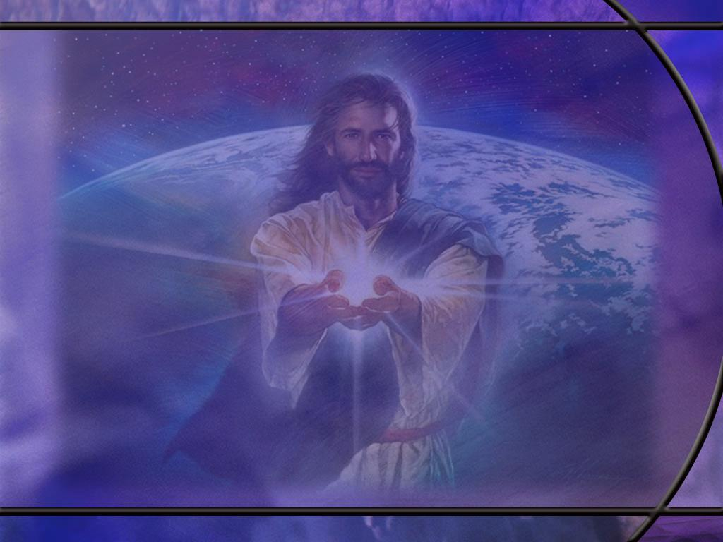
Genesis 22:7 ESV
And Isaac said to his father Abraham, "My father!" And he said, "Here I am, my son." He said, "Behold, the fire and the wood, but where is the lamb for a burnt offering?“ [R]
Notes:
Q1: What is the background for this first mention of a sacrificial lamb?
1. This was a test of Abraham’s faith.
2. It starts back in the first verse of Gen 22 where God tested Abraham’s faith by giving him this surprising command:
Genesis 22:2 ESV - 2 He said, "Take your son, your only son Isaac, whom you love, and go to the land of Moriah, and offer him there as a burnt offering on one of the mountains of which I shall tell you.“
Q2: Why would God, who is absolutely opposed to human sacrifices, tell Abraham to sacrifice his only son?
1. If we look back to Gen 22:1 it says that God “tested Abraham.”
2. So first, this was a test of faith to see if Abraham really believed God.
3. His obedience to God’s command was evidence that his faith was genuine.
4. But was there something more God wanted to do here in addition to proving Abraham’s faith?
5. Is it possible that God wanted to give Abraham and his posterity a deeper insight into the plan of salvation?
6. I think this is clearly the case.
7. This was an enacted parable to teach the truth of substitutionary atonement, where God provides the Substitute to die for our sins.

Slide 19
Genesis 22:5-6 NKJV
And Abraham said to his young men, "Stay here with the donkey; the lad and I will go yonder and worship, and we will come back to you." ⁶ So Abraham took the wood of the burnt offering and laid it on Isaac his son; and he took the fire in his hand, and a knife, and the two of them went together. [R]
Notes:
Q1: What hint do we have here that this ordeal would not be the end of Isaac?
1. Abraham tells the two young men with him that “we will come back to you.”
2. Does that say something about Abraham’s faith?
3. Is he still believing in the promises of God?
4. Here is the son of promise, and Abraham is about to sacrifice him, yet he still believes in God’s promise to keep His covenant with Isaac his son.
5. Based on that promise, he tells the young men, “we will return.”
Q2: How does the book of Hebrews help us to understand Abraham’s thinking?
1. If we look at the great Hall of Faith chapter in Hebrews 11, it comments on Abraham’s thinking.
Hebrews 11:19 ESV - He [Abraham] considered that God was able even to raise him [Isaac] from the dead, from which, figuratively speaking, he did receive him back.
Q3: How old is Isaac when this ordeal takes place?
1. The Bible doesn’t say how old he is, but it does give some hints.
2. Who is carrying the wood up Mt Moriah? (Isaac)
3. These are split logs for the fire, so we can conclude that Isaac was not a little boy.
4. Secondly, in this text, Abraham calls Isaac “the lad.”
5. It is the Hebrew word na’ar (nah'-ar).
6. It is the same Hebrew word translated “young men” in the sentence just before.
7. It is the same word used of Joseph when he was 17 and of Ishmael when he was about 15 or 16 years old.
8. From these clues, it is likely that Isaac was a teenager, strong enough to carry the wood and to overcome his much older father.
9. This means that Isaac also had faith in the promises of God, confident that God could raise him up again if the knife was not stopped.

Slide 20
Genesis 22:8 NKJV
And Abraham said, "My son, God will provide for Himself the lamb for a burnt offering." So the two of them went together. [R]
Notes:
Q1: How true were the words of Abraham here?
1. His answer was prophetic: God Himself will provide the Lamb.
2. This prophetic declaration is the essence of this parable of the gospel.
3. Sometimes the prophets may not understand completely the words that the Spirit of God places on their tongue.
4. But this prophecy was true, not only for Isaac, but for us as well.
Q2: How did John the Baptist describe Jesus after His baptism where John saw the Holy Spirit descend and remain on Him?
John 1:29 KJV - 29 The next day John seeth Jesus coming unto him, and saith, Behold the Lamb of God, which taketh away the sin of the world.
1. Here is the true Lamb of God that He provided for Himself.
2. This is the grace of salvation.
3. God Himself provides the Lamb that takes away the sin of the world.

Slide 21
Gen 22:13-14 (NKJV)
¹³ Then Abraham lifted his eyes and looked, and there behind him was a ram caught in a thicket by its horns. So Abraham went and took the ram, and offered it up for a burnt offering instead of his son. ¹⁴ And Abraham called the name of the place, The-Lord-Will-Provide;^{[a]} as it is said to this day, “In the Mount of the Lord it shall be provided.” [R]
Notes:
Footnote “a”: Hebrew YHWH Yireh
Yahweh Yireh or Jehovah Jireh.
1. So Abraham called the place of sacrifice “Yahweh-Will-Provide.”
2. Here in the OT we see that salvation is by faith and not by works.
3. God provides the sacrifice that forgives our sins.
4. Here we see the everlasting gospel of substitutionary atonement.
5. Our sins are laid on a Substitute that pays the penalty of death instead of us.
6. Note what it says at the end of verse 13:
7. Abraham offered up the ram INSTEAD of his son.
8. Yahweh Yireh: God provides the sacrifice; we simply trust His promise of forgiveness.

